Slide 1
Research Computing Support
Bob Muenchen (Pronounced Min’-chen)
muenchen@utk.edu
HelpDesk: 974-9900
Newsletter: http://listserv.utk.edu/archives/rcnews.html

Slide 2
Our Mission
To help UT researchers use information technology and analytic methods to:
Acquire Data
Manage Data
Visualize & Analyze Data
Disseminate Results
Archive & Share Data

Slide 3
Acquiring Data
How much to acquire?
Survey design & web deployment
Control lab instruments & log data: LabVIEW
Scantron scanner
Secondary data from data archives (Data Librarian, Ellie Read)

Slide 4
Managing Data
Converting formats
Merge / Concatenate / Transpose
Convert from relational to data warehouse
Cleaning data
Backing up
Archiving & Sharing Data / Results

Slide 5
Data Visualization & Analysis
Numbers
Math, Statistics
Data Mining
Geographic Maps / Geospatial Analyses
Words
Qualitative Analysis
Content Analysis
Linguistics / Sentiment Analysis
Latent Semantic Analysis
Content vs. Style

Slide 6
Data Analysis (continued)
Images
Quantitative
Qualitative
Audio & Video: Qualitative only for now

Slide 7
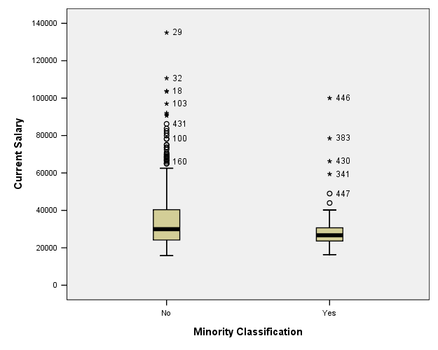
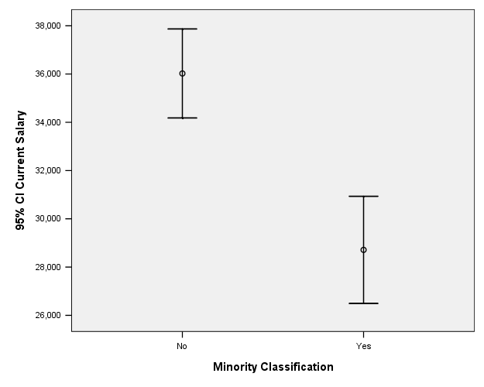
Disseminate Results
Graphics & Visualization
Tables
Writing up results

Slide 8
Fully Supported Research Software
Data Acquisition | LabVIEW, SPSS Data Collection (web survey server), Stat/Transfer
Numbers | Amos, Arc/GIS, MATLAB, Maple, SAS, SPSS, R, SAS Enterprise Miner
Text | ATLAS.ti, QDA Miner, SPSS Text Analysis for Surveys, SAS Text Miner, WordStat
Images | ATLAS.ti, ImageJ, QDA Miner
Audio/Video | ATLAS.ti

Slide 9
Hardware
Computer Labs – 1,000 machines
Analysis.utk.edu Terminal Server
Software appears to run on your computer
Opens/saves files stored on your computer
Prints to your printer
Supports Windows, Mac, Linux, iPad, iPhone…

Slide 10
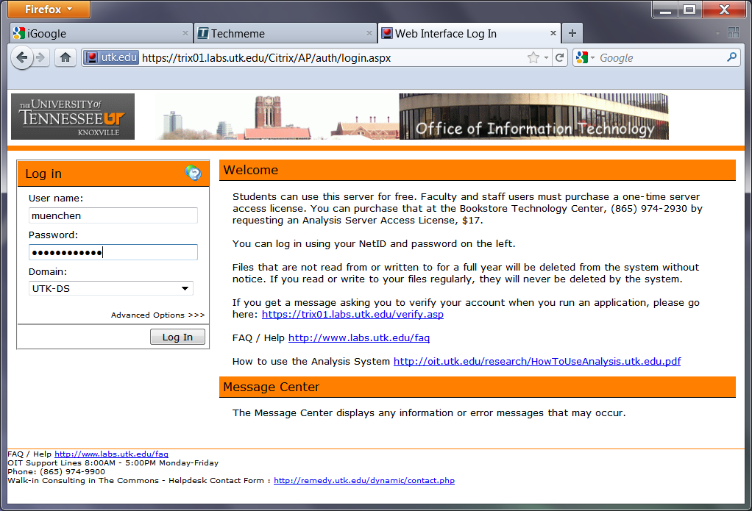

Slide 11
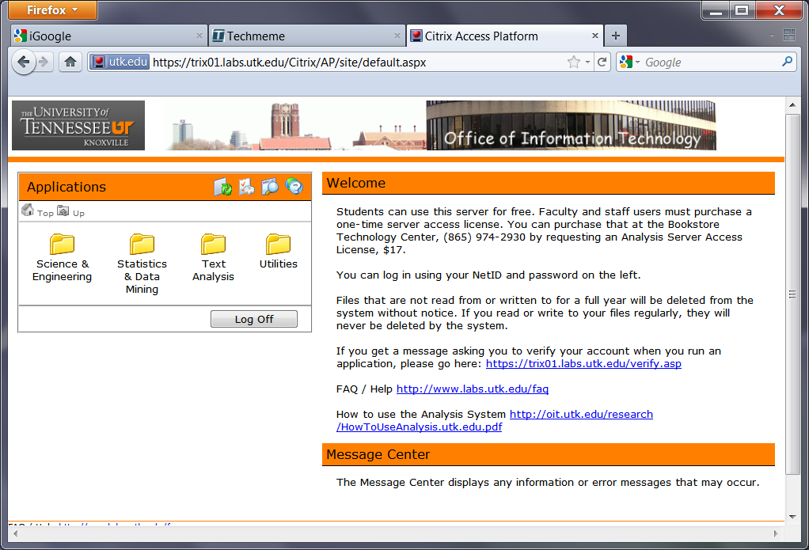

Slide 12
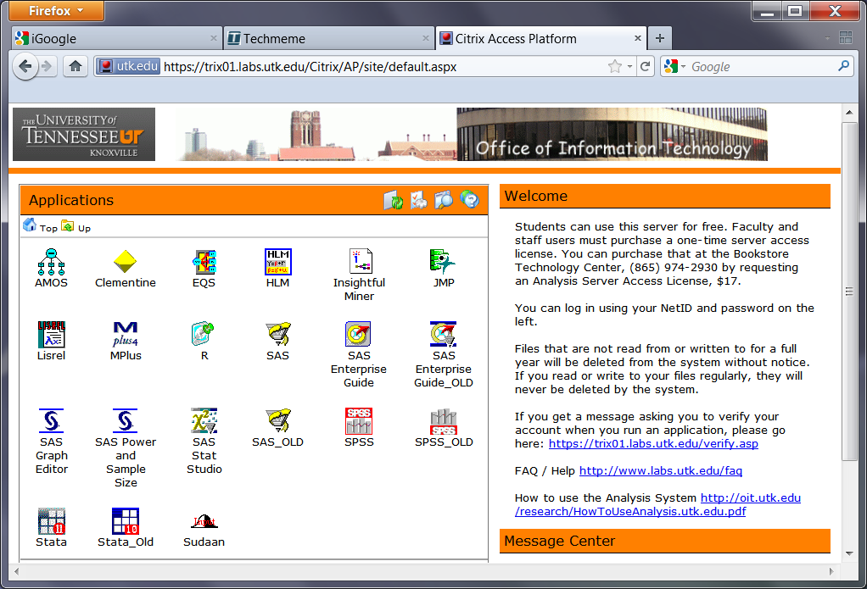

Slide 13
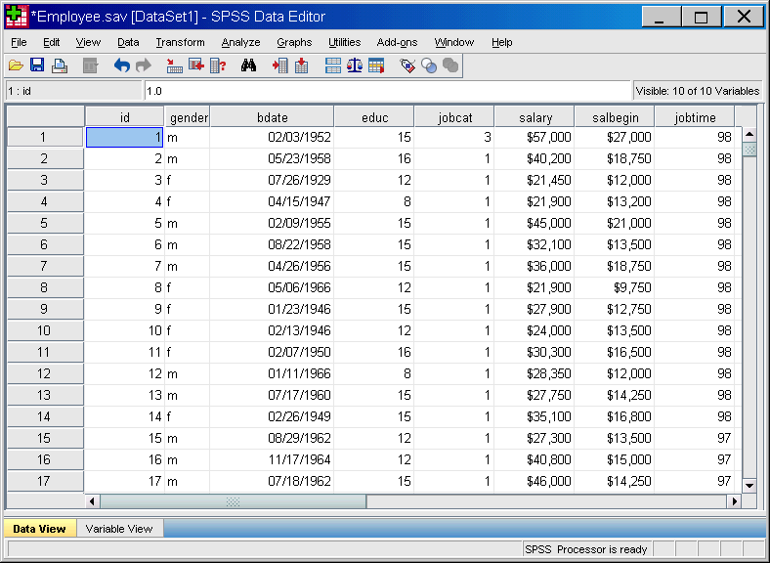

Slide 14
Hardware (continued)
Newton Linux Cluster
2,400 cores, 17 TFLOPS
128 GB of memory
77 terabytes of disk space
Infiniband high speed interconnect
Maple, Mathematica, MATLAB, R, SAS, SPSS,…
The Kraken
Cray XT5
100,000 processors, soon 1 PFLOP
4th fastest computer in the world

Slide 15
The Newton Project: 2,400 Cores

Slide 16
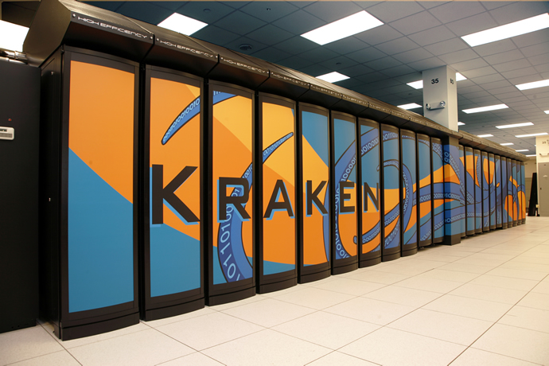
The Kraken: 100,000 processors

Slide 17
RCS Stats for 2010
Provided support to 1,714 projects
Scored 244,649 scan sheets in 1,998 batches
Managed 896 web-based surveys
Years of HPC time provided: 1,222
Maintained 30 research packages in download area, DVD and on servers
Updated handouts and taught 50 workshops on research computing on topics including: High Performance Computing, ATLAS.ti, LabVIEW, Linux, MATLAB, Maple, QDA Miner, R, SAS, SPSS, WordStat.

Slide 18
OIT Customer Satisfaction Survey
Overall satisfaction is 4.02/5.00
All groups more satisfied with email (e.g. students 3.99 to 4.25)
Faculty more satisfied with HelpDesk (4.36 to 4.52)
Staff less satisfied with enterprise systems (4.25 to 3.98)
Students
Web search up, 3.56 to 3.78
Registration down, 3.92 to 3.34

Slide 19
Who does research computing?
Students: 60%
Faculty: 44%
Staff: 17%

Slide 20
Research Computing Task | Percent
Statistics | 55.7%
Excel | 51.7%
Mapping | 35.9%
Science & Engineering | 34.6%
Programming Languages | 31.6%
Image Analysis | 23.4%
Survey Design & Deploy | 21.9%
Graphics | 14.7%
Text Analysis | 12.1%
Database | 11.4%
High Perf. Computing | 11.0%

Slide 21
Statistics
SPSS*
SAS*
Stata
R*
JMP
SAS Enterprise Miner*
* = fully supported

Slide 22
Science & Engineering
MATLAB*
Mathematica
AutoCAD
Maple*
FEMLAB
LabVIEW*

Slide 23
Text / Qualitative
QDA Miner*
SPSS Text Analytics for Surveys*
ATLAS.ti*
Nvivo
SAS Text Miner*
SPSS Text Workbench
WordStat* (part of QDA Miner)

Slide 24
Mapping / GIS
ESRI ArcGIS Desktop*
Google Maps/Earth
ERDAS
GRASS

Slide 25
Image Analysis
Photoshop
ImageJ*

Slide 26
Surveys
IBM SPSS Data Collection* (formerly mrInterview)
SurveyMonkey
Qualtrics
Zoomerang

Slide 27
Languages (most on Newton)
Java
FORTRAN
Python
C
C++
Basic
Perl
C#

Slide 28
High Performance Computing
Linux Cluster*
MPI*
Windows HPC Server

Slide 29
Graphics
Sigmaplot
Origin
Gnuplot
Tableau

Slide 30
Database
Microsoft SQL Server
MySQL
Oracle
SQLite

Slide 31
Questions?

