Slide 1
NCS Code Validation
ANSI/ANS-8.24
Chris Haught
Chief NCS Engineer for Consolidated Nuclear Security, LLC

Slide 2
Outline
Purpose
Requirements
Issues
Process to determine upper subcritical limit
Examples

Slide 3
Purpose
Validation is defined as “The process of quantifying … the suitability of a computer code system for use in nuclear criticality safety analyses…”
To establish the adequacy of a computer, code, and cross section set
(“the computational method”) for its intended use,
AND
To quantify the calculational bias and uncertainties, and acceptance criteria such that there is confidence that the calculated results thought to indicate subcriticality reliably indicate subcritical systems.
Different from “verification”, which establishes that your code is installed correctly and tests functionality issues
An upper subcritical limit (USL) is determined through the validation effort

Slide 4
Basic requirements from ANSI/ANS-8.24
ANSI/ANS-8.24, Validation of Neutron Transport Methods for Nuclear Criticality Safety
Select benchmarks
Determine calculational bias
Determine uncertainties in the bias
Establish a margin of subcriticality
Establish the validation area of applicability
Document work and conclusions

Slide 5
Benchmarks
“A representation of an experiment evaluated for use in validation. The experiment may be critical or slightly subcritical…”
These are the experiments defined in sufficient detail to create an accurate model of the experimental setup
Experiments involving materials and configurations similar to the actual fissile material processes at the site where the validation is applied
Should select as many experiments available that are similar to the actual fissile material processes
  Typically > 100
Validation must also consider the conditions representing the credible abnormal conditions associated with the fissile material processes
  Credible abnormal conditions are identified in the NCS Evaluations for the processes

Slide 6
Area of Applicability
Also referred to as validation applicability
“A domain, which could be beyond the bounds of the benchmark applicability, within which the margins derived from validation of a calculational method have been applied”
Benchmark applicability is the range of benchmark parameters (e.g., material compositions, geometry, neutron energy spectra) over which the bias and bias uncertainty of a calculational method are established.
Allows for extrapolation and wide interpolation of benchmnark data

Slide 7
Area of Applicability
Examples
Fissile Material Composition
  Uranium (high or low enriched)
  Plutonium (high or low ²⁴⁰Pu content)
  Solid or liquid (density/concentration)
  Metal or compounds (oxides, nitrates, etc.)
  Moderation (dry, water, carbon, Be, etc.)
  Homogeneous or heterogeneous
Neutron energy
Neutron absorbers
Geometry configuration
Single unit or interacting units (arrays)
  Interspersed materials
Reflected or unreflected

Slide 8
Area of Applicability
Can also be characterized in terms of physical or nuclear parameters with numerical limits
Examples -
Moderator ratio (H/X = 10 to 1000)
Average energy group (AEG = 6.5 to 21.3)
Energy at average lethargy (E = 0.025 to 300 keV)
Uranium Concentration (50 to 200 g-U/L)
Enrichment (2 to 10%)

Slide 9
Bias
A measure of the systematic difference between the experimental data (benchmark cases) and the calculated results.
Bias may not be constant; it may be a function of one or more independent variable(s) due to trends.
An experiment has a measured k_{eff} of 1.000, the calculated k_{eff} of the benchmark model is 1.003, the deviation for that case is 0.003.
These individual deviations are used to compute the systematic bias

Slide 10
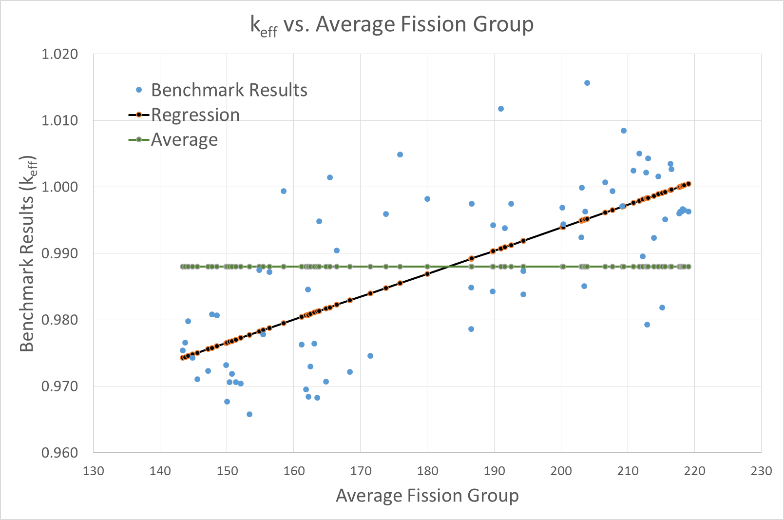
Bias
Bias is estimated for a group of benchmark results
Can be represented by regression analysis or by the average,
  Supplemented by visual inspection

Slide 11
Bias Uncertainty
“Accounts for the combined effects of uncertainties in the benchmarks (i.e. critical experiment), the calculational models of the benchmarks, and the calculational method”
The critical experiment uncertainties include:
  Material specifications - fuel and hardware (composition, assay, mass, density, etc.).
  Dimensional specifications - fuel and hardware (experimental apparatus, surroundings, etc.)
  Experimenters' manipulation and adjustments to the reported data.
The calculational model uncertainties include:
  Geometric modeling used
  Code options used (e.g. histories and generations, S(α,β), albedos, etc.).

Slide 12
Bias Uncertainty
The calculational method uncertainties include:
  Convergence criteria (deterministic codes) or statistical variation (Monte Carlo codes) (usually negligible).
  The mathematical equations solved and approximations used.
  Cross-section data and scientists’ evaluation of that data (ENDF libraries).
  Resonance cross section processing
The combined uncertainty is exhibited as scattering of the calculated results
Typically quantified using statistical analysis

Slide 13
Errors
Not part of the bias uncertainties
ANSI/ANS-8.24 requires independent review of:
  the benchmark applicability
  the input files and output files to ensure accurate modeling and adequate convergence
  the methodology, and its use, for determining bias, bias uncertainty, and margins
  concurrence with the validation applicability (interpolation between benchmarks and extrapolation)
The value of the upper subcritical limit (k_{USL}) is never intended to compensate for errors!

Slide 14
Margin of Subcriticality
“An allowance beyond the calculational margin to ensure subcriticality”
Calculational Margin: An allowance for bias and bias uncertainty plus considerations of uncertainties related to interpolation, extrapolation, and trending
Also called the minimum subcritical margin
Think of this margin of subcriticality as bolstering confidence in the upper subcritical limit
Typically includes between 2 and 5% Δk (i.e. 0.02 to 0.05) that is best described as commonly accepted “good practice”
  A value of 2% ΔK is not unusual within the DOE complex

Slide 15
Margin of Subcriticality
What does it cover?
  The origins of the MoS values in use are not clear
  Some say it is there to cover the “unknown unknowns”
What is NOT covered?
  Does not cover any accident or upset condition
  Does not cover software or data error
  Does not cover poorly characterized system models

Slide 16
Upper Subcritical Limit
k_{USL} = 1.0 + Bias - Bias Uncertainty – MoS
This is the maximum allowable k_{eff} accepted as being subcritical, with some defined confidence
1.0 represents the experimental result
Bias: estimate of expected difference between computed and experimental results
  Must be estimated over the entire domain representing validation applicability
  Can be a constant or a function
Bias Uncertainty: uncertainty in the bias estimate
  Typically determined by the variability in the benchmark results (residuals between bias estimate and computed k_{eff})
  Can be a constant or a function
MoS: margin of subcriticality
  Typically a constant
This form does not include margin for wide
interpolation or extrapolation

Slide 17
Upper Subcritical Limit
Typical acceptance criterion:
k_{eff} + 2σ_{calc} ≤ k_{USL}
In order for a calculated configuration to be considered (reliably) subcritical, the computed k_{eff}, including calculational uncertainty, must not be greater than the USL
This does not necessarily represent a safe fissile material process
It merely represents a condition that is reliably subcritical – provided no other changes to the system occur
The NCS evaluation determines the fissile material process is safe

Slide 18
Validation Report
Description of the critical experiments
  Materials
  Dimensions
  Other parameters used to establish applicability
Description of the calculational models
  Differences between experiments and models
Description of the calculational method
  Code (e.g. MCNP or SCALE) and version
  Platform (i.e., the machine on which the code is installed)
  Calculational technique (e.g. kcode or CSAS25)
  What cross section set was used
  Cross section processing options used (e.g. S(α,β) or NITAWL resonance processing)
  Other code options

Slide 19
Validation Report
Description of the validation technique
  Range/area of applicability
  Determination of bias, bias uncertainty
  Margin of subcriticality
  Extrapolation and wide interpolation (if allowed) and additional margin to apply
  k_{USL}

Slide 20

Validation Report
Pedigreed descriptions of numerous critical experiments are available in The International Handbook of Evaluated Criticality Safety Benchmark Experiments
Commonly referred to as the ICSBEP – International Criticality Safety Benchmark Experiment Project
Validation reports typically reference the handbook for benchmark details

Slide 21

Issues
“A positive bias exists where the mean bias or the value of the fitted function is greater than zero”
This is where the mean k_{eff} is greater than 1 or the range where the k_{eff} function is greater than 1
If positive bias is used, “…its use shall be justified by the close applicability of the benchmarks.”
“If the justification cannot be made, the positive bias shall be removed using methods consistent with the statistical approach or through the use of an increased margin of subcriticality”
Not all “critical” experiments have k_{eff} of 1
Benchmark results can be normalized for statistical analysis:
$$k_{norm}=\frac{k_{calc}}{k_{exp}}$$

Slide 22
Issues
“The margin of subcriticality and its basis shall be documented.”
  The origins of the MoS values in use are not clear
  Some say it is there to cover the “unknown unknowns”
Adequacy of cross section data for certain materials
How close does the system of concern need to "fit" the range of applicability?
Use of benchmarks that have been used to evaluate nuclear data
  Computed k_{eff} should be exactly 1 because the nuclear data was adjusted to achieve that result
Are statistical processes even applicable?
  Each critical experiment is a unique measurement involving specific materials, configurations, and conditions. Statistics views experiments (i.e. a sample population) as a common effort to measure the “same” condition (k_{eff} = unity.)

Slide 23
Statistical Analysis
Typically used to determine bias and bias uncertainty
Population:
  the actual or sample population (seen)
  and
  the true or parent population (not seen)
The actual or sample population is the set of calculated k_{eff} values for the set of experiments utilized (i.e. benchmark cases)
The true or parent population is the statistical extension of the observed population to a hypothetical infinite number of experiments within the area of applicability

Slide 24

Statistical Analysis
Deviation: the difference between an individual sample point and the estimate determined from all sample points
Variance:
  Average of the squares of the deviations about the sample mean (divide by N-1)
  or
  Average of the squares of the deviations about k_{eff}(x) correlation (divide by N-2 for first order fit)
Standard Deviation: The square root of the variance for a normal (Gaussian) distribution
Confidence Level: the percentage of all possible samples that can be expected to include the true population parameter
Benchmark Uncertainty
  Can be used for weighting
$$σ_{i}=\sqrt{σ_{calc}^{2}+σ_{exp}^{2}}$$

Slide 25
Consider what the
desired area of
applicability is
Least
conservative
A decision process for selecting a statistical method to compute bias and bias uncertainty
(1.0 + Bias - Bias Uncert)
Most
conservative

Slide 26
Selecting a Statistical Method
Confidence and tolerance bands will follow the curve fit (below the fit)
Confidence band may not lie below all data points
Tolerance limit lies below the average

Slide 27
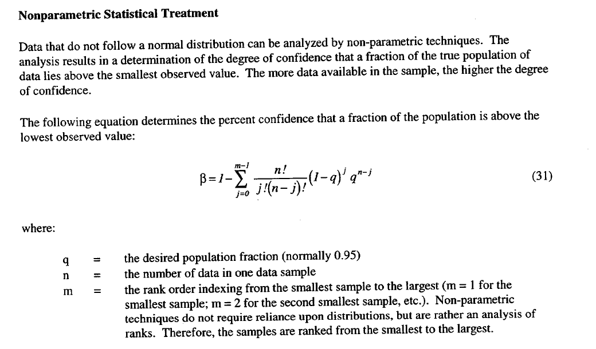
Non-parametric Method (NUREG/CR-6698)
Used when sample population does not have a normal distribution (or another distribution with defined parameters)
(above the value at rank m)

Slide 28
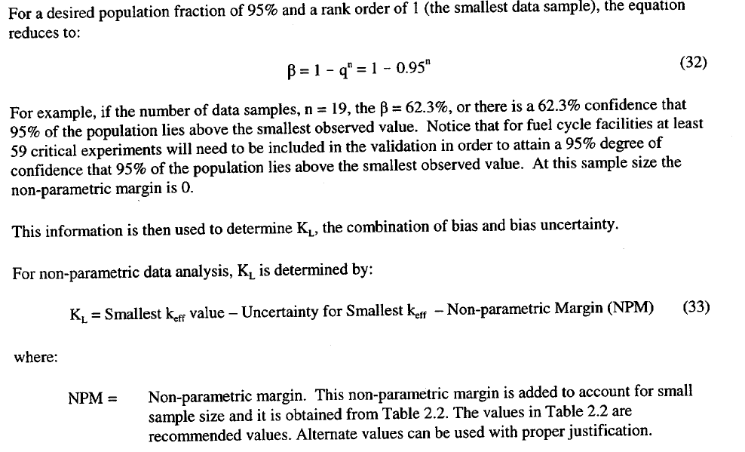
Non-parametric Method (NUREG/CR-6698)
(above the lowest rank)
(1.0 + Bias - Bias Uncertainty)

Slide 29
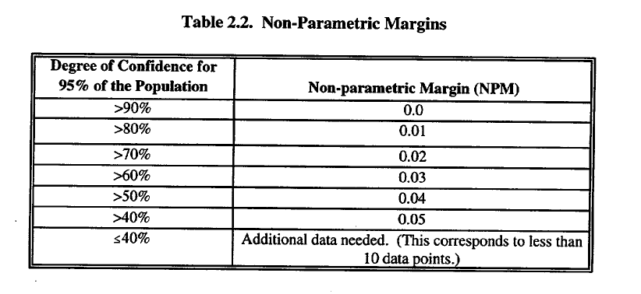
Non-parametric Method (NUREG/CR-6698)
$$k_{USL}=smallest k_{eff}−σ_{i} of smallest k_{eff}−NPM−MoS$$

Slide 30
Single-sided Lower Tolerance Limit
A single, lower limit above which a defined fraction of the true population of calculated k_{eff} values are expected to lie with a prescribed confidence within the area of applicability
The limit is computed from the mean of the results
95% confidence and 95% population fraction are typical

Slide 31
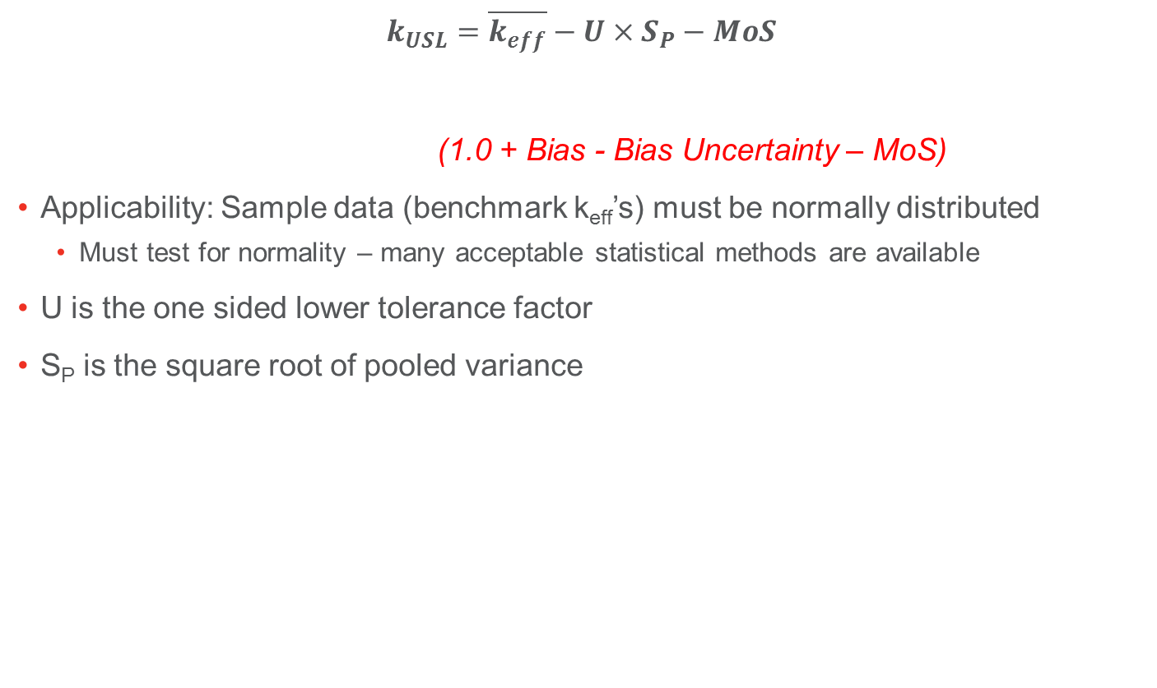
Single-sided Lower Tolerance Limit (NUREG/CR-6698)
$$k_{USL}=\overline{k_{eff}}−U×S_{P}−MoS$$
(1.0 + Bias - Bias Uncertainty – MoS)
Applicability: Sample data (benchmark k_{eff}’s) must be normally distributed
  Must test for normality – many acceptable statistical methods are available
U is the one sided lower tolerance factor
S_{P} is the square root of pooled variance

Slide 32
Single-sided Lower Tolerance Limit (NUREG/CR-6698)
Selection of single-sided lower tolerance factor, U
If data points (benchmark experiments) exceed 50, the factor for n=50 may be conservatively used

Slide 33

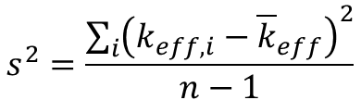

Single-sided Lower Tolerance Limit (NUREG/CR-6698)
Mean and Pooled Variance – Nonweighted
Mean (average) k_{eff}:
n is the number of data points
Variance about the mean:
(square root of) Pooled variance:
  Only considers variability in results and not benchmark uncertainties
$${\overline{k}}_{eff}=\frac{\sum_{i}{k_{eff, i}}}{n}$$
$$s^{2}=\frac{\sum_{i}{{\left(k_{eff,i}−{\overline{k}}_{eff}\right)}^{2}}}{n−1}$$
$$S_{P}=\sqrt{s^{2}}$$

Slide 34

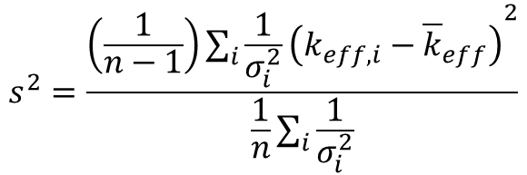

Single-sided Lower Tolerance Limit (NUREG/CR-6698)
Pooled Variance – Weighted Formulations
Weighted against benchmark uncertainty
Weighted variance about the mean:
Average total uncertainty:
Weighted average k_{eff}:
$$s^{2}=\frac{\left(\frac{1}{n−1}\right)\sum_{i}{{\frac{1}{σ_{i}^{2}}\left(k_{eff,i}−{\overline{k}}_{eff}\right)}^{2}}}{\frac{1}{n}\sum_{i}{\frac{1}{σ_{i}^{2}}}}$$
$${\overline{σ}}^{2}= \frac{n}{\sum_{i}{\frac{1}{σ_{i}^{2}}}}$$
$${\overline{k}}_{eff}=\frac{\sum_{i}{\frac{k_{eff, i}}{σ_{i}^{2}}}}{\sum_{i}{\frac{1}{σ_{i}^{2}}}}$$

Slide 35

Single-sided Lower Tolerance Limit (NUREG/CR-6698)
Pooled Variance - Weighted Formulations, continued
Square root of pooled variance:
For non-weighted application, k_{eff} is the mean, σ² is zero, and pooled variance reduces to variance about the mean
$$S_{P}=\sqrt{s^{2}+{\overline{σ}}^{2}}$$

Slide 36
Single-sided Lower Tolerance Band
A band about a k_{eff} correlation above which a defined fraction of the true population of calculated k_{eff} values are expected to lie with a prescribed confidence
A tolerance band requires a regression fit to the data
The fitted curve lower-bounds the "true" k_{eff} population
Limited extrapolation beyond the benchmark applicability is reasonable

Slide 37
Single-sided Lower Tolerance Band (NUREG/CR-6698)
Method based on establishing a trend with some independent variable (e.g. H/X, fissile constituent concentration, average energy group, etc.)
Calculated k_{eff}’s are fitted to a line or curve as a function of that independent variable
Some type of Goodness of Fit test is necessary to establish a valid trend
  Chi-squared
  Correlation coefficient (R²)
  Visual observation
  Many others
If there is not a good fit, then this method cannot be used

Slide 38
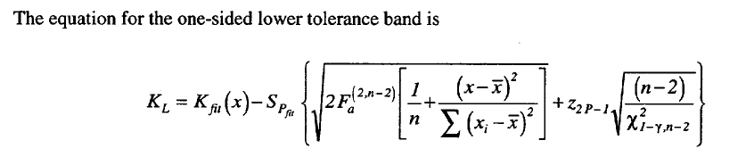
Single-sided Lower Tolerance Band (NUREG/CR-6698)
Bias is represented by fit to k_{eff} results - K_{fit}(x)
Pooled variance, S_{Pfit}, is determined for fit to k_{eff} results
  Measures spread of results
  (more to follow)
Factors inside the brackets measure the spread of the independent variable
  (more to follow)
K_{L} = (1.0 + Bias - Bias Uncertainty)

Slide 39
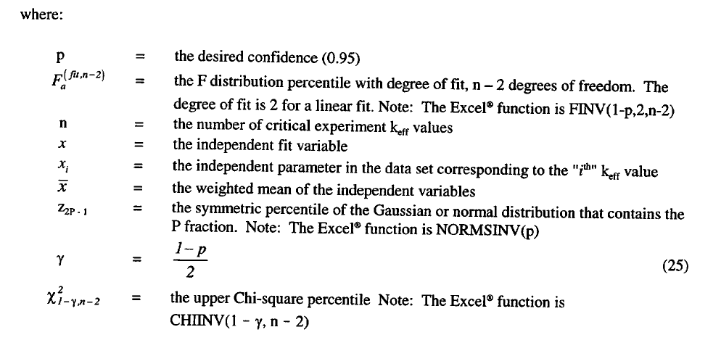
Single-sided Lower Tolerance Band (NUREG/CR-6698)

Slide 40
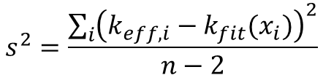

Single-sided Lower Tolerance Band (NUREG/CR-6698)
Pooled Variance - Unweighted
Variance:
Square root of pooled variance:
Pooled Variance - Weighted
$$s^{2}=\frac{\sum_{i}{{\left(k_{eff,i}−k_{fit}(x_{i})\right)}^{2}}}{n−2}$$
n-2 for a linear fit
$$S_{P}=\sqrt{s^{2}}$$
Terms to be replaced
in K_{L} formulation

Slide 41

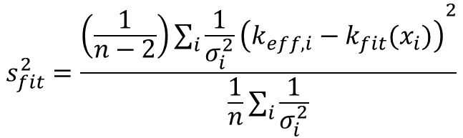

Single-sided Lower Tolerance Band (NUREG/CR-6698)
Pooled Variance – Weighted, continued
Average total uncertainty:
Variance:
Square root of pooled variance:
$${\overline{σ}}^{2}= \frac{n}{\sum_{i}{\frac{1}{σ_{i}^{2}}}}$$
$$s_{fit}^{2}=\frac{\left(\frac{1}{n−2}\right)\sum_{i}{{\frac{1}{σ_{i}^{2}}\left(k_{eff,i}−k_{fit}(x_{i})\right)}^{2}}}{\frac{1}{n}\sum_{i}{\frac{1}{σ_{i}^{2}}}}$$
n-2 for a linear fit
$$S_{P}=\sqrt{s_{fit}^{2}+{\overline{σ}}^{2}}$$

Slide 42
Single-sided Lower Confidence Band
A band about a k_{eff} correlation that lower bounds the true correlation with a prescribed degree of confidence (the fitted curve lower-bounds the bias and accounts for uncertainty of the bias)
A confidence band requires a regression fit to the data
Limited extrapolation beyond the benchmark applicability is reasonable
Least conservative among the four methods
Requires practitioner judgment for its usage plus choice of MoS

Slide 43
Single-sided Lower Confidence Band
The lower confidence band formulation for K_{L} is the same as the lower tolerance band but with the last term omitted
All other terms and formulations presented for the lower tolerance band apply to the lower confidence band
K_{L} = (1.0 + Bias - Bias Uncertainty)
Omission of this term results in the confidence band formulation

Slide 44
Examples
Lower tolerance limit
Nonparametric limit
Lower confidence band

Slide 45
EXAMPLE 1: Lower Tolerance Limit
Code and cross section, computer:
KENO-V.a as SCALE 4.4a routine CSAS25,
ENDF/B-V – based 238-neutron-energy group library
WS5, a controlled and verified workstation at ORNL

Slide 46
EXAMPLE 1: Lower Tolerance Limit
Code Options:
“Latticecell” for cross-section processing.
Standard specifications for the KENO-V.a case inputs included:
GEN=550 (number of generations)
NPG=10,000 (number of neutrons per generation)
NSK=50 (number of generations to skip)
SCT=3 (order of scattering, P5)
In general, each KENO-V.a result is based on ~5,000,000 neutron histories.
Flat neutron start, no albedos or reflector biasing options used.

Slide 47
EXAMPLE 1: Lower Tolerance Limit
Selected Benchmark Experiments:
The LEU-COMP-THERM-001 experiments had square-pitch lattices of 2.032 cm, and a ²³⁵U enrichment of 2.35 %. In one experiment, all involved fuel rods were in a single cluster. In the remaining seven experiments, the rods were arranged in three separate clusters, with spacing between the clusters ranging from ~4 cm to ~ 12 cm.
The LEU-COMP-THERM-002 experiments had square pitch lattices of 2.54 cm and a ²³⁵U enrichment of 4.31 %. The experimental material was obtained from N. S. Savannah Core II fuel assemblies; the fuel pellets were of the same diameter as for the lower enrichment (3.9%) Core II fuel.
The LEU-COMP-THERM-007 experiments involved a ²³⁵U enrichment of 4.738 %. Both square and triangular lattices were involved, with fuel rod pitches varying from 1.26 cm to 2.52 cm.

Slide 48
EXAMPLE 1: Lower Tolerance Limit
Selected Benchmark Experiments: (Cont’d)
The LEU-COMP-THERM-009 experiments involved a ²³⁵U enrichment of 4.31 %, using the same experimental rods as for LEU-COMP-THERM-002, in clusters of three fuel rod lattices similar to those considered in LEU-COMP-THERM-001. In the LEU-COMP-THERM-009 experiments, absorber plates of various materials were located between the two outer clusters and the central cluster. Square lattices of 2.54 cm pitch were involved. Only the first four experiments were selected for inclusion in this validation; those experiments involve mild steel plates of 0.485 cm (0.191-inch) or 0.302 cm (0.119-inch) thicknesses as the absorber plates.
The LEU-COMP-THERM-019 experiments involved a ²³⁵U enrichment of 5.00 %. Three experiments in triangular lattices were involved, with fuel rod pitches of 0.7, 0.8 and 1.4 cm. These experiments are distinct from the other experiments utilized here, in that the fuel rods are fabricated using stainless steel as the cladding. (All other referenced ICSBEP low-enrichment fuel reports involve aluminum-clad fuel.)

Slide 49
EXAMPLE 1: Lower Tolerance Limit
Benchmark
Results:
(30 points)

Slide 50
EXAMPLE 1: Lower Tolerance Limit
No obvious or significant trend in data if stainless steel clad experiments are omitted.
Apply Shapiro-Wilk test for normality to the 27 points (with stainless clad experiments omitted).
NOTE: Normality test fails with stainless steel clad experiments included, as expected.

Slide 51
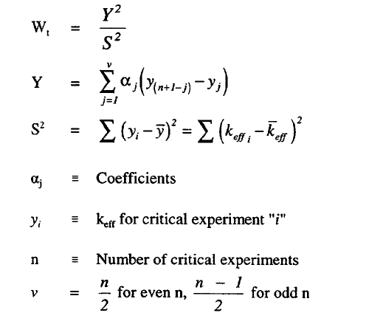
EXAMPLE 1: Lower Tolerance Limit
Terms for Shapiro-Wilk Normality Test

Slide 52
EXAMPLE 1: Lower Tolerance Limit
Processing of 27
Data Points
Notes:
S2 is the sum of the squares of the deviation, not the variance

Slide 53
EXAMPLE 1:
Lower Tolerance
Limit
Application of
Shapiro-Wilk Test
for Normality of
Data

Slide 54
EXAMPLE 1: Lower Tolerance Limit
Determination of USL (k_{USL}):
K_{USL} = k_{eff} – US_{p} – MoS
(1.0 + Bias - Bias Uncertainty – MoS)
U is the one sided lower tolerance factor
S_{p} is the square root of pooled variance
Use a MoS = 0.02.
Notes:
KsubL is the limit with bias and bias uncertainty

Slide 55

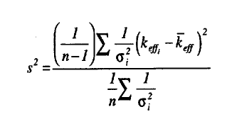
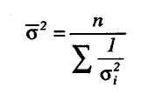
EXAMPLE 1: Lower Tolerance Limit
Determination of S_{P} , weighted factors:
Datapoint uncertainty
(σ_{i})
Variance about the mean
Average total uncertainty
Similar terms apply for non-weighted application.

Slide 56
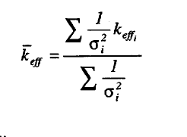

EXAMPLE 1: Lower Tolerance Limit
Determination of S_{P} , weighted factors (cont’d):
Weighted average k_{eff}
Square root of pooled variance
For non-weighted application, k_{eff} is the mean, σ² is zero,
Pooled variance reduces to variance about the mean

Slide 57
EXAMPLE 1: Lower Tolerance Limit
Determination of USL (k_{USL})
(Nonweighted Example)
Notes:
Sp2 is the sum of the squares of the deviations divided by n-1

Slide 58
EXAMPLE 2: Non-Parametric Limit
Need: A k_{USL} value for highly enriched uranium as single or multiple units, in well-moderated forms (i.e., mixed with water).
In the process application, moderating reflectors of concern are water or concrete (or both).

Slide 59
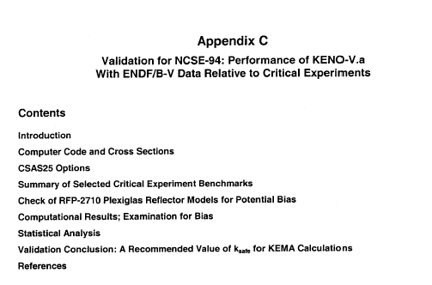
EXAMPLE 2: Non-Parametric Limit

Slide 60
EXAMPLE 2:
Non-Parametric Limit
Picked many highly
enriched uranium
(HEU) solution
experiments…

Slide 61
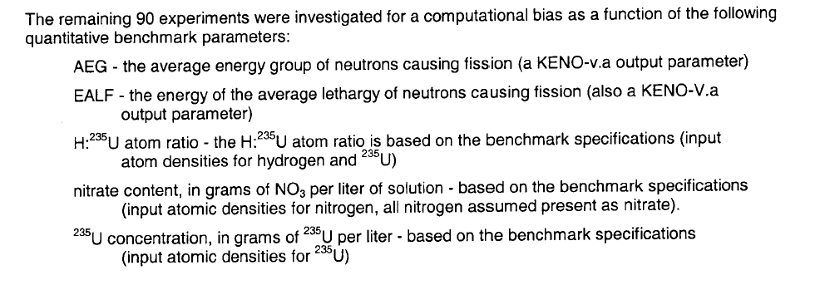
EXAMPLE 2: Non-Parametric Limit

Slide 62
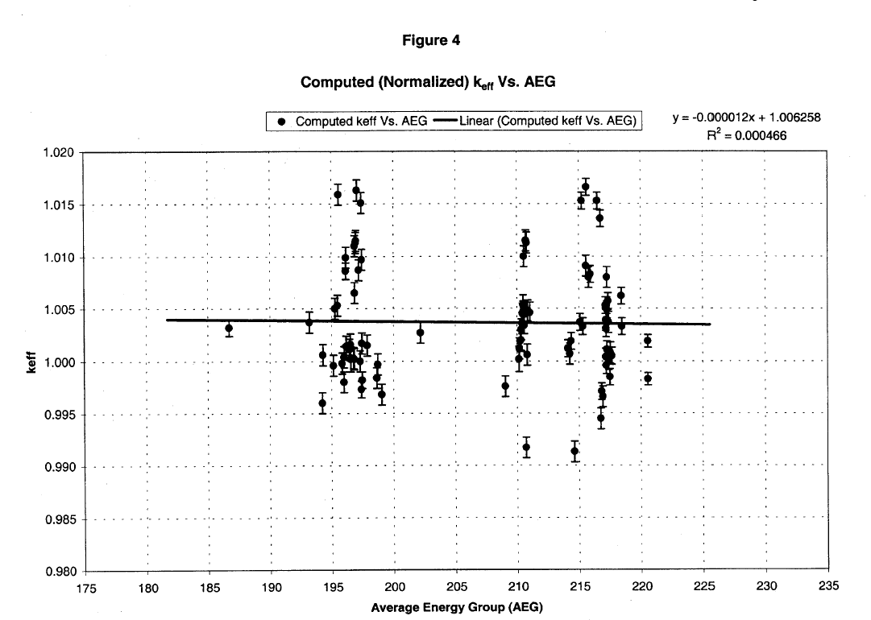
EXAMPLE 2: Non-Parametric Limit
Check for Fit as Function of AEG

Slide 63
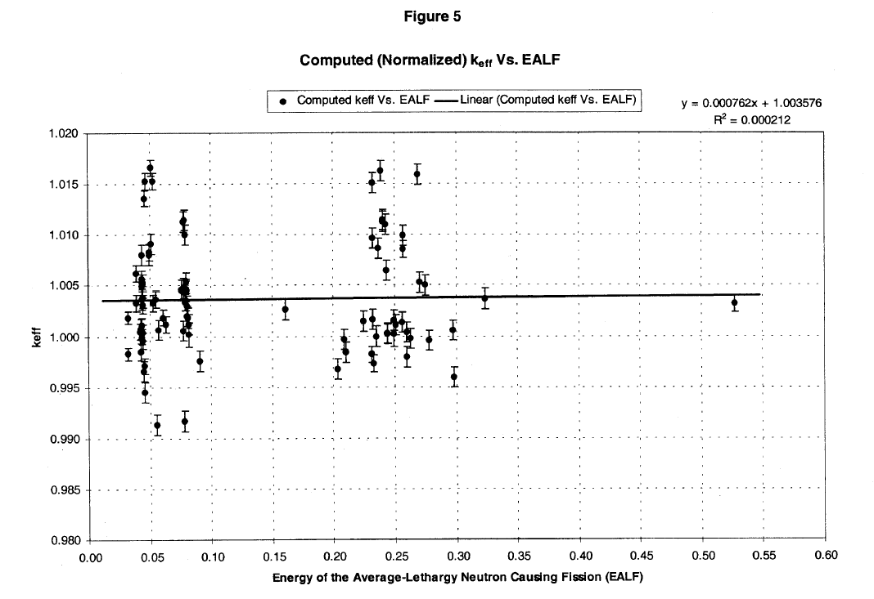
EXAMPLE 2: Non-Parametric Limit
Check for Fit as Function of EALF

Slide 64
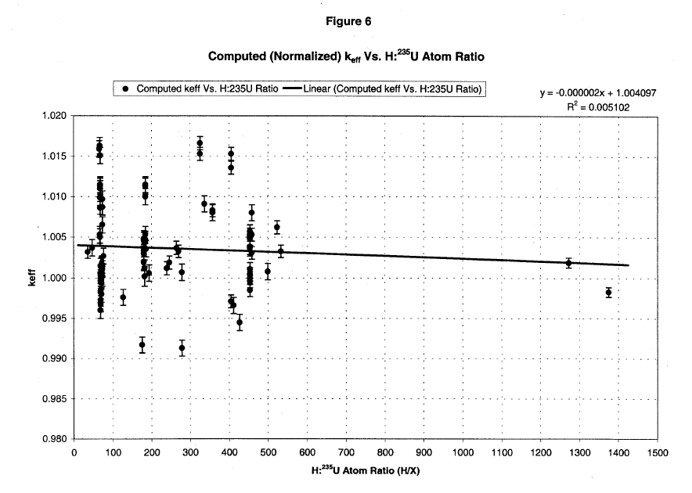
EXAMPLE 2: Non-Parametric Limit
Check for Fit as Function of H:²³⁵U Ratio

Slide 65
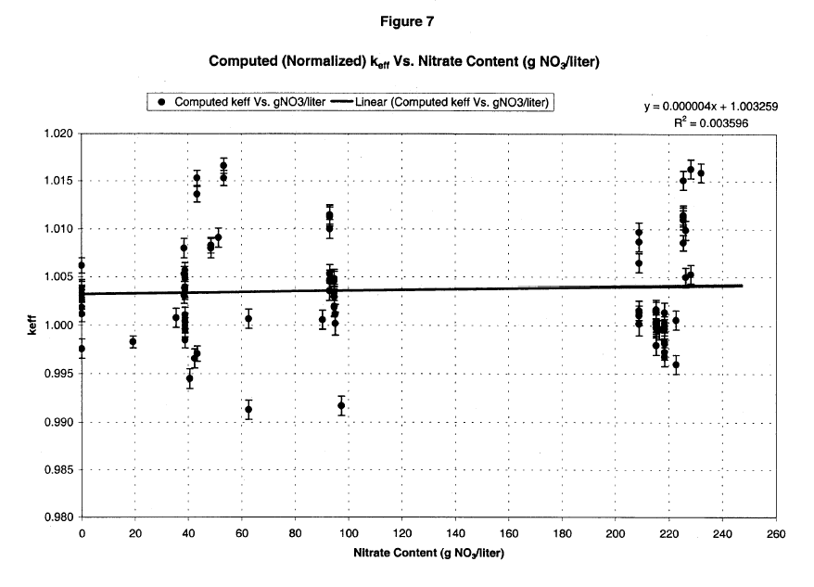
EXAMPLE 2: Non-Parametric Limit
Check for Fit as Function of Nitrate Content

Slide 66
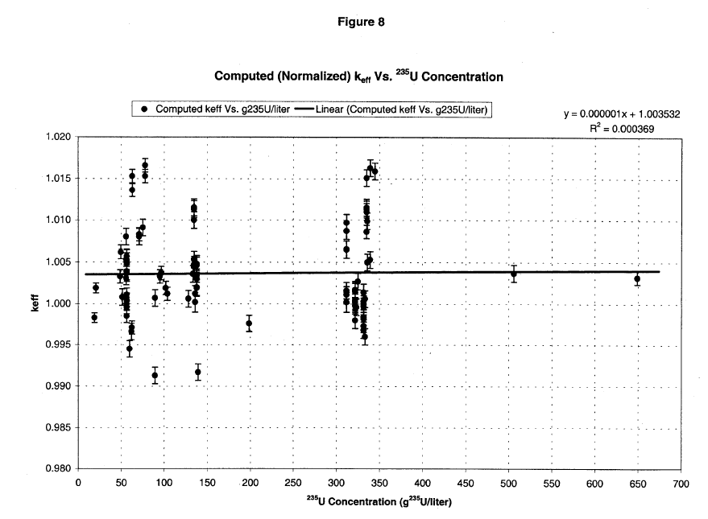
EXAMPLE 2: Non-Parametric Limit
Check for Fit as Function of ²³⁵U Concentration

Slide 67
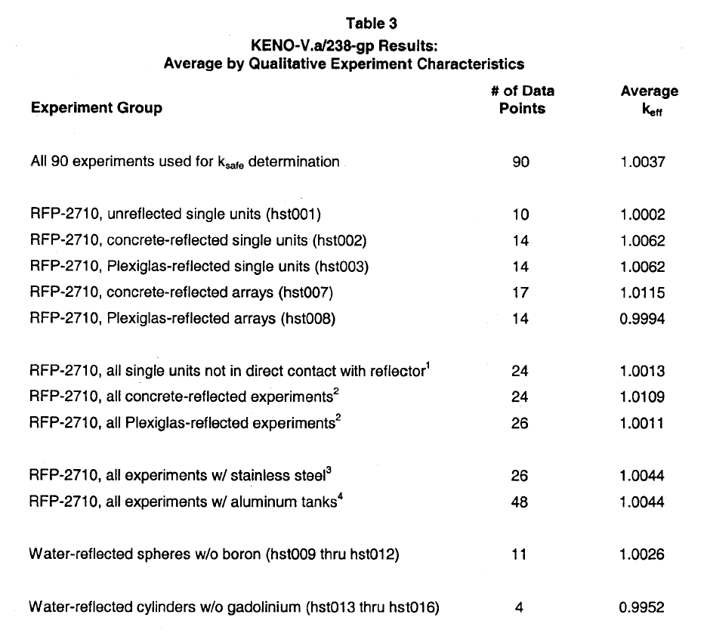
EXAMPLE 2: Non-Parametric Limit
Qualitative Check

Slide 68
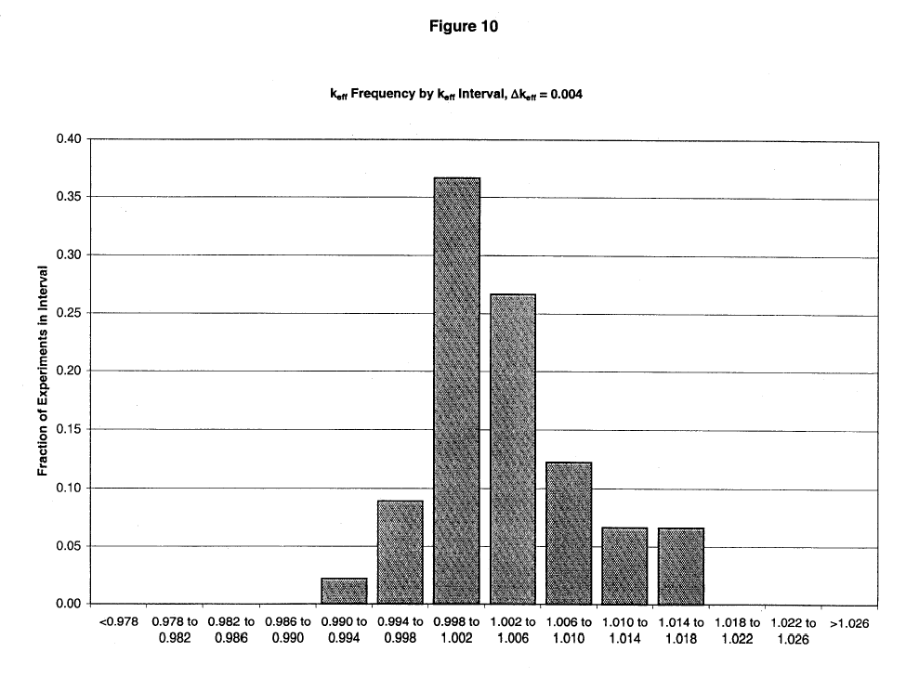
EXAMPLE 2: Non-Parametric Limit
90 Cases Fail Chi-Square Normality Test (Δk=0.004)

Slide 69
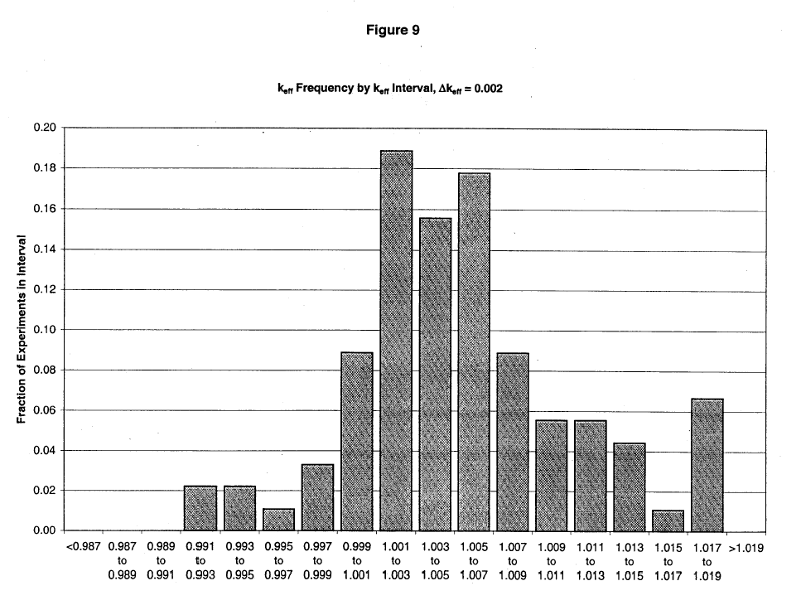
EXAMPLE 2: Non-Parametric Limit
Fails Chi-Square Normality Test Again (Δk=0.002)

Slide 70
EXAMPLE 2: Non-Parametric Limit
Guidance from NUREG/CR-6698
(above the value at rank m)

Slide 71
EXAMPLE 2: Non-Parametric Limit
Guidance from NUREG/CR-6698
(1.0 + Bias - Bias Uncertainty)

Slide 72
EXAMPLE 2: Non-Parametric Limit
Application
There are n = 90 data points.
The confidence level that 95% of similar critical systems will have computed k_{eff} values greater than the lowest computed k_{eff} value is
= 1 – q^{n} = 1- (0.95)⁹⁰
= ~ 99%

Slide 73
EXAMPLE 2: Non-Parametric Limit
Our degree of confidence is ~ 99% (for 95% of the population); an NPM value of 0.0 is appropriate.

Slide 74
EXAMPLE 2: Non-Parametric Limit
Lowest computed k_{eff} value is 0.9913,
with σ_{calc} = 0.0005 and σ_{expt} = 0.0025;
_{total} = 0.00255.
k_{USL} = smallest k_{eff} value
- uncertainty of smallest k_{eff} value
- non-parametric margin
- MoS
k_{USL} = 0.9688 for MoS = 0.02.

Slide 75
EXAMPLE 3: Lower Confidence Band
Equations are more complicated, especially if data uncertainty (weighted values) are used. From NUREG/CR-6698:
(1.0 + Bias - Bias Uncertainty)
Note: Omission of this term results in the confidence band fit

Slide 76
EXAMPLE 3: Lower Confidence Band

Slide 77
EXAMPLE 3: Lower Confidence Band
Bias is represented by fit to k_{eff} results
  First order least squares in this example
  Trial and error
Pooled variance is determined for fit to k_{eff} results
  Measures spread of results
  Weighted formulation includes avg. total uncertainty, σ²
  Factors inside the brackets measure the spread of the independent variable

Slide 78
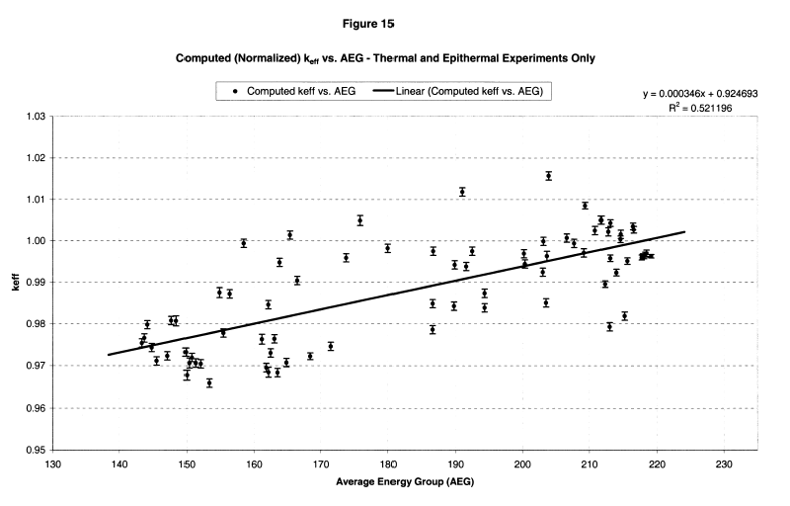
EXAMPLE 3: Lower Confidence Band
All 76 thermal and epithermal ²³³U solution benchmarks in the 2001 IHECSB Handbook: k_{eff} vs AEG

Slide 79
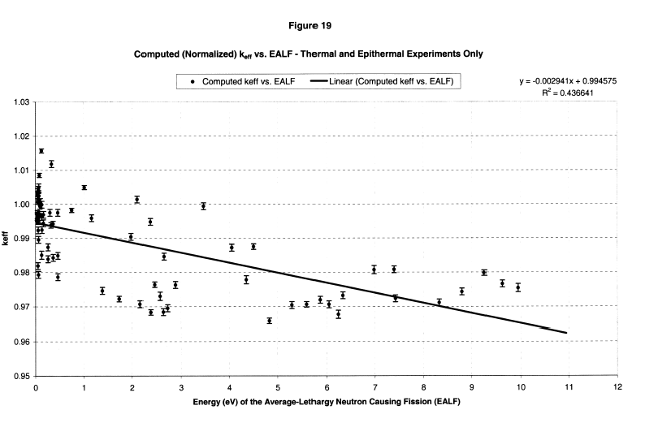
EXAMPLE 3: Lower Confidence Band
All 76 thermal and epithermal ²³³U solution benchmarks in the 2001 IHECSB Handbook: k_{eff} vs EALF

Slide 80
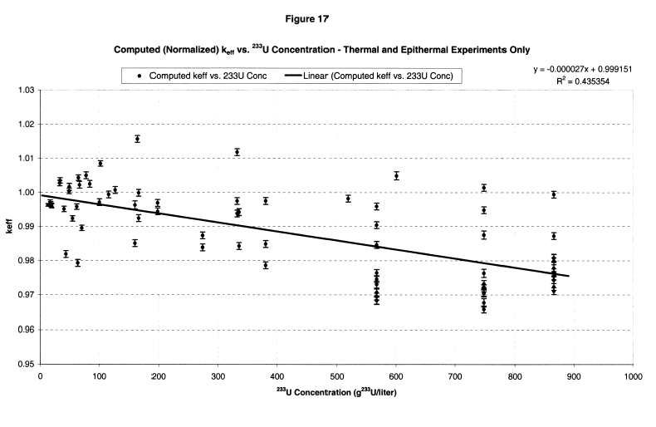
EXAMPLE 3: Lower Confidence Band
All 76 thermal and epithermal ²³³U solution benchmarks in the 2001 IHECSB Handbook: k_{eff} vs ²³³U Concentration

Slide 81
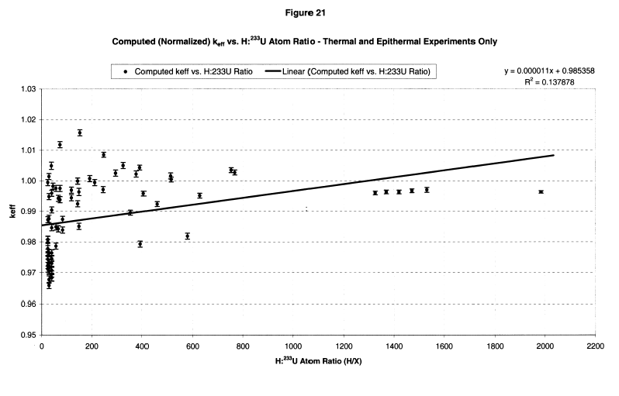
EXAMPLE 3: Lower Confidence Band
All 76 thermal and epithermal ²³³U solution benchmarks in the 2001 ICSBEP Handbook: k_{eff} vs H:²³³U atom ratio

Slide 82
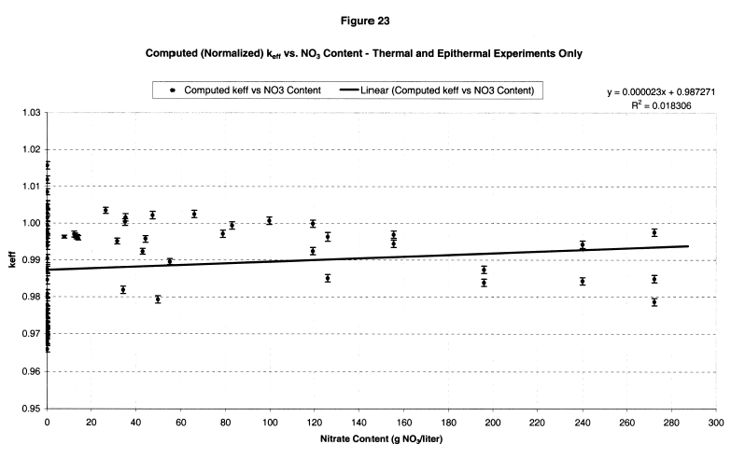
EXAMPLE 3: Lower Confidence Band
All 76 thermal and epithermal ²³³U solution benchmarks in the 2001 IHECSB Handbook: k_{eff} vs NO₃ content

Slide 83
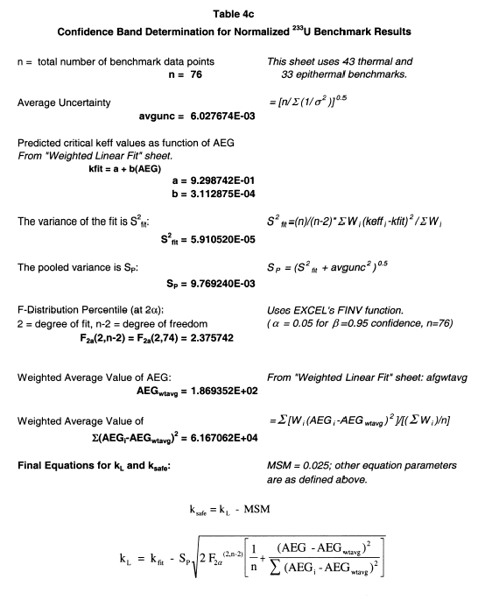
EXAMPLE 3: Lower
Confidence Band
Final confidence
band expression
(MSM is MoS)
(1.0 + Bias - Bias Uncertainty)

Slide 84
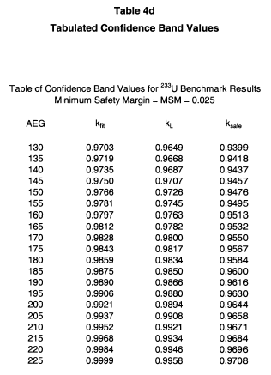
EXAMPLE 3: Lower
Confidence Band
Final confidence
band tabulated
values
(MSM is MoS)

Slide 85
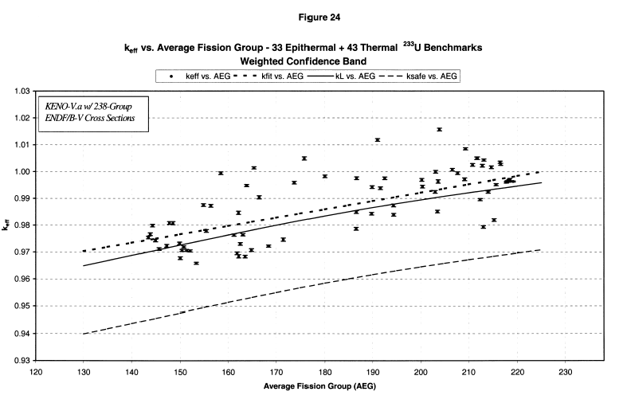
EXAMPLE 3: Lower Confidence Band

Slide 86
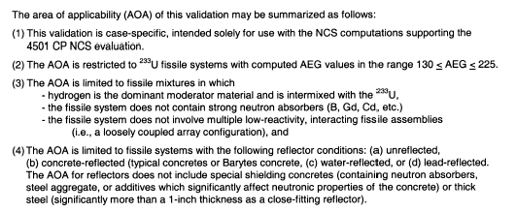
EXAMPLE 3: Lower Confidence Band
Area of Applicability Statement

Slide 87
Essential References
NUREG-1475, Revision 1, “Applying Statistics,” 2011
NUREG/CR-6698, "Guide for Validation of Nuclear Criticality Safety Calculational Methodology," 2000.
FCSS ISG-10, Nuclear Regulatory Commission Interim Staff Guidance 10, "Justification for Minimum Margin of Subcriticality for Safety," 2006.

