Slide 1
Neutron Transport Modeling using Monte Carlo Codes
Dallas Moser
Dallas.Moser@pxy12.doe.gov
Nuclear Criticality Safety Engineer

Slide 2
Topics
What is Monte Carlo?
Monte Carlo vs. deterministic
Why do we use Monte Carlo?
What cross sections are used (multi-group vs. continuous)
What codes are used?
Why are these used?
What are the differences between the codes?
How are the codes used?
Example of a process that is modeled
Extra 3D models of what you can do with them
What is a parametric study?
Basics of a parametric study
Examples

Slide 3
What is Monte Carlo: Monte Carlo Versus Deterministic
Monte Carlo
Using random sampling of particle tracks to determine k_{eff}
Able to use continuous data (geometry, scattering angles, cross sections, etc…)
Doesn’t always calculate the “correct” answer (sampling issues)
Tends to take a longer run time since each particle has to be simulated (ray tracing)
Deterministic
Analytical approach using Boltzmann transport equation, which is discretized into a system of algebraic equations
Must use discrete data (approximate geometries, group cross section, and scattering angles, etc..)
Calculates the analytical answer, everywhere, all at once
Relatively quick run time, mostly solving systems of equations/matrices, can take up memory due to large amount of data storage

Slide 4
What is Monte Carlo: Why Monte Carlo?
Monte Carlo provides an approximate answer to an exactly defined problem
Deterministic provides an accurate answer to an approximate problem
As computer resources get more advanced:
Memory is less limited (RAM and storage)
Run time is not as much an issue
With more histories, Monte Carlo can approach an “exact” answer
Deterministic will always be limited by its discrete data

Slide 5
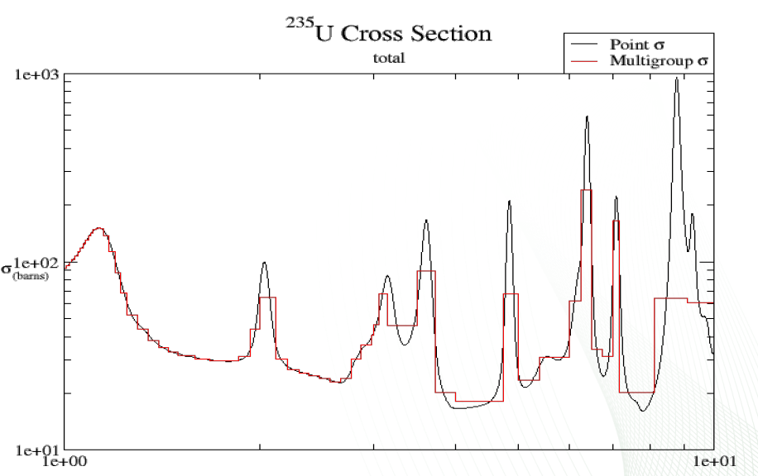
What is Monte Carlo: Cross Sections
Two main types of cross section data:
Multi-group
Continuous
Grouped cross section data creates bins of the data to average over an energy range
Requires some extra processing to handle resonance self-shielding
Continuous data is not averaged, enough data points exist to show “real” cross section data
Inherently accounts for resonance self-shielding, no extra processing needed
Notes:
Image from ORNL training slides.

Slide 6
What Codes are Used?
Main two codes used in DOE:
MCNP
SCALE
Why are these used?
MCNP is developed at LANL
SCALE is developed at ORNL
DOE provides funding for these codes to be produced, has some say in what features are being developed to make them more usable.

Slide 7
What is the Difference between SCALE and MCNP
MCNP
Uses universe based input system with sense based geometry definition
Materials are defined by specifying each isotope and its contribution to the mixture
All functions are integrated into the main code stream
Tends to be used more with detectors and shielding
SCALE
Prior to KENO-VI (KENO V.a), inputs were geometry limited, KENO-VI made the input very similar to MCNP
Materials can be defined via isotopes, but also contains a materials library with shortcuts for certain materials
Written as a series of modules that have to be called together to work properly (sequences)
Many modules are written for things other than simple particle tracking (e.g. depletion)

Slide 8
How are Codes Used?
Processes need to be evaluated to ensure subcriticality (ANSI/ANS-8.1)
Ways to find data to show subcriticality:
Critical Experiments
Handbook data
Hand calculations
Subcritical limits from standards
Calculations
If sufficient data does not already exist to show subcriticality, calculations can be performed to show that the process is subcritical (statistically)
Use of codes requires validation (later lecture)
Comparison of calculations to critical experiments
Establish bias in the code
Generate an Upper Safety Limit (USL) to incorporate bias, experimental uncertainties, and safety margin
USL becomes the “safety limit” for k_{eff} in calculations

Slide 9
Simplifications for Modeling
Codes are usually limited in exactly what they can model, even with more advanced geometry methods
Codes use text-based geometry definitions:
Not inherently CAD capable
Makes it more challenging to develop complex geometries
Introducing CAD capability requires new knowledge/testing of meshing
Must determine how to conservatively simplify equipment such that it can be more easily modeled
Simplified models should have an equivalent or greater reactivity than the “realistic” model
Use engineering judgement to determine what details can be removed, simplified, or are worth the time to model
Can re-introduce realism if simplified models are sufficient

Slide 10
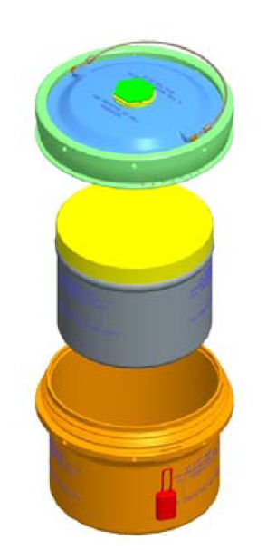
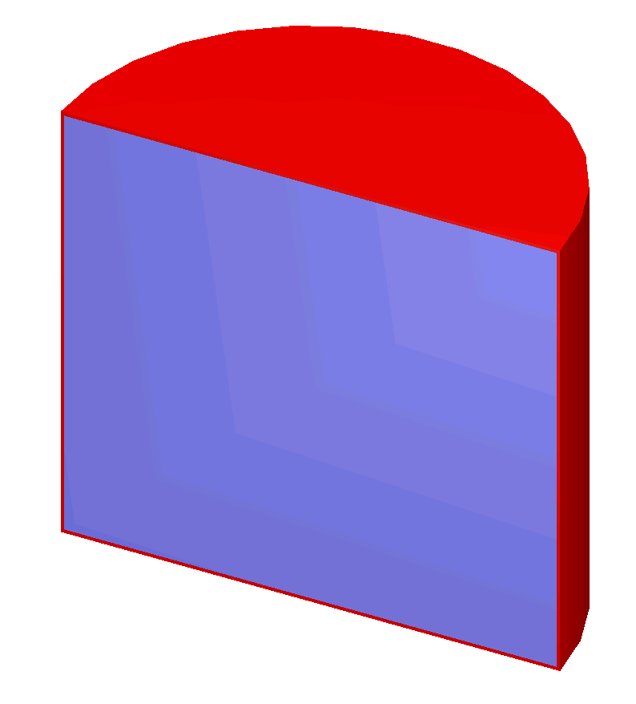
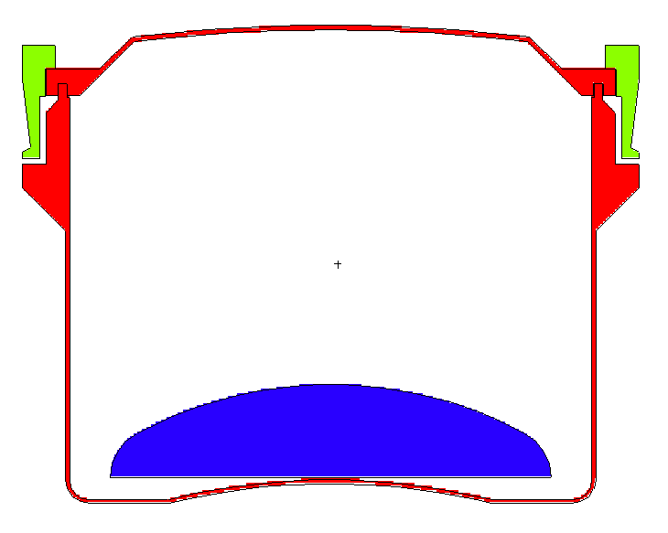
Modeling Examples: Container
Actual Container
Advanced Model
Simplified Model
~5kg ²³⁵U as a “button”
~5kg ²³⁵U
as a sphere
~5kg ²³⁵U
filling container

Slide 11
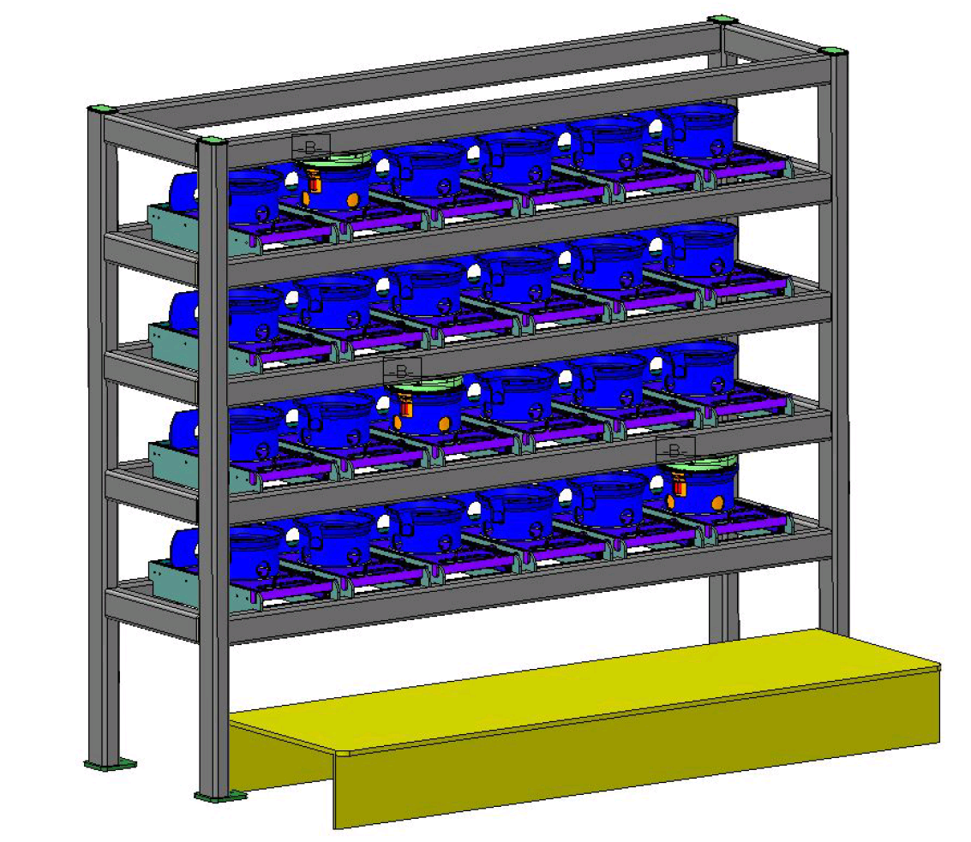
Modeling Examples: Can Rack
Actual Rack
Simplified Model

Slide 12
What is a Parametric Study and what are Perturbations?
Will need more than just a single model to understand the system
Need to vary different nuclear parameters to see how they affect reactivity
Usually looking for trends about a certain parameter or limit to a certain parameter:
Max allowable mass
Optimal concentration
Optimal interspersed moderation (sprinklers, pipe bursts, etc…)
Flooding
Stacking
Solution outside of safe geometry equipment
Perturbations can include parametric studies, but usually include a change in nuclear parameters that aren’t directly related:
Change in geometry
Change in reflection
Change in moderator

Slide 13
Perturbations: Different Geometries
Using the same fissile mass in each case
Sphere
Cylinder at the max radius of the container
Cylinder at the max height of the container
Cylinder with an H/D=1

Slide 14
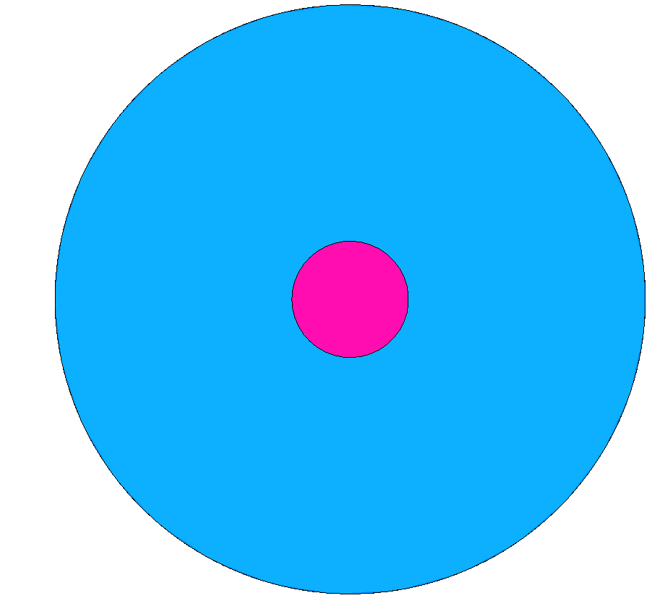
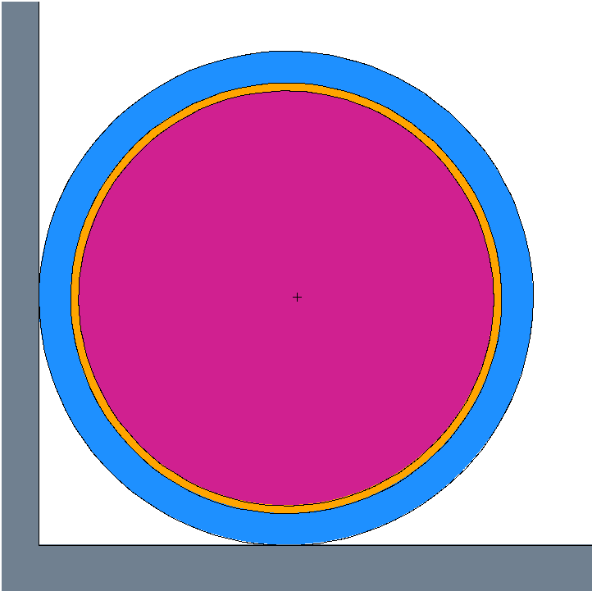
Perturbations: Different Reflection Conditions
20’x20’ concrete room, with ½” tight fitting water reflection and 1/8” tight fitting polyethylene
Water Reflector
Tight fitting 12” water reflection (effectively infinite water reflection)
Polyethylene (plastic wrap)
Fissile

Slide 15
Parametric Study: Overmass (Normally Dry Material)

Slide 16
Parametric Study: Flooding (Normally Dry Material)

Slide 17
Parametric Study: Interaction (Normally Moderated Material)

Slide 18
Parametric Study: Spacing

Slide 19
Reports
After calculations are performed, reports must be written so that they are documented and able to be referenced by others
Calculations and their associated reports must be independently reviewed (peer reviewed)
Reports contain all the needed information for the model:
Geometries
Material compositions
Code package
Validation applicability
Methodology
Pictures of the models
Graphical representations of the data
Presentation showing how much data can go into a report: https://www.osti.gov/biblio/1582020

Slide 20
Conclusion
Performing calculations in support of a criticality safety evaluation is much more involved than simply making a 3D model and calculating a k_{eff}
Much thought has to go into generating useable models and documenting the results in a meaningful way
Understand the limitations of the code
Ensure models are appropriate for their use-case
Ensure simplifications made for the models are conservative
Perform parametric studies to understand the system

