Slide 1
MAGICMERV: Nuclear Parameters
Dallas Moser
dallas.moser@cns.doe.gov
Nuclear Criticality Safety Engineer

Slide 2
Outline
Introduction to MAGICMERV
Mass
Absorption
Geometry
Interaction
Concentration
Moderation
Enrichment
Reflection
Volume

Slide 3

Introduction
What is MAGICMERV? – An acronym used to represent the most common nuclear parameters that influence criticality of fissile material
What does MAGICMERV stand for?
  Mass
  Absorption
  Geometry
  Interaction
  Concentration
  Moderation
  Enrichment
  Reflection
  Volume
Are these all of the nuclear parameters of concern? – No, there are more nuclear parameters that can be considered in an evaluation. Examples?

Slide 4
Mass – Fissile Mass
What is it? – Represents the physical mass of fissile material (i.e. 350g ²³⁵U, 1kg ²³⁹Pu)
How does it work? – The lower the mass of fissile material, fewer fissile nuclei exist decreasing the likelihood that a neutron would interact with a fissile nuclei therefore reducing the probability of a fission
How does it effect reactivity? – Typically, more fissile mass leads to increased reactivity (higher k_{eff}). Examples where this is not true?
How often is this used as a controlled parameter? – Mass is often controlled as it’s easy to measure and understand, and directly effects neutron multiplication in a system
Concepts related to fissile mass:
  Minimum critical mass
  Subcritical mass limit
  Assay uncertainty/ measurement uncertainty

Slide 5
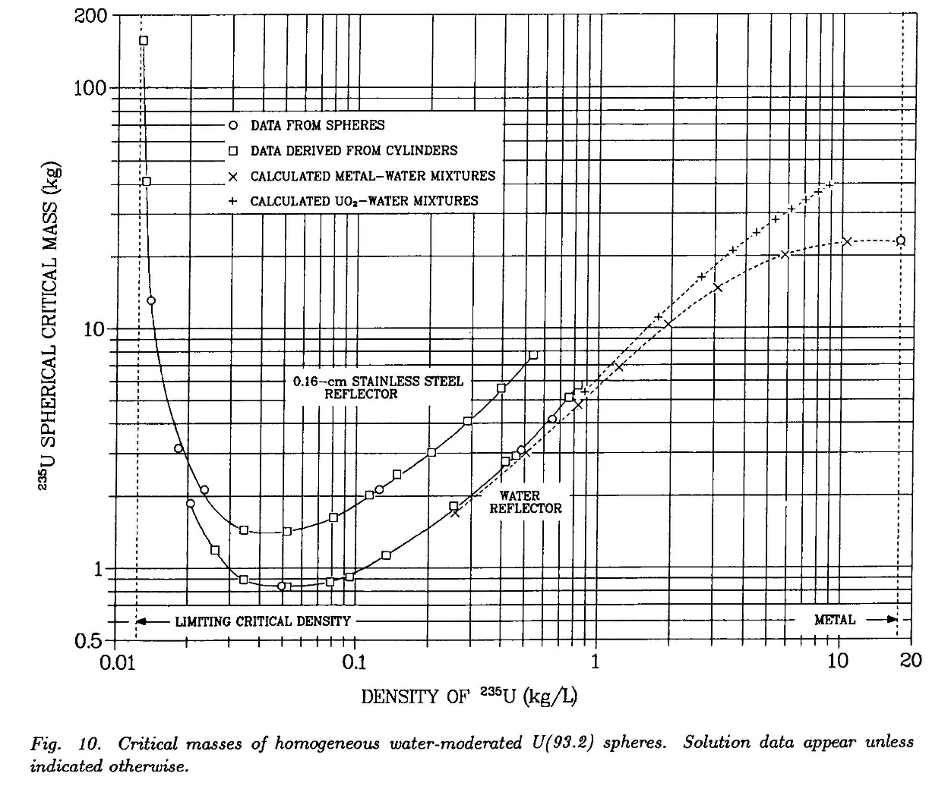
Mass – Minimum Critical Mass and Subcritical Mass Limit
What is Minimum Critical Mass? – This is the lowest amount of fissile mass required for a unit/system to be critical (i.e. ~800g for 93% enriched ²³⁵U)
What is Subcritical Mass Limit? – This is simply the minimum critical mass with some added safety margin so that it can be used as a safety limit (i.e. 700g for ²³⁵U from ANSI/ANS-8.1).
LA-10860-MS Figure 10

Slide 6
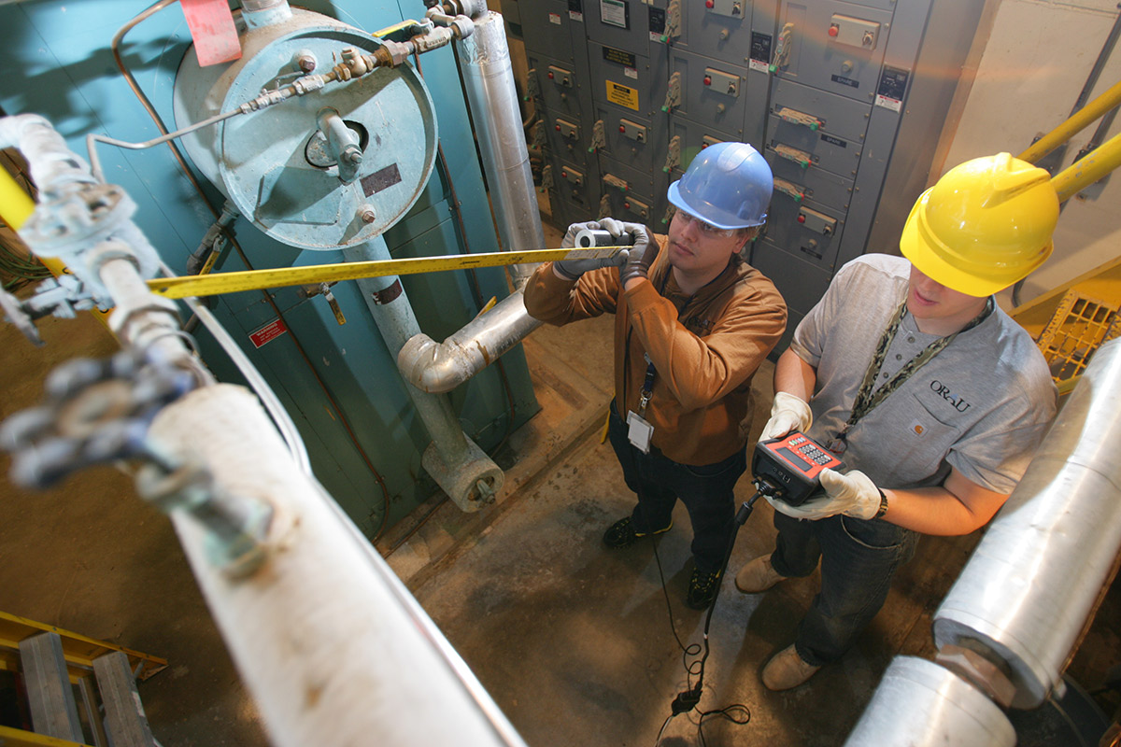
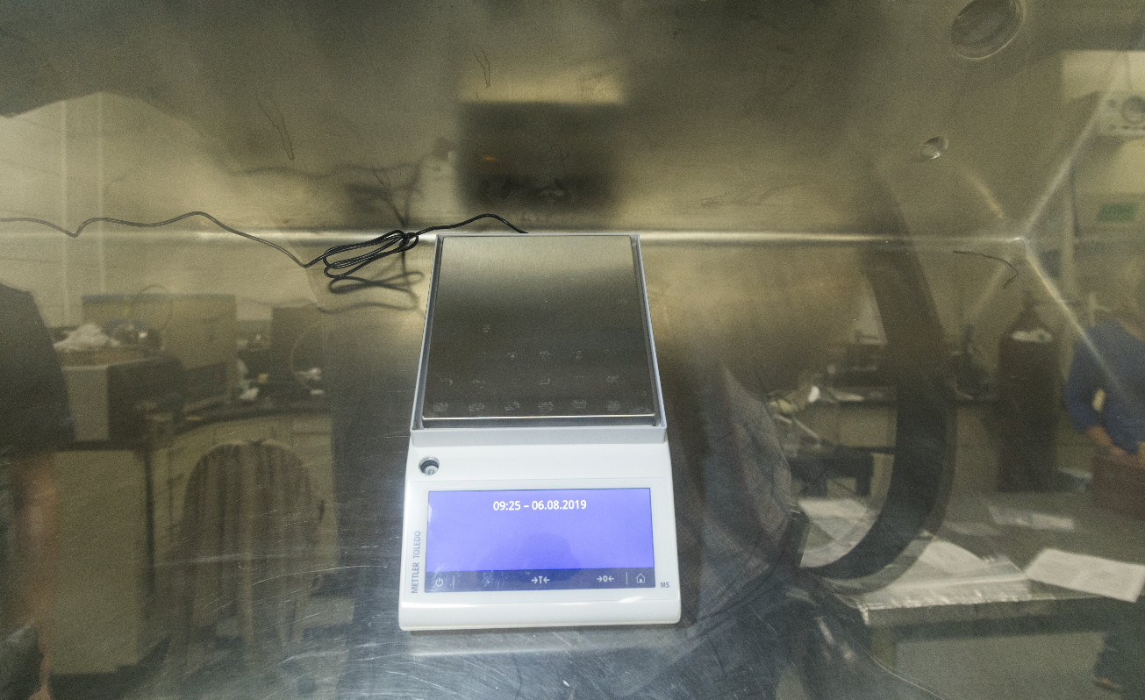
Mass – Measurement Uncertainty
What is it? – No weight scale or detector is perfect, uncertainty in measurements should be taken into consideration during the analysis

Slide 7
Absorption – Neutron Absorbers
What is it? – Neutron absorbers are materials/atoms that have the potential to absorb a neutron without causing a fission (i.e. boron or cadmium).
How does it work? - Some isotopes present a neutron absorption cross section that allow neutrons to be absorbed without causing the nucleus to fission. These can also be referred to as “neutron poisons” because they typically reduce the neutron population.
How does it effect reactivity? – Loss of neutron absorbers typically leads to increased reactivity (higher k_{eff}). Examples where this is not true?
How often is this used as a controlled parameter? – Absorbers are often avoided, even if they are present in a system because their presence is difficult to verify, however increased rigor on procurement can make it more of a possibility
Concepts related to neutron absorbers:
  Mild neutron absorbers versus strong neutron absorbers
  Single unit versus array reactivity
  How neutron energy effects absorbers

Slide 8
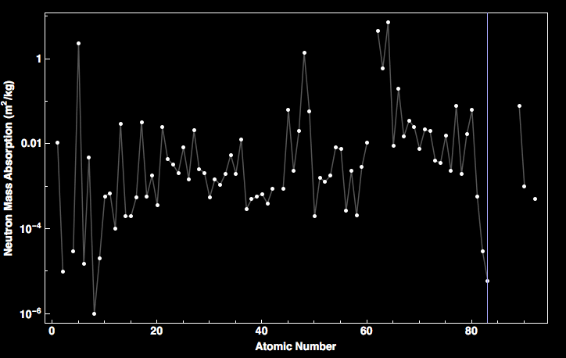
Absorption – Mild Absorbers
What are they? – Mild absorbers are as they sound, isotopes that provide a small probability of absorption. These type of absorbers are not usually intentionally placed into a system for the purpose of neutron absorption, but are often part of materials that are commonly used.
What are some examples of commonly found mild neutron absorbers?
  Iron or aluminum – commonly found in many forms of steel used in drums, containers, or gloveboxes
  Chlorine – Can be found in some plastics or chemicals
  Fluorine – Can be found in some chemicals
Al
Cl
Fe
Interactive plot: https://periodictable.com/Properties/A/NeutronMassAbsorption.html

Slide 9
Absorption – Strong Absorbers
What are they? – Strong absorbers present a significant absorptions cross section when compared to other elements/isotopes. These are not usually found in common materials of construction, but are intentionally put into a material for the purpose of neutron absorption
What are some examples of strong neutron absorbers?
  Boron (most easily available)
  Cadmium
  Gadalinium
B
Cd
Gd
Samples of Borated Ceramic Used at Y12

Slide 10
Absorption – Single Unit Versus Array Reactivity
What is single unit reactivity? – This is the reactivity with respect to neutron population of a single unit by itself
What is array reactivity? – This is the reactivity with respect to neutron population of several units placed near enough to each other such that neutrons from one unit can effect the neutron population of other nearby units.
How can the presence of neutron absorbers effect single unit reactivity? – Although neutron absorbers absorb neutrons, the effect is mostly seen if the absorber is present between fissile atoms, otherwise the neutron absorbers acts mostly as a scatterer, in which case single unit reactivity can increase if absorber is only present around the single unit
How can the presence of neutron absorbers effect array reactivity? – Arrays of units allows for absorbers to be placed between units where neutrons can be absorbed when travelling from one unit to another, decreasing array reactivity.

Slide 11
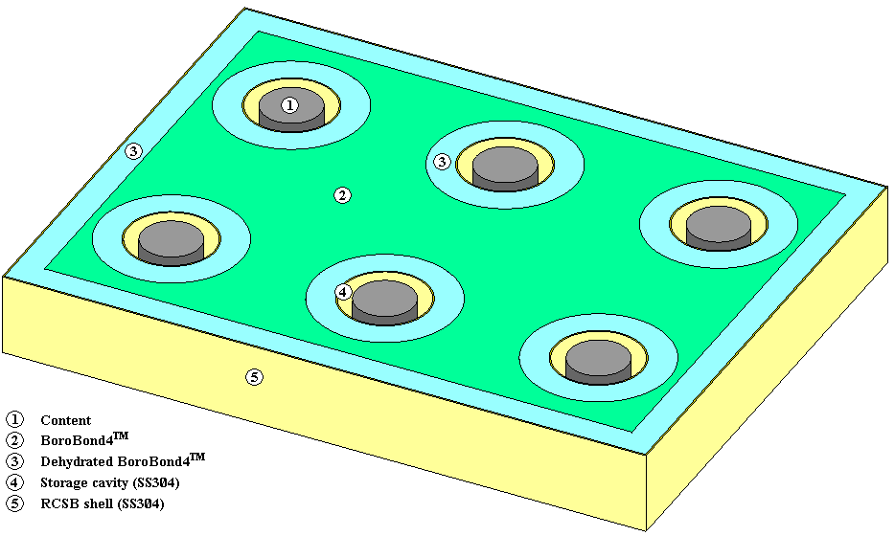
Absorption – Effects of Neutron Energy
What are the effects of neutron energy on absorption? – Just like any other cross section, absorption cross sections are dependent on neutron energy. Many of the absorption cross sections for strong neutron absorbers (i.e. boron) increase drastically when neutron energy is lower, therefore making it more effective
How can this be utilized? – This information can be used when designing poisoned systems by attempting to thermalize neutrons before it reaches the absorber so it can be more effective
Description | Single Unit K_{eff} | Large Array K_{eff}
20 kg metal 0" dehydrated | 0.80611 | 0.86382
20 kg metal 1" dehydrated | 0.79689 | 0.86701
20 kg metal 2" dehydrated | 0.79443 | 0.89262
20 kg metal full dehydrated | 0.79893 | 1.09493
ceramic containing boron and water

Slide 12
Geometry – The Fissile Shape
What is it? – Represents the physical shape of fissile material or the container that it is in
How does it work? – The physical geometry of fissile material will determine the neutron leakage of a system or how many neutrons can make it out of the fissile material without interacting. The surface area of a shape can be equated to neutron leakage, while the volume represents the amount of fissile material a geometry can hold, thus a system with a higher surface area to volume ratio will have more leakage.
How does it effect reactivity? – This depends, generally geometries with a higher surface area to volume ratio will be less reactive and vice versa
How often is this used as a controlled parameter? – Geometry is often controlled for containers (i.e. cylindrical)
Concepts related to geometry:
  Commonly considered geometries
  Typical containers and geometry limitations
  Favorable versus unfavorable geometry

Slide 13
Geometry – Commonly Considered Geometries
What are they? – The most commonly considered geometries are: spheres, cylinders, and cuboids/slabs
What’s the difference?
  Sphere: The most reactive single unit shape because it has the lowest surface area to volume ratio leading to the least amount of neutron leakage.
  Cylinder: Typically considered the second most reactive single unit (depending on height to diameter (H/D) ratio). The lowest surface area to volume ratio for a cylinder is and H/D=1, however it is not the most reactive H/D. Most reactive is closer to H/D≈0.92 shown by buckling. A very thin rod or very short height cylinder will have high leakage and low single unit reactivity.
  Cuboidal/Slabs: Cubes often have the most leakage and offer the lowest single unit reactivity (depending on height, width, and length ratios). A very thin cube (slab) will have very high leakage and low reactivity.
Do these geometry reactivity assumptions apply to arrays? – Sometimes, yes, and other times, no. Putting units in arrays becomes a balancing act between single unit reactivity and interaction between units. Sometimes creating a geometry with more leakage can allow for more interaction in an array, causing an increase of reactivity.

Slide 14
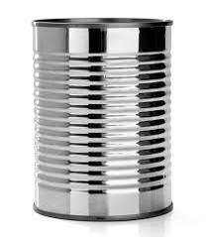
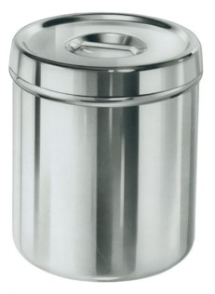
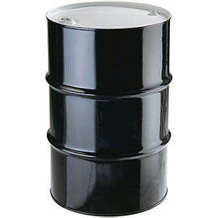

Geometry – Typical Containers and Geometry Limitations
What is the typical container geometry? – Containers are typically cylindrical in nature, however they are often limited to a maximum height and maximum diameter.

Slide 15
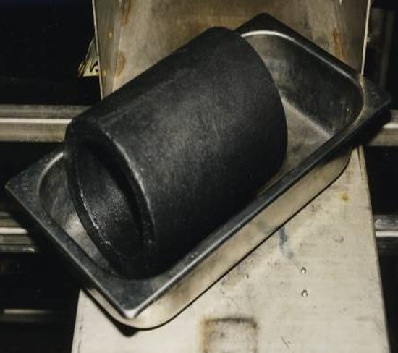
Geometry – Favorable Versus Unfavorable
What is a favorable geometry? – This is a geometry that has inherently higher leakage, making it potentially safer than a geometry with lower leakage
What is an unfavorable geometry? – This is a geometry with inherently lower leakage, making it potentially more reactive than its low leakage counterpart
Favorable
Unfavorable
Rod/Pipe
Annulus
Sphere
Large Tank
Slab

Slide 16
Interaction – Neutron Interaction Between Fissile Units
What is it? – Occurs when more than one fissile unit is present (not limited to discrete units)
How does it work? – Neutrons between physically separated fissile material can influence each other’s neutron population (i.e. neutrons from one unit can cause a fission in another physically separated unit and vice versa) increasing the overall reactivity of the system
How does it effect reactivity? – Typically, more interaction is more reactive, if units are spaced further apart, reactivity decreases. How the units are arranged (i.e. square or triangle pitch) can influence reactivity, stacking of units can influence reactivity, and the number of units interacting will effect reactivity. Examples where increased interaction may be worse?
How often is this used as a controlled parameter? – Interaction is often considered in analysis, even if it’s not explicitly controlled. Interaction includes topics such as: interaction with surrounding fissile processes, interaction with system hold up, and storage array
Concepts related to interaction:
  Spacing and how it effects interaction
  Physical controls on interaction

Slide 17
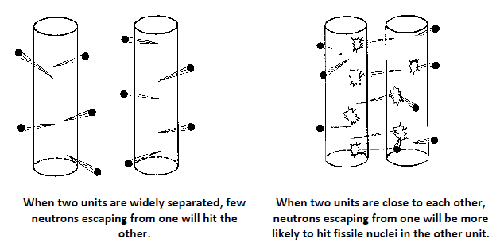
Interaction - Spacing
What is it? – Spacing is, as it sounds, the physical distance between fissile units

Slide 18
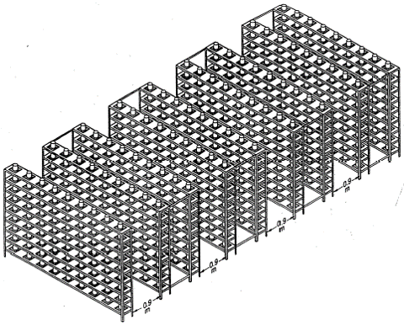
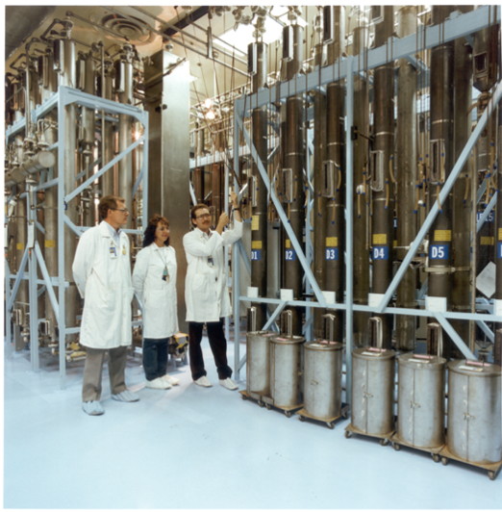
Interaction – Physical Controls
What are the typical physical controls? – These can be required spacers installed so that discrete units cannot be placed closer together. Often with containers and dollies, spacing is built into the design to decrease interaction between units in the container/dolly and between other containers/dollies.

Slide 19
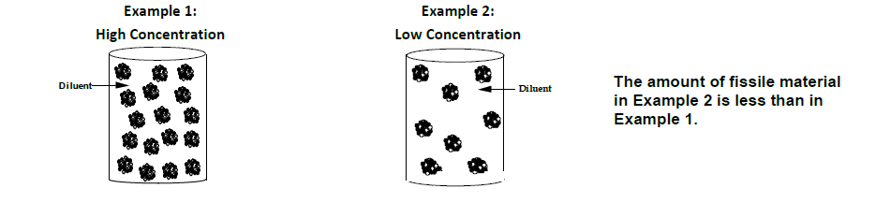
Concentration – Fissile Material Concentration or Density
What is it? – Typically referencing the g fissile/L of solution or g fissile/cm³ of metals or compounds
How does it work? – For dry compounds, lowering density introduces void space, for solution it introduces more moderation
How does it effect reactivity? – For dry compounds, lower density materials will be less reactive. If moderated, lower density solutions or compounds could be more reactive
How often is this used as a controlled parameter? – max concentration of solution and max density of oxides/other compounds is often credited in analysis

Slide 20
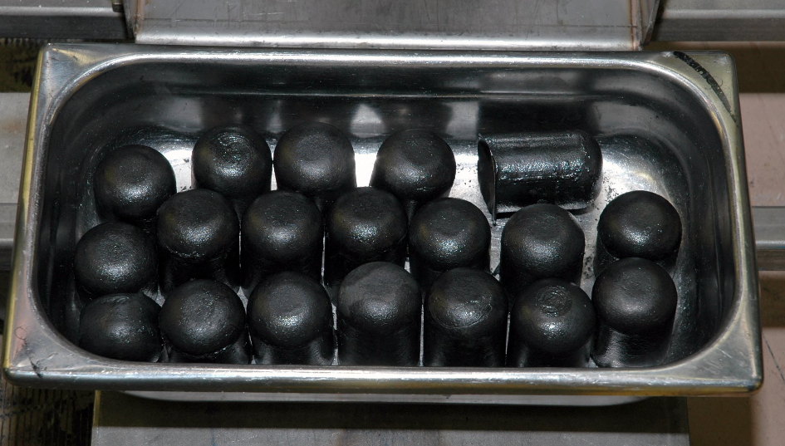
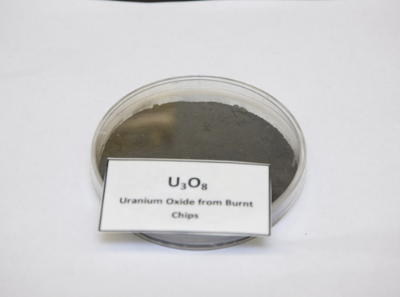
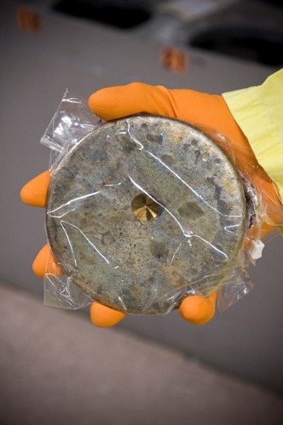

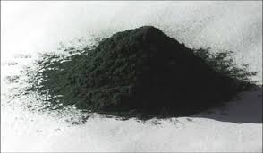
Concentration – Varying Density Materials

Slide 21
Moderation
What is it? – Introduction of some material that can effectively slow neutrons through multiple scatters
How does it work? – Neutrons lose energy when they scatter, more energy is lost per scatter if the nucleus is closer to the size of a neutron (i.e. hydrogen)
How does it effect reactivity? – Mixing fissile with a moderator will increase reactivity to an optimum, then it will decrease reactivity
How often is this used as a controlled parameter? – Moderation is often considered in analyses because it is so common (i.e. sprinklers, leaking pipes/roofs, oils, etc…)
Concepts related to Moderation:
  Over-moderation versus under-moderation
  Average logarithmic energy decrement
  Moderating ratio

Slide 22
Moderation – Over-moderation Versus Under-moderation
What is over-moderation? – Fissile has been moderated so much that individual fissile atoms no longer interact
What is under-moderation? – Fissile has not been moderated enough to reach optimum
Over-moderated
Under-moderated
Optimal

Slide 23
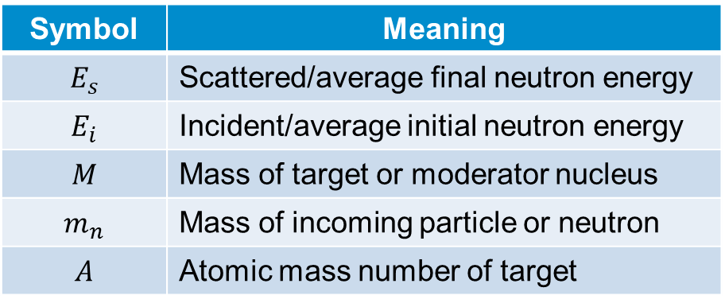
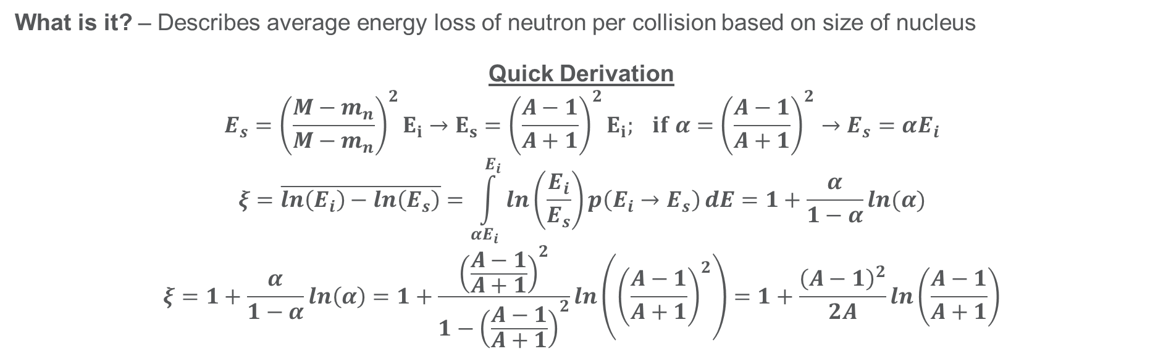

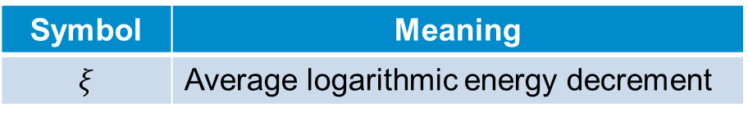
Moderation – Average Logarithmic Energy Decrement
What is it? – Describes average energy loss of neutron per collision based on size of nucleus
Quick Derivation
$$E_{s}={\left(\frac{M−m_{n}}{M−m_{n}}\right)}^{2}E_{i}→E_{s}={\left(\frac{A−1}{A+1}\right)}^{2}E_{i}; if α={\left(\frac{A−1}{A+1}\right)}^{2}→E_{s}=αE_{i}$$
$$ξ=\overline{ln\left(E_{i}\right)−ln\left(E_{s}\right)}=\int_{αE_{i}}^{E_{i}}{ln\left(\frac{E_{i}}{E_{s}}\right)p\left(E_{i}→E_{s}\right)ⅆE=1+\frac{α}{1−α}ln(α)}$$
$$ξ=1+\frac{α}{1−α}ln\left(α\right)=1+\frac{{\left(\frac{A−1}{A+1}\right)}^{2}}{1−{\left(\frac{A−1}{A+1}\right)}^{2}}ln\left({\left(\frac{A−1}{A+1}\right)}^{2}\right)=1+\frac{{\left(A−1\right)}^{2}}{2A}ln\left(\frac{A−1}{A+1}\right)$$
Symbol | Meaning
$$E_{s}$$ | Scattered/average final neutron energy
$$E_{i}$$ | Incident/average initial neutron energy
$$M$$ | Mass of target or moderator nucleus
$$m_{n}$$ | Mass of incoming particle or neutron
$$A$$ | Atomic mass number of target
Symbol | Meaning
$$ξ$$ | Average logarithmic energy decrement
Final Equation
$$ξ=1+\frac{{\left(A−1\right)}^{2}}{2A}ln\left(\frac{A−1}{A+1}\right)$$

Slide 24
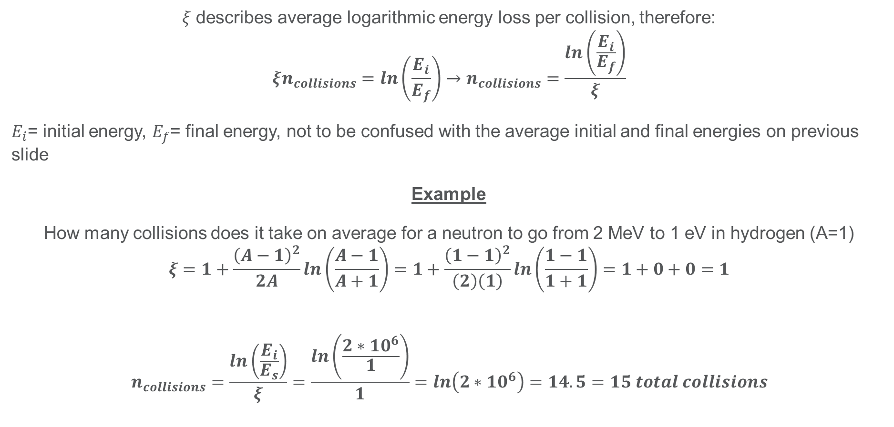
Moderation – Using Average Logarithmic Energy Decrement
$ξ$ describes average logarithmic energy loss per collision, therefore:
$$ξn_{collisions}=ln\left(\frac{E_{i}}{E_{f}}\right)→n_{collisions}=\frac{ln\left(\frac{E_{i}}{E_{f}}\right)}{ξ}$$
$E_{i}$= initial energy, $E_{f}$= final energy, not to be confused with the average initial and final energies on previous slide
Example
How many collisions does it take on average for a neutron to go from 2 MeV to 1 eV in hydrogen (A=1)
$$ξ=1+\frac{{\left(A−1\right)}^{2}}{2A}ln\left(\frac{A−1}{A+1}\right)=1+\frac{{\left(1−1\right)}^{2}}{\left(2\right)\left(1\right)}ln\left(\frac{1−1}{1+1}\right)=1+0+0=1$$
$$n_{collisions}=\frac{ln\left(\frac{E_{i}}{E_{s}}\right)}{ξ}=\frac{ln\left(\frac{2∗10^{6}}{1}\right)}{1}=ln\left(2∗10^{6}\right)=14.5=15 total collisions$$

Slide 25
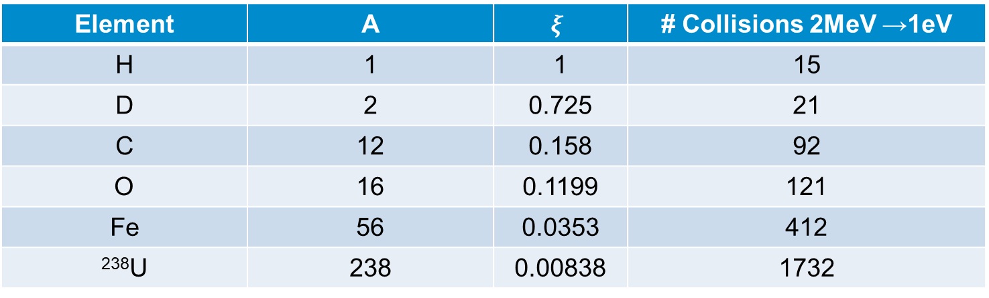
Moderation – Average Logarithmic Energy Decrement Typical Values
Examples of common elements
Decent website for reference:
https://www.nuclear-power.net/glossary/neutron-moderatoraverage-logarithmic-energy-decrement/
Element | A | $$ξ$$ | # Collisions 2MeV →1eV
H | 1 | 1 | 15
D | 2 | 0.725 | 21
C | 12 | 0.158 | 92
O | 16 | 0.1199 | 121
Fe | 56 | 0.0353 | 412
²³⁸U | 238 | 0.00838 | 1732

Slide 26
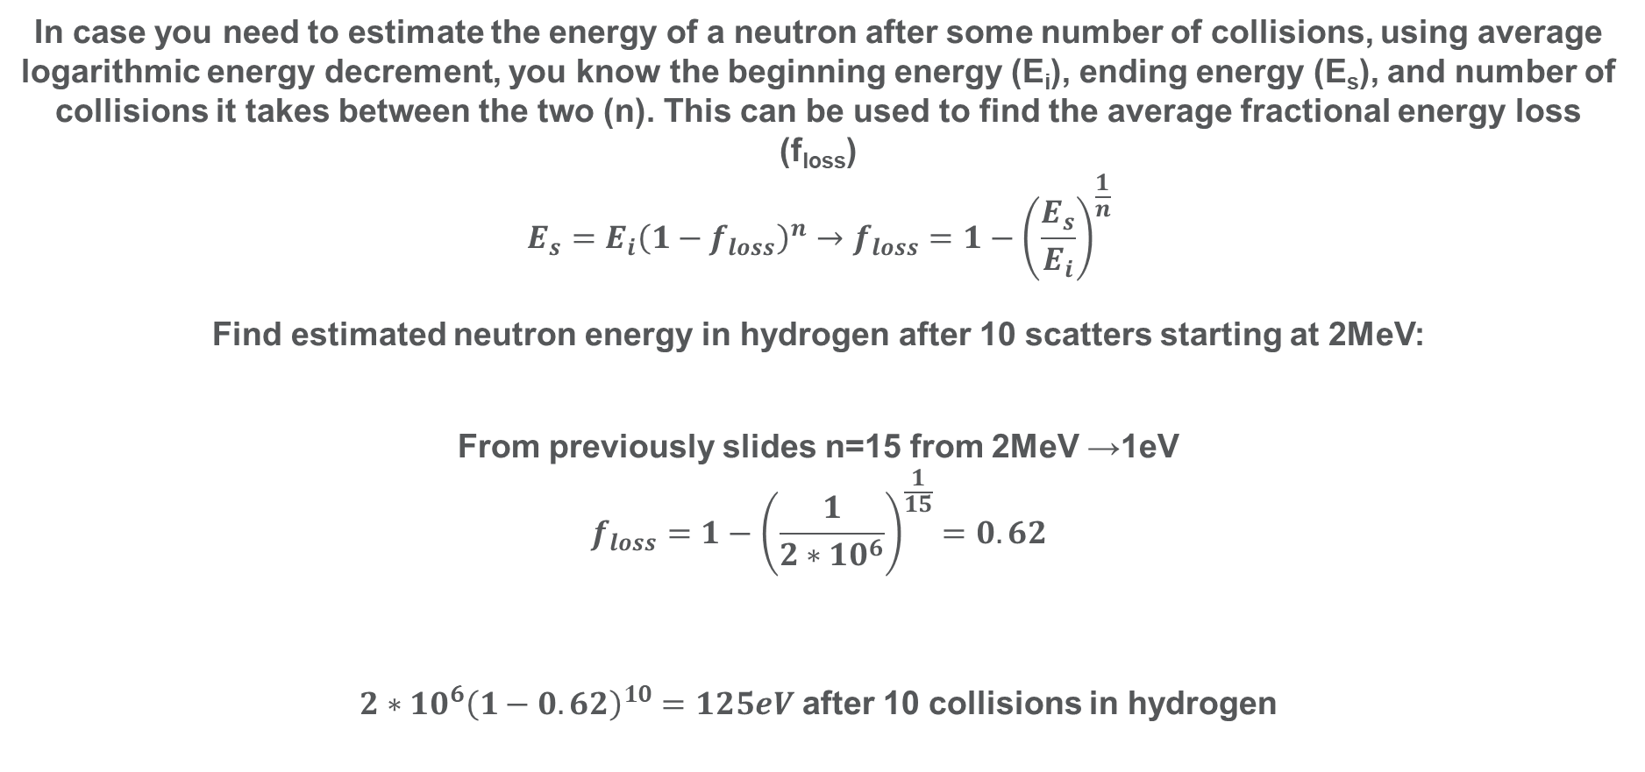
Moderation – Fractional Energy Loss per Collision
In case you need to estimate the energy of a neutron after some number of collisions, using average logarithmic energy decrement, you know the beginning energy (E_{i}), ending energy (E_{s}), and number of collisions it takes between the two (n). This can be used to find the average fractional energy loss (f_{loss})
$$E_{s}=E_{i}{\left(1−f_{loss}\right)}^{n}→f_{loss}=1−{\left(\frac{E_{s}}{E_{i}}\right)}^{\frac{1}{n}}$$
Find estimated neutron energy in hydrogen after 10 scatters starting at 2MeV:
From previously slides n=15 from 2MeV →1eV
$$f_{loss}=1−{\left(\frac{1}{2∗10^{6}}\right)}^{\frac{1}{15}}=0.62$$
$2∗10^{6}{\left(1−0.62\right)}^{10}=125eV$ after 10 collisions in hydrogen

Slide 27
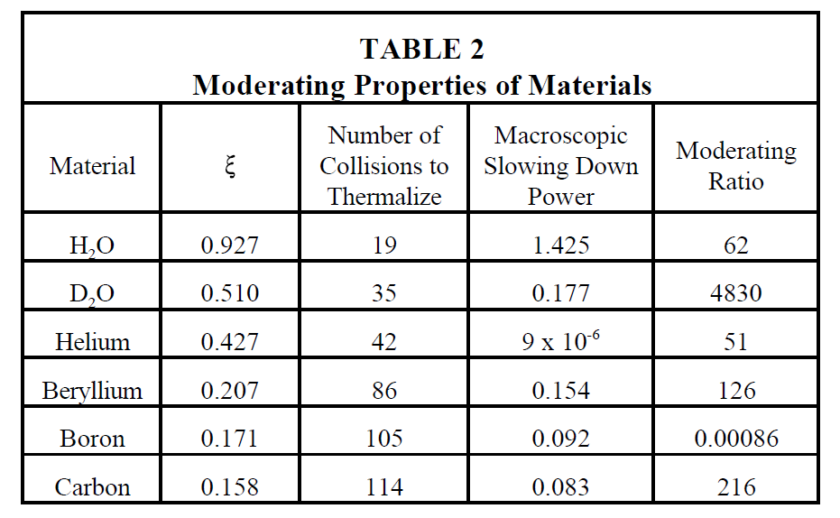

Moderation – Macroscopic Slowing Down Power and Moderating Ratio
What is it? – MSDP describes a moderators ability to scatter neutrons including its energy loss. MR describes a material’s effectiveness as a moderator, including scattering and absorption
$$MSDP=ξΣ_{s} MR=ξ\frac{Σ_{s}}{Σ_{a}}$$
$ξ$: Amount of energy that can be lost per collision based on nucleus size
$Σ_{s}$ (macroscopic scattering cross section): Probability of the moderator to scatter neutrons
$Σ_{a}$ (macroscopic absorption cross section ): Probability that the moderator will absorb neutrons
DOE-HDBK-1019/1-93

Slide 28
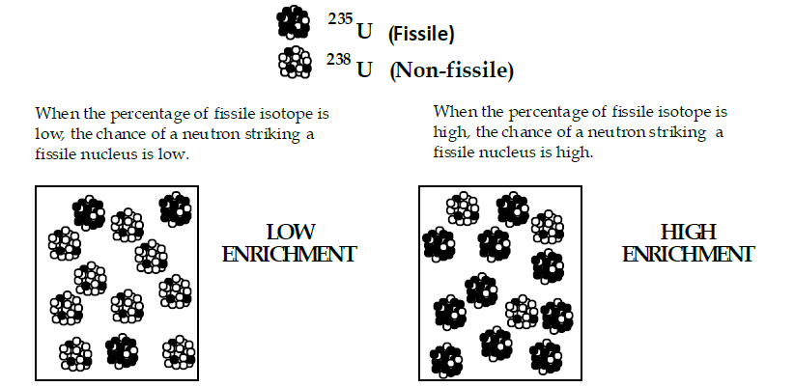
Enrichment – Fissile Isotope Percentage
What is it? – The percentage of fissile isotope in an element
How does it work? – Typically reported as weight percent (i.e. 20wt% ²³⁵U)
How does it effect reactivity? – Higher enrichment means more fissile atoms, which increases reactivity
How often is this used as a controlled parameter? – Most of the time, enrichment is evaluated at the highest possible, but is always considered in analysis

Slide 29
Reflection – Neutron Reflection
What is it? – Material that can scatter neutrons back into fissile material
How does it work? – Primary function is to scatter neutrons back into fissile material, good moderators are often good reflectors, however highly dense materials are also good reflectors (i.e. tungsten, lead, etc…)
How does it effect reactivity? – The addition of reflection is almost always more reactive
How often is this used as a controlled parameter? – Reflection is always considered in evaluations and often controlled for equipment like gloveboxes or situations that present more than nominal reflection (i.e. 1 inch of water)
Concepts related to Reflection:
  What to consider in reflection
  Effect of reflection versus moderation
  Effectiveness of various reflectors
  Effectively infinite (full) reflection

Slide 30
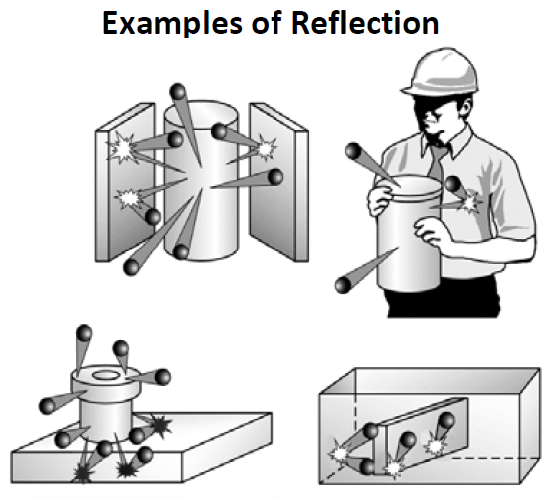
Reflection – What to Consider

Slide 31
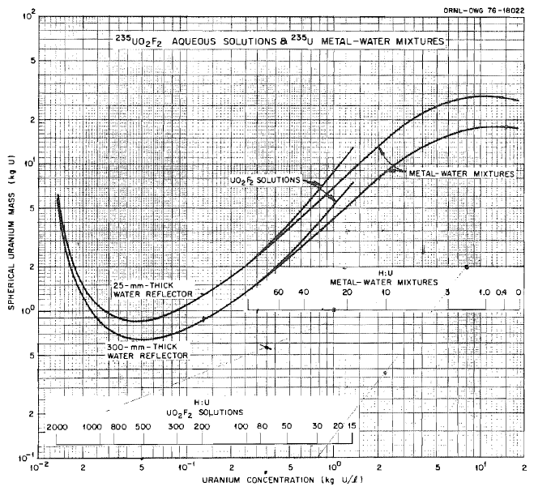
Reflection – Reflection Versus Moderation
What is the difference?
Reflection changes critical mass by ~2x
Moderation by ~an order of magnitude
~2x change (reflection)
~20-30x change (moderation)
TID-7016

Slide 32
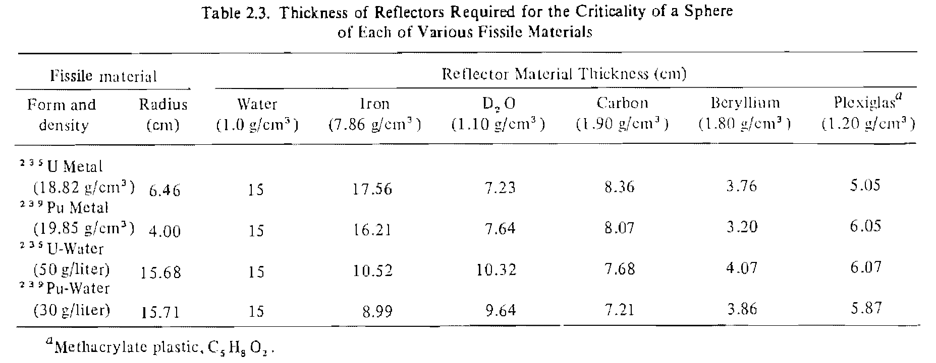
Reflection – Effectiveness of Various Reflectors
TID-7016

Slide 33
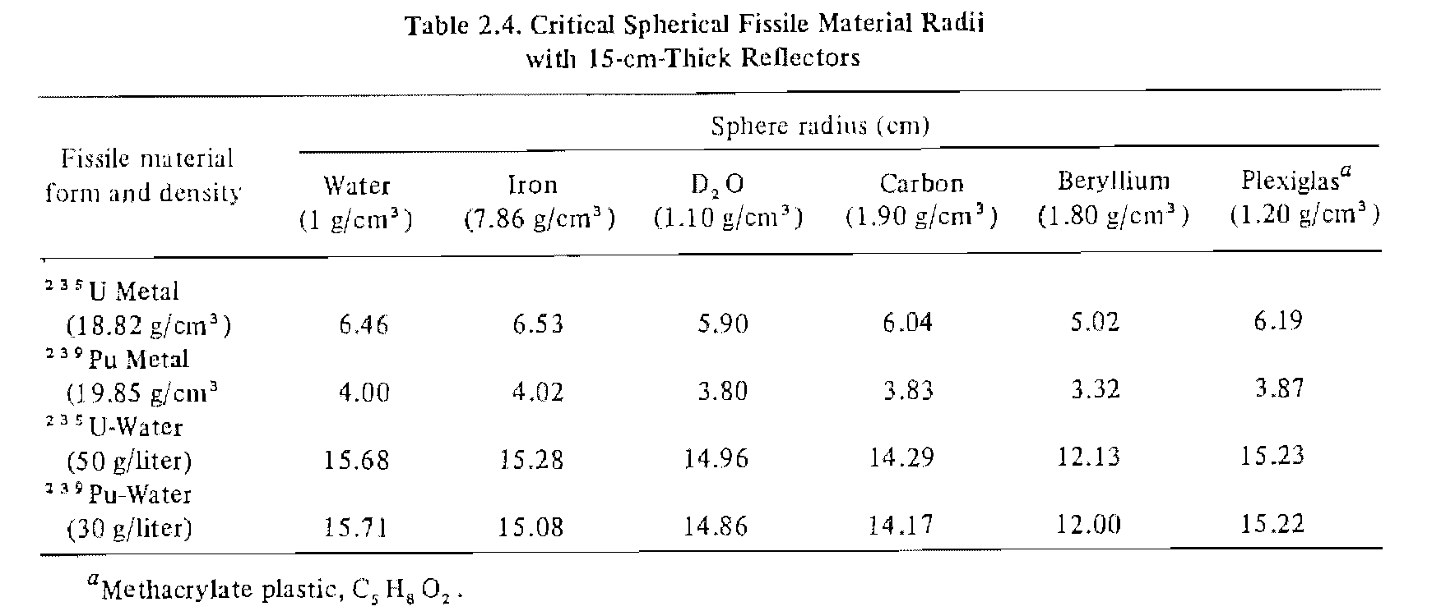
Reflection – Effectiveness of Various Reflectors
TID-7016

Slide 34
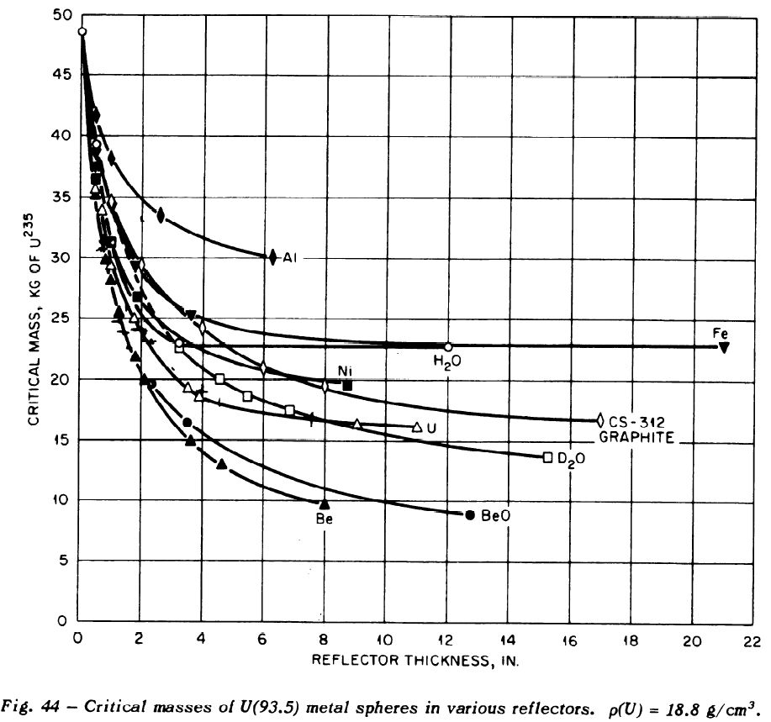
Reflection – Effectiveness of Various Reflectors
TID-7028

Slide 35
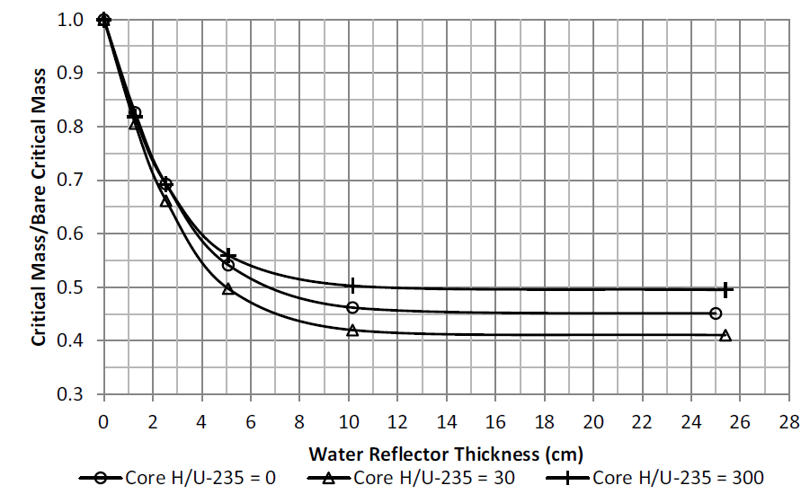
Reflection – Effectively Infinite (Full) Reflection
What is it? – Effectively infinite or full reflection is where the addition of more reflecting material causes a negligible change in reactivity
Negligible change past this point (15cm ~= 6inch), 12 inches is often considered “full” water reflection
LA-3612

Slide 36
Volume – Fissile Volume
What is it? – The physical volume fissile material can occupy
How does it work? – Larger containers can hold more fissile material (related to geometry)
How does it effect reactivity? – Larger volumes typically have potential to be more reactive
How often is this used as a controlled parameter? – Volume is often controlled along with mass and geometry

Slide 37
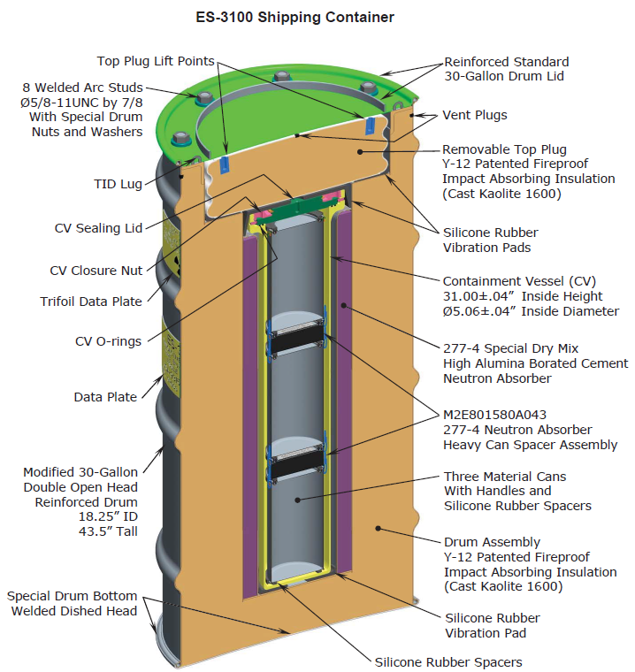
Example of Everything Together

Slide 38
Questions

Slide 39
DISCLAIMER
This work of authorship and those incorporated herein were prepared by Consolidated Nuclear Security, LLC (CNS) as accounts of work sponsored by an agency of the United States Government under Contract DE‑NA‑0001942. Neither the United States Government nor any agency thereof, nor CNS, nor any of their employees, makes any warranty, express or implied, or assumes any legal liability or responsibility to any non-governmental recipient hereof for the accuracy, completeness, use made, or usefulness of any information, apparatus, product, or process disclosed, or represents that its use would not infringe privately owned rights. Reference herein to any specific commercial product, process, or service by trade name, trademark, manufacturer, or otherwise, does not necessarily constitute or imply its endorsement, recommendation, or favoring by the United States Government or any agency or contractor thereof, or by CNS. The views and opinions of authors expressed herein do not necessarily state or reflect those of the United States Government or any agency or contractor (other than the authors) thereof.
Copyright Notice
This document has been authored by Consolidated Nuclear Security, LLC, a contractor of the U.S. Government under contract DE‑NA0001942, or a subcontractor thereof. Accordingly, the U.S. Government retains a paid‑up, nonexclusive, irrevocable, worldwide license to publish or reproduce the published form of this contribution, prepare derivative works, distribute copies to the public, and perform publicly and display publicly, or allow others to do so, for U. S. Government purposes.

