Slide 1
Lesson 9: Structure of an NCSE

Slide 2
Outline
Structure of an NCSE
Example DOC in Public area

Slide 3
Structure of an NCSE

Slide 4
Outline of Typical CSE
Introduction
Description of process
Computational methodology
Discussion of contingencies
Evaluation and results
Design features and administrative controls
Summary & conclusions
Appendices

Slide 5
Discussion of contingencies
Discuss how contingencies were identified (copy the first two paragraphs)
Contingency Table 5.1 including controls (it had better agree with your discussion!)
I will look for the BIG THREE even if the example CSE did not have all of them!
Parametric review: Step-by-step sweep through MAGICMERV, either listing contingencies or saying why the parameter was N/A and/or saying what was assumed for it.

Slide 6
Discussion of contingencies (2)
There is one subsection per MAGICMERV parameter
All contingencies in the category should be listed and described
Each should include a statement of why it is unlikely
Student was counted off for saying UNUSED parameters were “not considered as a contingency” rather than “not controlled”
HINT: If a parameter has something in the Control column, a failure of the control us USUALLY a contingency

Slide 7
Outline of Typical CSE
Introduction
Description of process
Computational methodology
Discussion of contingencies
Evaluation and results
Design features and administrative controls
Summary & conclusions
Appendices

Slide 8
Evaluation and results
Materials discussion, including assumptions (point to Appendix A)
Normal Model development
Normal & accident
Simplified through the use of parametric studies
Contingency case models as variation on normal model

Slide 9
Evaluation and results (2)
JUST DO IT: Calculate the normal case and each of the contingencies you have identified
But, you CAN save effort by combining multiple contingencies into one calculation, if you want.
Table of results that stands alone
Like Tables in Section 6.4 of ExampleCSE
Enough columns to differentiate cases (repeat columns from contingency table, if desired)
Keff column, sigma column, AND Keff+2sigma column
Mark the limiting case with BOLD or larger font (or both)
Discuss results in text

Slide 10
Table x. Calculational Results
Case | Description column(s) | keff | σ | k-eff+2σ
10

Slide 11
Outline of Typical CSE
Introduction
Description of process
Computational methodology
Discussion of contingencies
Evaluation and results
Design features and administrative controls
Summary & conclusions
Appendices

Slide 12
Design features and administrative controls
Description of:
Engineered safety features
Posted controls
Most important and most often referred to
Very controlled format
Control 7.x.x: Actual posting wording
Basis: Follow the example, pointing back to the analysis to say why your analysis requires it. (NOT why violating it is bad)
It is helpful to think of the Basis as being a note to future NCS engineers about why you thought this was necessary.

Slide 13
WHAT you control
Limits are set so that criticality cannot occur when operators comply with the limits
Examples
Mass limit is MAX 350 g ²³⁵U per canister (i.e., maximum mass)
Concentration limit is MAX 1 g ²³⁵U/liter (i.e., maximum concentration)
Moderation limit is MAX H/U = 4 (i.e., maximum moderation)
Volume limit is MAX 4 liters (i.e., maximum volume)
Container limit is MAX 4 containers (i.e., maximum number of containers)
Spacing limit is MIN 2 feet (i.e., minimum spacing)
Stacking limit is MAX 4 high (i.e., maximum number of items in a stack)

Slide 14
HOW you control
The example did NOT use Engineered safety features, although I like to see them!
Remember our preference
Passive control: railroad bridge over highway
Active control: lights and gate at railroad crossing
Administrative: stop sign at railroad crossing
NOTE: The first two are rolled together into “Engineered Safety Features” in our Example CSE.

Slide 15
Control Selection
Passive engineered control examples
Mass: container design (i.e., limit container size)
Absorption: solid poisons (Raschig rings, boron-Al plates
Geometry: container design (slab tanks, pencil tanks, bottle diameter)
Interaction: spacers (storage racks, bird cages, carts)
Moderation: sealed containers or systems (covers on storage racks to exclude sprinkler water)
Reflection: spacers (storage racks, bird cages)
Volume: container design

Slide 16
Writing Controls
Clear
Concise
Unambiguous
Doable
Simple and easy to perform
Directly controllable by operator
Language that an operator will understand
Relates to upset/change that needs to be prevented

Slide 17
Design features and administrative controls (2)
In addition, Appendix C contains PowerPoint slide examples of the Postings themselves

Slide 18
Outline of Typical CSE
Introduction
Description of process
Computational methodology
Discussion of contingencies
Evaluation and results
Postings & controls
Summary & conclusions
Appendices

Slide 19
Summary & conclusions
Summary
Conclusions

Slide 20
Appendices: Follow examples
A. Materials and compositions
B. Input and output listings: Use COURIER NEW font for listings
C. Postings: WYSIWYG using colors
D. Comment review sheets (Deleted - no longer required)
E. Validation check sheets (Deleted - no longer required)
F. IDC Listing (Deleted - no longer required)
G. Validation report: Which we covered last time
H. Parametric studies: See following slides
20

Slide 21
Appendix C: Postings
Immediate information that the operator would NOT be expected to remember from training
Very controlled format in Sect. 7
Control
Basis: Tied directly to Section 5 (Do not add or subtract)
Similarly controlled format in the posting itself:
Important words CAPITALIZED and possibly in a stand-out color
Few articles (a, an, the)
No convoluted IF/THEN syntax

Slide 22
Appendix C: Postings (Example)
Nuclear Criticality Safety Limits and Controls
NO MORE than 4300 kg Plutonium per 8-liter container.
•NO MORE than ONE operator may carry ONE 8-liter container at a time to the drum loading area.

Slide 23
App. G: Validation
We discussed the technical aspects last week, so just be sure to document it according to the ExampleCSE
Include:
Table of cases used
Discussion of USL formula, values used, and final determination of USL
Questions asked and answered to support MSM
Complete table (using the format from Test#2, NOT from ExampleCSE
23

Slide 24
App. H: Parametric Studies
Stand alone pre-analysis studies in order to refine the normal case (What is normal?)
Ideal: Perturbations on limiting case
At minimum:
PS#1 = Worst case of concrete
Follow format of ExampleCSE
24

Slide 25
Parametric studies
Arise out of modeling questions
Most reactive material makeup
Most reactive reflection
Most reactive placement of fissile (primary)
Most reactive arrangement of other material (including other fissile elements)
Acceptability of modeling simplification (e.g., leaving out walls, ceilings, etc.)
Sometimes order matters—you want to clear up the most “independent” modeling questions first to use in the others
25

Slide 26
Final Reports

Slide 27
What I will look for in your reports
Report clearly written, all elements of each part of report there
Pictures
Normal and contingency analysis complete and clear
“Controls” in Sect. 5 table justify “contingency” (i.e., unlikely) status
Sect 7 controls are covered in Sect 5 table
Conversely, all controls from table that need to be listed in Sect 7 are
Engineering safety features relied on are in Sect 5 table AND Sect 7 list
Example postings are in App C and agree with Sect 7
Controls are justified (BASIS) in Sect 7
Validation appendix complete, clear, and approval has been given (e-mail)
Parametric studies appendix complete (i.e., if mentioned in Sect 6, show up in App. H and vice versa)

Slide 28
What I will look for (cont’d)
Normal and contingencies from table are actually calculated
SCALE input corresponds with cases quoted
Calculations could be reproduced from data given (NOT including the input deck—the next person to calculate might not be able to “read” SCALE)
Results make sense
App A and B complete

Slide 29
Final report requirements
The Final Report MUST be e-mailed to me by the due date/time:
Stand alone—no cutting and pasting required by the professor!
=ONE WORD document

Slide 30
I.Z.26. University of Alabama, 19 October 2019
Marsha Goodstudent

Slide 31
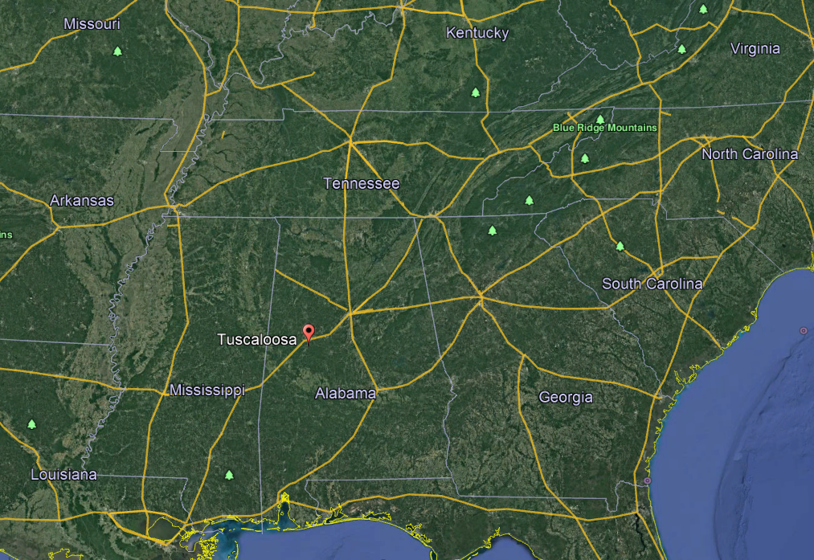
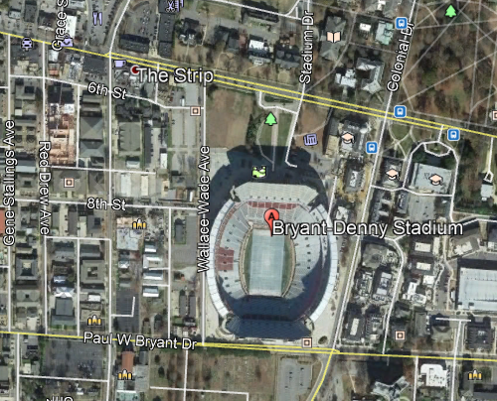
Geographic Location

Slide 32
Geometry of the Process Area
Under the football stadium
Filtrate Receiving Vessel: Chamber of Dirt Devil, nominally 2 quarts

Slide 33
Important Equipment
Item 1
Item 2
Item 3
Item 4
Glovebox
No temperature monitoring device (temp was controlled by feeling the container)
No on-line instrumentation for measuring process parameters such as uranium concentration (the operators just guessed)

Slide 34
Normal Steps of the Process
The main feed material, impure uranyl nitrate, was generated in the Field House next door
This, along with was introduced into the precipitation vessel using small buckets. Which was stirred by hand.
The precipitate slurry was then vacuum into a holding tank using a Dirt Devil
The precipitate was collected on the filter fabric (old football jerseys) and the filtrate was saved in the Dirt Devil chamber.

Slide 35
Changes to the Normal Geometry and Process
The operators were in a hurry to get to the game.
No jerseys were available (since it was game day, duh)
Therefore all of the fissile material went into the vacuum cleaner
The Dirt Devil had been taken for use in the game, so an old Hoover was used, which had a larger collection chamber

Slide 36
How the Accident Progressed
Occurred during vacuum (non)-filtration.
Hoover chamber glowed blue, followed by violent release of gas and ejection of some of the precipitate onto the glove box floor.
Operator ran out of the room screaming.
Release of gas or vapor continued for three hours (until the game was over and someone realized that the operator was not screaming because Alabama was losing to the Vols).

Slide 37
Emergency Response
Criticality alarm went unnoticed because of crowd noise.
Operators had no criticality safety training, since no viable Engineering College on campus.
Criticality accident determined to have occurred by a UTNE nuclear engineering student who happened to be passing by.
Measurements indicated intense gamma radiation field 20 minutes after this occurred.
Prompt evacuation of the area. (Most of the crowd had left early anyway.)

Slide 38
Outcome and Consequences
Operator received dose of about xxx rad. He was treated…..
5 other operators in the room at varying distances from the reacting vessel. Received dose of approximately xxx rad.
Equipment cleaned and put back into use with addition of a radiation meter.

Slide 39
Lessons Learned
Operating instructions were revised.
Enhanced operator training was implemented.
Lead to the decision to set up an implant critical experiment measurement capability to better determine critical parameters for vessels in routine use.

