Slide 1
Lesson 8: Critical experiments and Validation

Slide 2
Critical Experiments

Slide 3
Discussion of Experiments
Critical “Benchmarks”: Tie codes to reality
Static criticality experiments
Direct application - Requires good fit to your situation
Criticality curves - Typical configurations and materials
Validation of computer codes: Finding area of applicability
Interpolation
“Bracketing”
Dynamic criticality experiments
Fission yields
What stops the accident?
Temperature (metals)
Boiling
Material ejection
Human reaction (very slow)

Slide 4
Important Considerations for Benchmarks
Well defined compositions
Precise dimensions
Regular geometries (for modeling)
Requires some isolation from “rest of the world” = piping, tables, floors, etc.

Slide 5
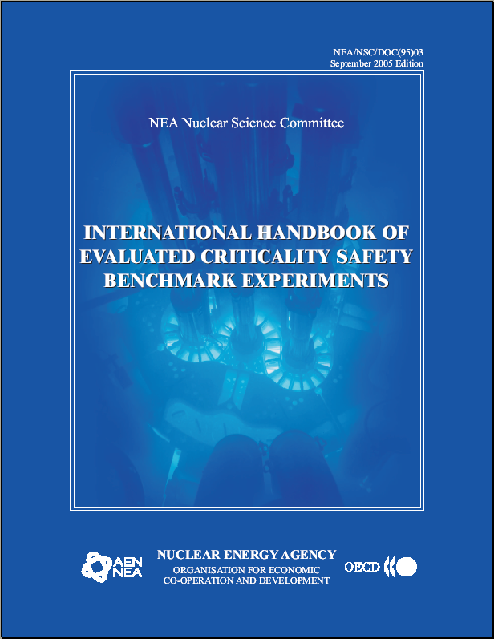
IHECSBE: “Benchmark book”
Overview of
International
Handbook of
Evaluated
Criticality
Safety
Benchmark
Experiments

Slide 6
What?
Collection of EVALUATED benchmark critical, subcritical, and (some) alarm placement experiments
Someone did and published the experiment (You hope!)
Someone else (you?) writes it up and submits to the Benchmark Book
Reviewed
Included in next revision of BB
Suitable for reproduction to validate computer code
All sorts of fissile materials, absorbers, geometries, interactions, etc.

Slide 7
Who?
Sponsored by OECD-NEA
Put together by Dr. Blair Briggs of INEL
Hundreds of participants world-wide from multiple countries

Slide 8
Why?
The purposes of the International Criticality Safety Benchmark Evaluation Project (ICSBEP) Working Group are:
Identify and evaluate a comprehensive set of benchmark critical and subcritical experiment data;
Verify the data, to the extent possible, by reviewing original and subsequently revised documentation and by talking with experimenters or individuals who were associated with the experiments or the experimental facility;
Evaluate the data and quantify overall uncertainties through various types of sensitivity analyses;
Compile the data into a standardized format;
Perform sample calculations of each experiment with standardized criticality safety neutronics codes; and
Formally document the work into a single source of verified and extensively peer reviewed benchmark critical data.

Slide 9
Get it on your computer
Not a controlled document
Can be freely distributed
415 experiments x Many variations
I recommend that you Google it and sign up (not required for this course, but it doesn’t matter to them)

Slide 10
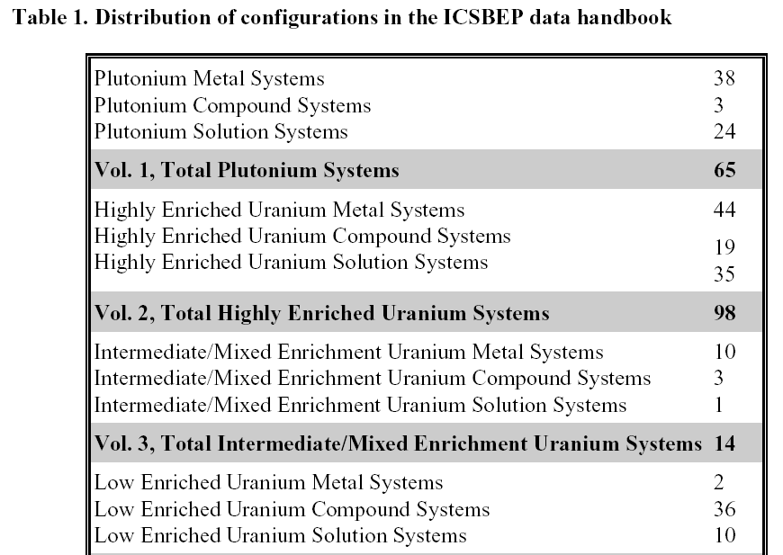
Benchmark book sections
From “Study and Perspectives of the OECD/NEA Working Party on Nuclear Criticality Safety Projects,” M.C. Brady-Rapp, et al., 1999.

Slide 11
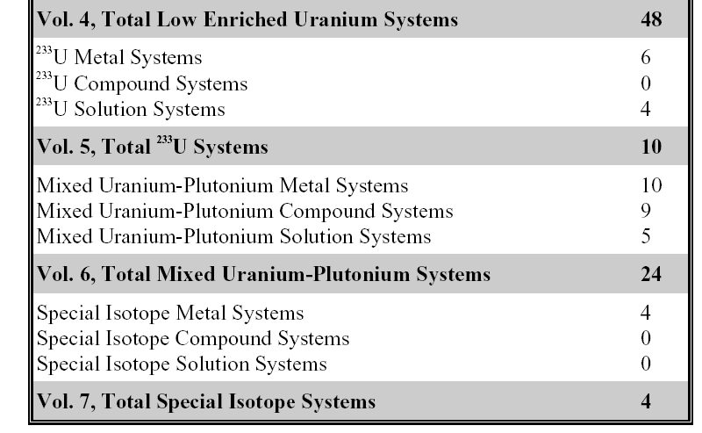
Benchmark book sections (2)
From “Study and Perspectives of the OECD/NEA Working Party on Nuclear Criticality Safety Projects,” M.C. Brady-Rapp, et al., 1999.

Slide 12
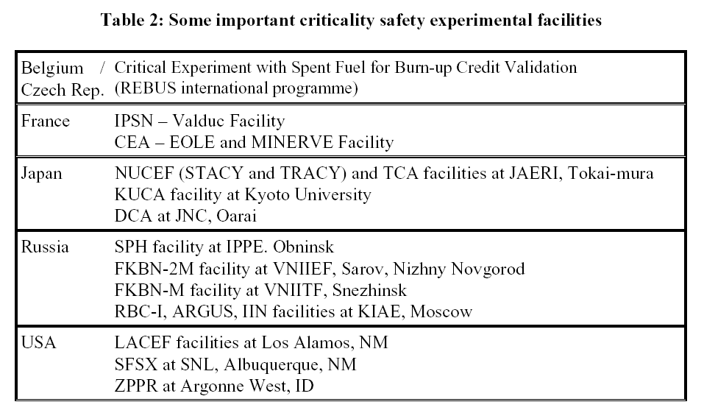
Overview of Experimental Facilities in the World
From “Study and Perspectives of the OECD/NEA Working Party on Nuclear Criticality Safety Projects,” M.C. Brady-Rapp, et al., 1999.

Slide 13
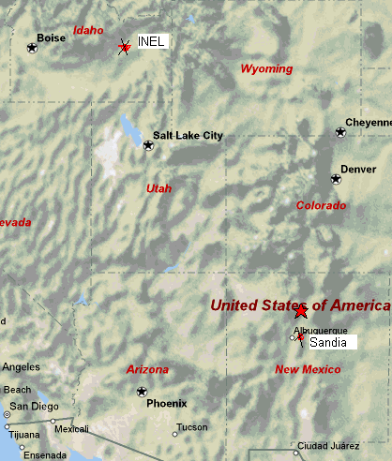
USA: LACEF at Los Alamos
Los Alamos Critical Experiments Facility
“Pajarito site” or “TA-18”
Most of the experiments
have been shut down

Slide 14
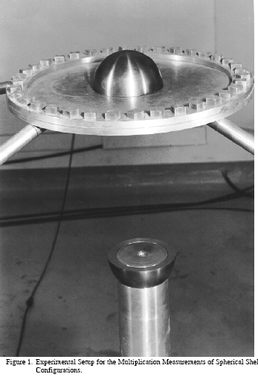
LANL: Godiva
94% enriched Uranium
r=8.7407
rho=18.74 g/cc

Slide 15
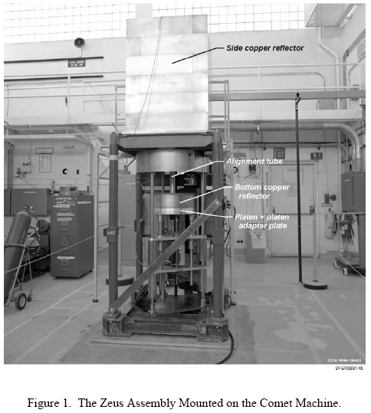
LANL: COMET
Vertical assembly
machine
Shown here with the
ZEUS assembly (2002)

Slide 16
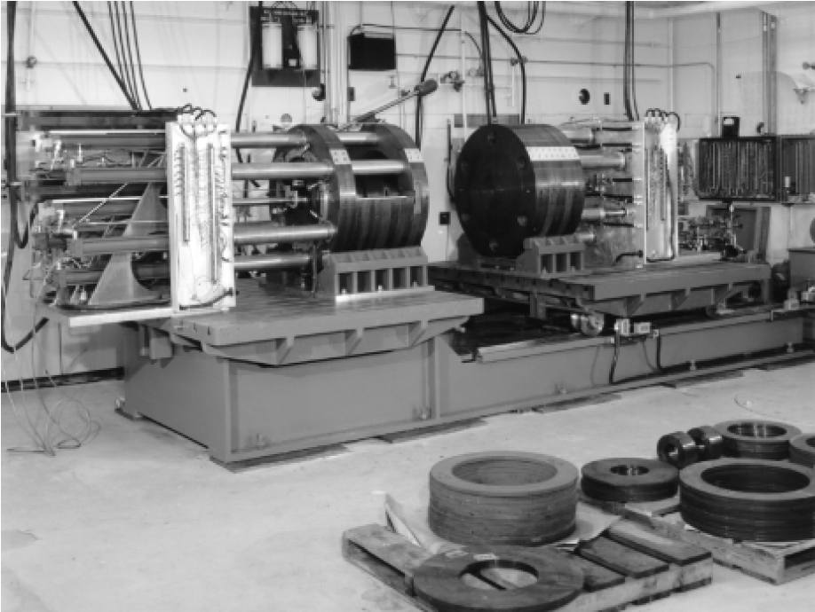
LANL: Big Ten
Cylindrical core of metal fuel
10 tons of uranium at
10% enrichment
Reflected by
natural
uranium

Slide 17
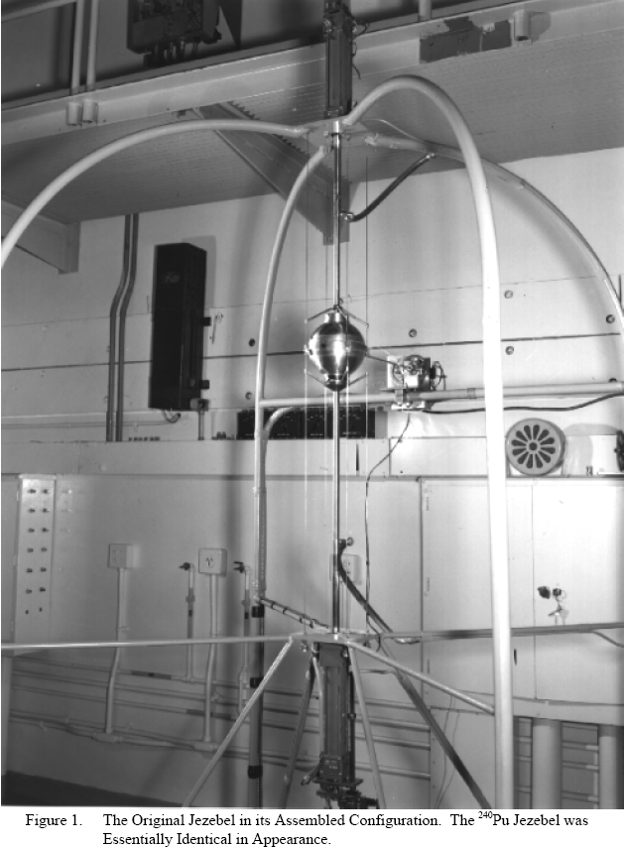
LANL: Jezebel
3 in series of bare spheres
Pu-239 Jezebel
2.45% Pu-240
Pu-240 Jezebel
20.1% Pu-240
U-233 Jezebel

Slide 18
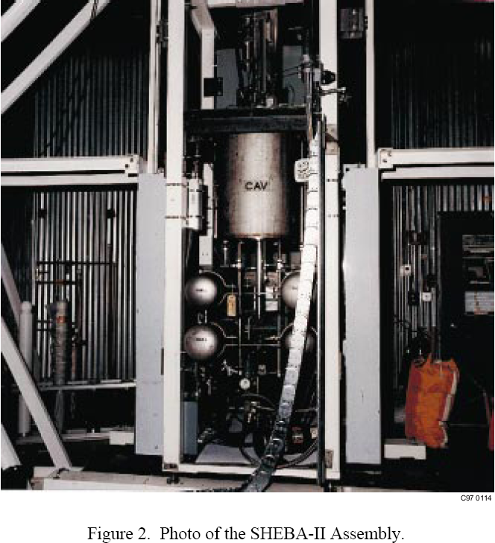
LANL: SHEBA
“Solution High-Energy Burst Assembly”
Critical assembly of 5%
enriched uranyl fluoride
Solution normally
stored in 4 tanks
under the assembly

Slide 19
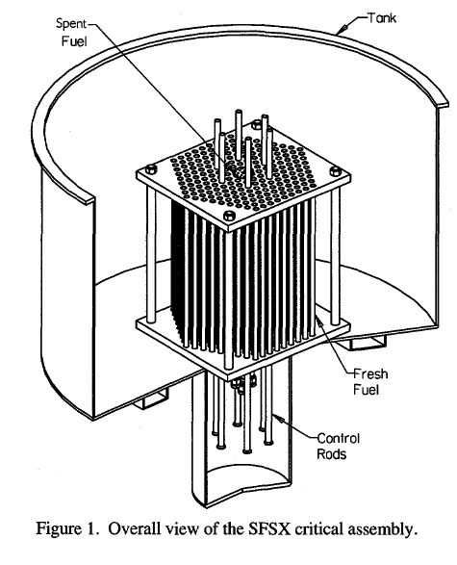
USA: SFSX at Sandia
Spent Fuel Safety Experiment
Burnup effect on k-eff and
axial burnup profiles
Burned 3% fuel from
Calvert Cliffs + fresh 4.31%
BUCCX (burnup credit critical
experiment) in 2002

Slide 20
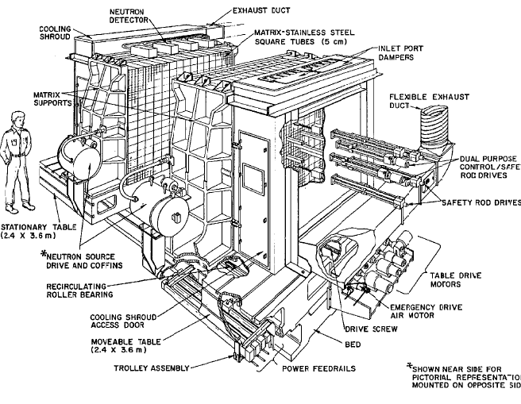
USA: ZPPR at Argonne West
Zero Power Physics Reactor
“Split-table” type reactor
Fuel put in “drawers”
of arrays that were
then moved together
Shut down in 1990

Slide 21
Validation

Slide 22
V&V
Motivation: IF you use a calculational method to answer the question “Is it safe?”
THEN
You must verify and validate the method.

Slide 23
Verification: Compare vs Theory
Motivation: If computer program used, make sure the program is working as intended
Get same answer as test problems provided by developer
Comparison to previous version of code (if you have one)
Repeat after “any changes to the computer program”

Slide 24
Validation: Definition
Indication of reliability of calculation vs. reality
How far do we trust the calculational method and under what conditions?
vs. Verification = Indication of reliability that the mathematical operations are being performed as expected
Use sample problems from vendor

Slide 25
Validation: Def. (cont’d)
Applies to code AND data
WRONG: “We validated KENO-Va.”
RIGHT: “We validated KENO-Va using the standard 238 group library.”
Bottom line: “Conditions predicted to be subcritical would be expected to be subcritical.”
NOT vice versa.
Not accuracy, but reliability (conservatism) in a particular direction.

Slide 26
Validation: Compare vs. Reality
Steps:
Establish bias by correlating the results of using the method on “critical or exponential” experiments
Usually this is the deviation of k-eff from unity
Establish bias uncertainty due to:
Uncertainties in experimental conditions
Lack of accuracy and precision in method
Some multiple (e.g., 3) times the bias standard deviation
Add additional margin sufficiently large to ensure subcriticality (Minimum Subcritical Margin, MSM)
Can use trends (we usually don’t)

Slide 27
Example: Linear regression

Slide 28
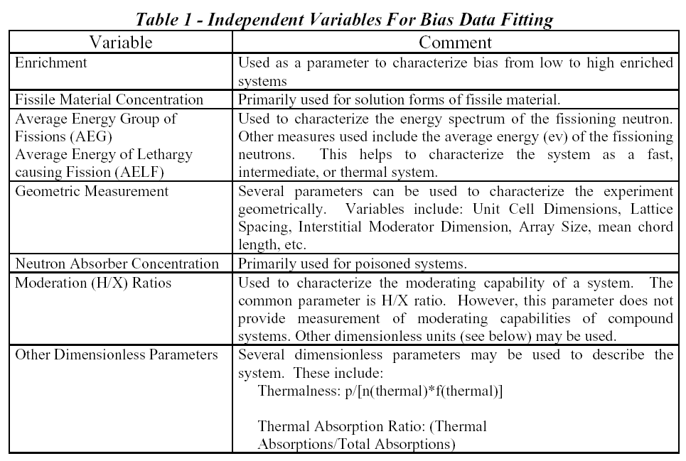
Picking variables for regression

Slide 29
Other terms of interest
Upper subcritical limit (“k-safe”) = highest value of calculated k-eff + 2σ that is considered subcritical in evaluation.
U.S.L. = 1 + bias - bias uncertainty - MSM
Bias = systematic disagreement between calculated and experimental data.
Single sided lower tolerance limit
Single sided lower tolerance band
Calculated as the average calculated k-effective

Slide 30
Other terms (cont’d)
Bias uncertainty: Measure of precision of calculation and accuracy of experiment
Uncertainty in experiment
Lack of precision in calculational method
(Extension to conditions out range of experiments)
Calculated as
1. Some multiple (usually 3) of the standard deviation of the population of calculated k-effectives (i.e., consider the k-effs as a series of estimates and calculate the SD: NOT the SD of the calculations) (Statistical approach)
2. A value that is below the lowest calculated k-effective for any benchmark (Non-statistical approach)
NOTE: Both the bias and bias uncertainty can vary with a parameter (usually enrichment)

Slide 31
Other terms (cont’d)
Minimum Subcritical Margin (MSM) = Extra safety margin applied to U.S.L.
Does a thorough validation exist?
Have independent experimenters been used?
How do conditions compare to AOA?
Is the system/process simple or complex?
Does fissile material maintain its shape?
Are the physics/chemistry well understood?
How sensitive is reactivity to changes?
Usually some minimum (e.g., 3%)

Slide 32
AOA
Area of applicability (AOA) = Range covered by experiments in “variable space”
Traditional procedure:
1. Decide on the important nuclides in the problem based on
Fissile material
Enrichment (% range)
Absorbers
Moderation (H:X range)
Moderating material
Reflection material
2. Find benchmark problems that contain these nuclides—preferably several of each to BOUND the concentration that the application has
3. Pay particular attention to spectrum based on:
H/U ratio (or its equivalent for moderation and fissile material in the problem
EALF=“energy of the average lethargy of fission”
4. Take a USL “penalty” (added to the MSM) if outside AOA

Slide 33
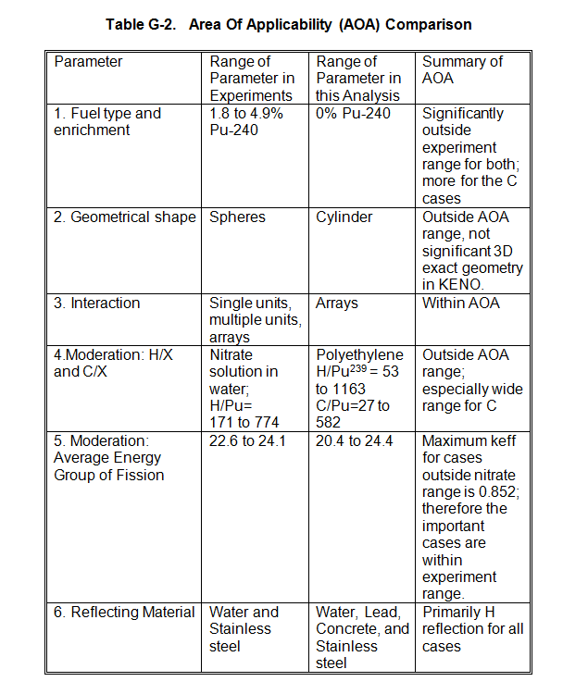
AOA

Slide 34
What sigma to use in calculations…
Generally use:
3 sigma associated with the experiments to get the bias uncertaintly
2 sigma added to calculated k-effective to compare to k-safe
Question:
What calculational sigma should we use?
One of those cases where we KNOW the extremes (0 and infinity) are not optimum.
What is optimum?
Usual answer: “As much as we can afford.”

Slide 35
What sigma to use in calculations…

Slide 36
Validation report
Describe method used in enough detail to allow duplication of results
Computer code (with version)
Cross section library
Resonance processing used (NITAWL or CENTRM)
Identify experimental data and list parameters used
List of experiment numbers with k_{exp}, k_{calc},
State the Area of Applicability
Range covered by experiments in “variable space”
We use a table. See Appendix G in example NCSE
State the bias, bias uncertainty, and MSM used—and the resulting USL

Slide 37
What you have to do
Pick the most applicable experiments (20-40) that best cover your analysis
Materials:
Fissile material (every experiment)
Moderating material
Reflecting material
Other important nuclides (e.g., absorbers)
Enrichment range
Moderation
EALF range
H/X range
# of units
If you fail in any of these, add to your MSM

Slide 38
What you have to do (cont’d)
Find bias = average of experimental k_{calc}-k_{exp} values
Find bias uncertainty = 3 x σ_{bias}
Establish your MSM
Minimum of 0.03
See next slide for questions to consider (and document the answers to in App. G)
Determine USL from formula
Subcritical is now DEFINED as the condition that k_{calc}+2σ_{calc} < USL
Both k_{calc} and σ_{calc} given near bottom of SCALE output file

Slide 39
Sample problem
Using an MSM of 3% and a 3σ bias uncertainty, determine an USL for the following calculated k-effectives:
1.01 0.98 0.995 1.005 1.000
Average = 0.998 = (sum of values/5)
Bias = -0.002 = average - 1 (or 0 if positive)
Variance = 0.000133
= Average of error-squared*N/(N-1)
Sigma = 0.0115 = Square root of variance
Resulting USL = 0.933 = 1 + bias – 3σ – MSM

Slide 40
Example
Using Valid2019.xlsx from the public area

