Slide 1
Lesson 2: MAGICMERV
Left over slides
  Four factor formula
MAGICMERV

Slide 2
Think like a neutron
What separates good NCS engineers from great NCS engineers is to see a situation
  Understand the process being evaluated [multi-disciplinary]
  Understand the risks by understanding how neutrons behave [Feynmann K-25]
  This gives you credibility because you can explain why different rules are in place without having to look them up [crit vs fire as you get close]
  NOT having to say: “Wait, let me calculate that” [8.26 hands-on course]

Slide 3
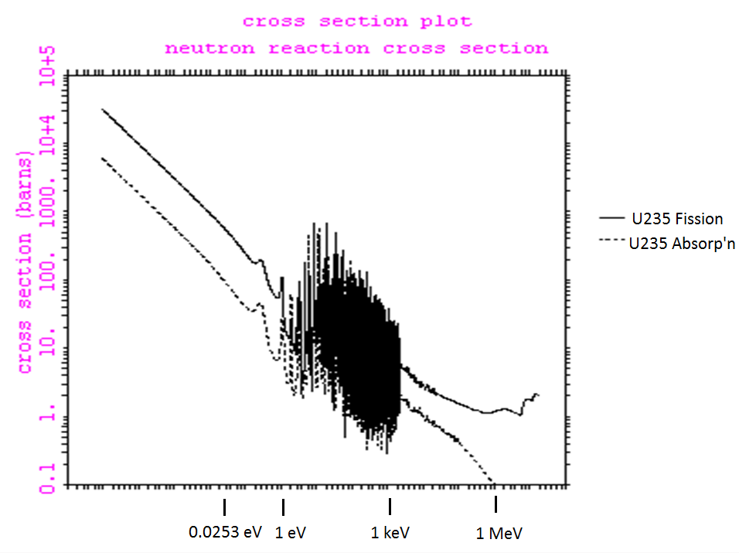

Slide 4
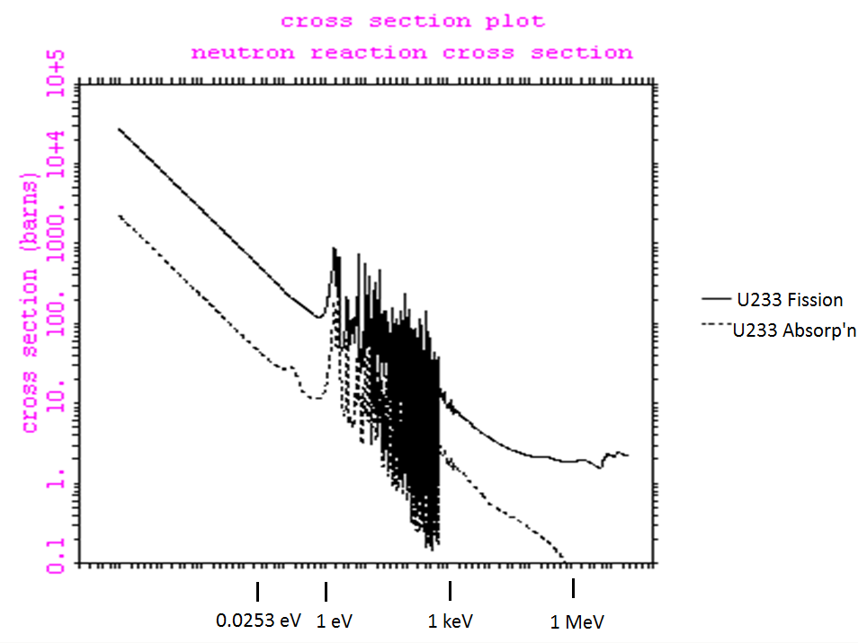

Slide 5
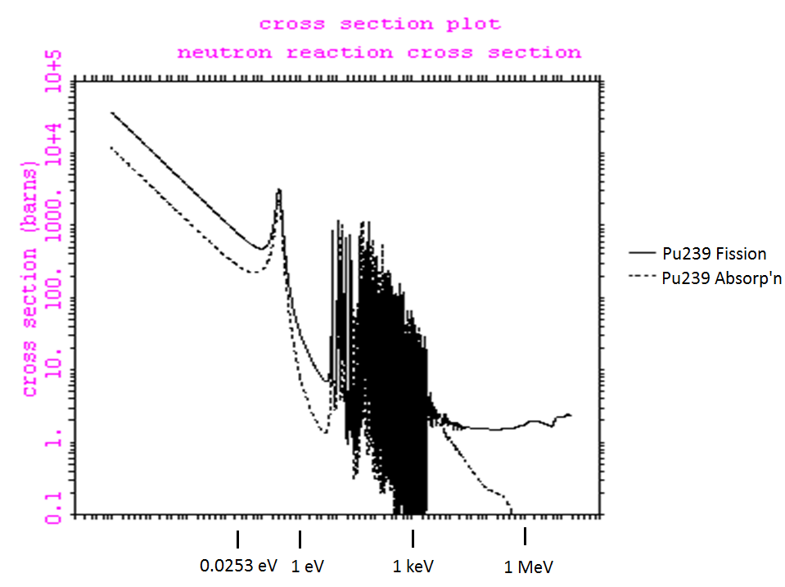

Slide 6
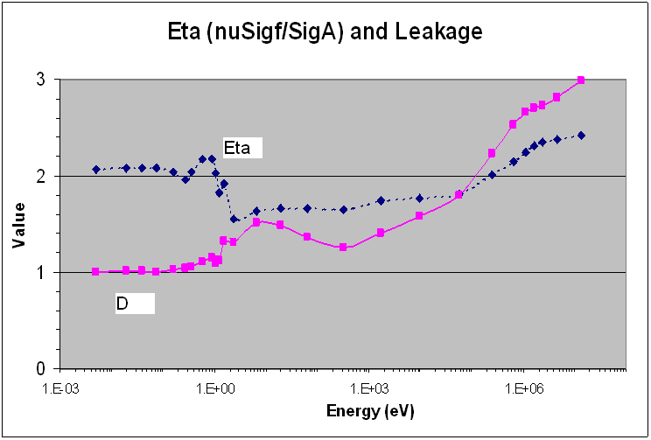
U-235 Sphere

Slide 7
K-effective: Take 1
Generational
What is a generation?
Most unsophisticated
Surprisingly, this is the one that KENO uses!

Slide 8
K-effective: Take 2
Four factor formula (yeah, I know it has five!):
Fermi’s invention: One of the most amazing analysis tools ever
  He knew how to put together experiments to determine each of them
  When the multiplied to give >1, he knew it was physically possible!

Slide 9
K-effective: Take 3
Balance: Neutron PRODUCTION from fission exactly balances neutron LOSS from absorption and leakage
Most useful for us because it ties to the MAGICMERV parameters

Slide 10
K-effective: Take 4
Eigenvalue
The eigenvalue λ is k-effective
Its represents how much ν would have to decrease to make the equation balance

Slide 11
Criticality: Neutron balance (2)
Our focus is a little different from reactor physics because we are much more influenced by LEAKAGE
In this regard, we are much closer to Fermi, et al., because of the UNIQUENESS of our situations and our strong dependence on SIZE and SHAPE of the system being considered

Slide 12
Parametric overview: MAGICMERV

Slide 13
MAGICMERV
Simple checklist of conditions that MIGHT result in an increase in k-eff.
  Mass
  Absorber loss
  Geometry
  Interaction
  Concentration
  Moderation
  Enrichment
  Reflection
  Volume
13

Slide 14
Parameter #1: Mass
Mass: Mass of fissile material in unit
  More is worse -- higher k-eff (usually).
  Possible maximization problem. (Example?)
  Should allow for measurement uncertainties (e.g., add 10% for assay accuracy)
  Parametric studies?
14

Slide 15
Figure 7: Effects of Mass on a Fission Chain Reaction

Slide 16
Parameter #2: Loss of absorbers
Loss of absorbers: Losing materials specifically depended on for crit. control
  More (loss) is worse
  Not usually a problem because not usually used
  We specifically avoid this situation by removing all absorbers we can identify (e.g., can walls, boron in glass)
  BE CAREFUL: Fruitful area for contention
  Parametric studies?
16

Slide 17
Parameter #3: Geometry
Geometric shape of fissile material
  Worst single unit shape is a sphere: Lowest leakage
  Worst single unit cylindrical H/D ratio ~ 1.00
    0.94 in a buckling homework problem
  Do not depend on either of these in situations with multiple units
  Parametric studies?
17

Slide 18
Figure 9: Typical Containers

Slide 19
Figure 10: Favorable vs. Unfavorable Geometry

Slide 20
Parameter #4: Interaction
Interaction: Presence of other fissile materials
  More is usually worse. (Counterexample?)
  Typical LATTICE study:
    Number
    Arrangement
    Stacking
  Other processes (e.g., material movement) in same room
  Hold-up
  Parametric studies?
20

Slide 21
Figure 11: Neutron Interaction

Slide 22
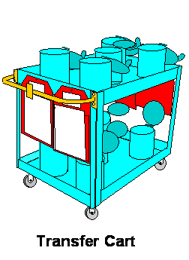
Figure 12: Example of Physical Controls on Interaction

Slide 23
Parameters #5: Concentration
Concentration
  Solution concentration
  Considered in addition to mass, volume, moderation because of CONTROL possibilities
  No new physics here
23

Slide 24
Parameter #6: Moderation
Moderation: Non-fissile material that is intermingled with fissile material
  Slows down the neutrons [elastic on board]
  Affects absorption (up) and leakage (down)
  More is usually worse.
  Simultaneously a reflector
  Usual cases:
    Other material in vicinity of unit (structure, equip’t)
    Water from sprinklers
    Operator body parts
  Parametric studies?
24

Slide 25
Figure 14: Energy Losses in
Neutron Collisions

Slide 26
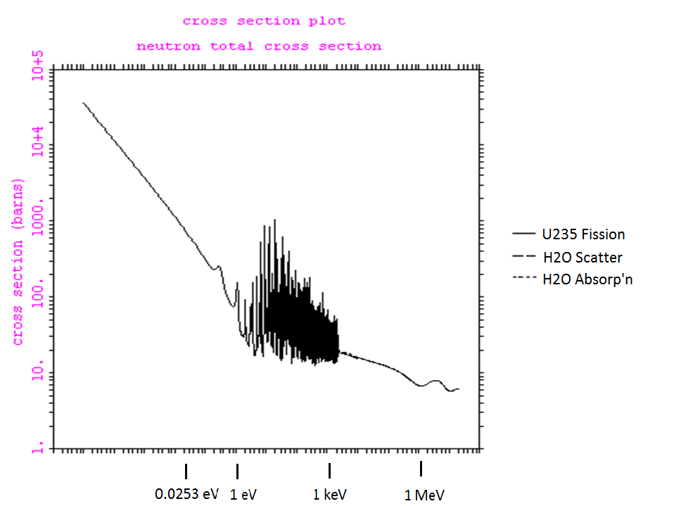
U-235 Cross sections

Slide 27
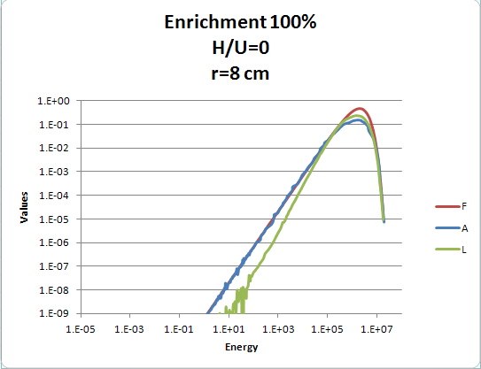
100% enriched, H/U=0

Slide 28
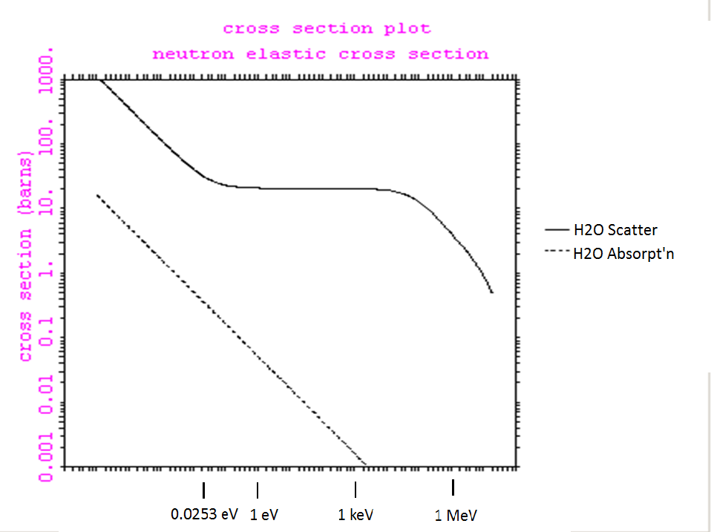

Slide 29
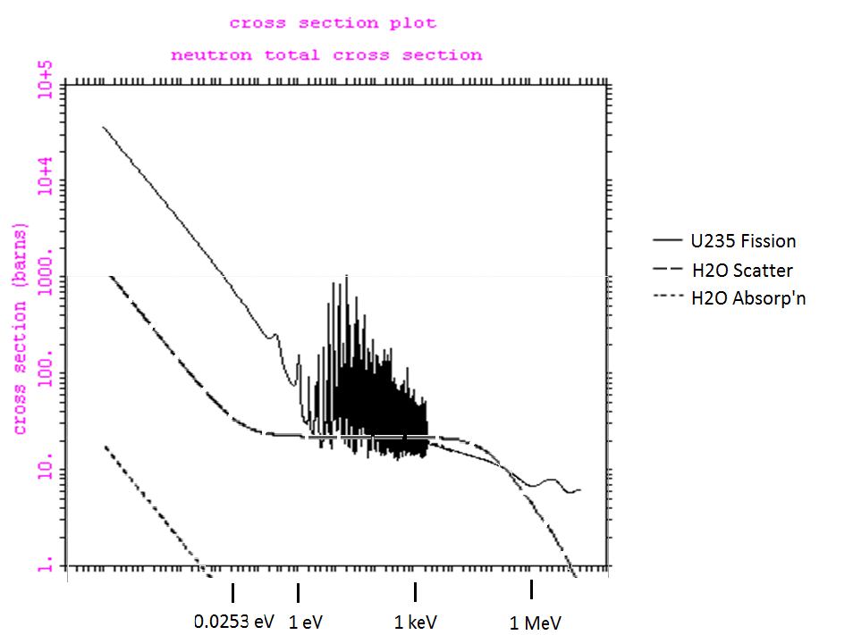
U-235 Cross sections

Slide 30
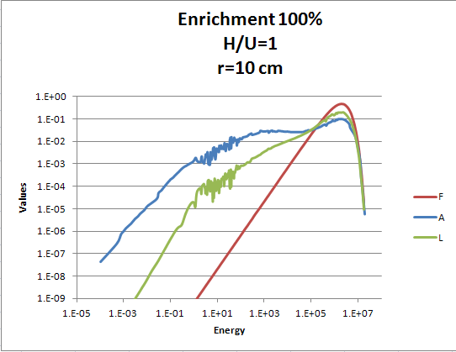
100% enriched, H/U=1

Slide 31
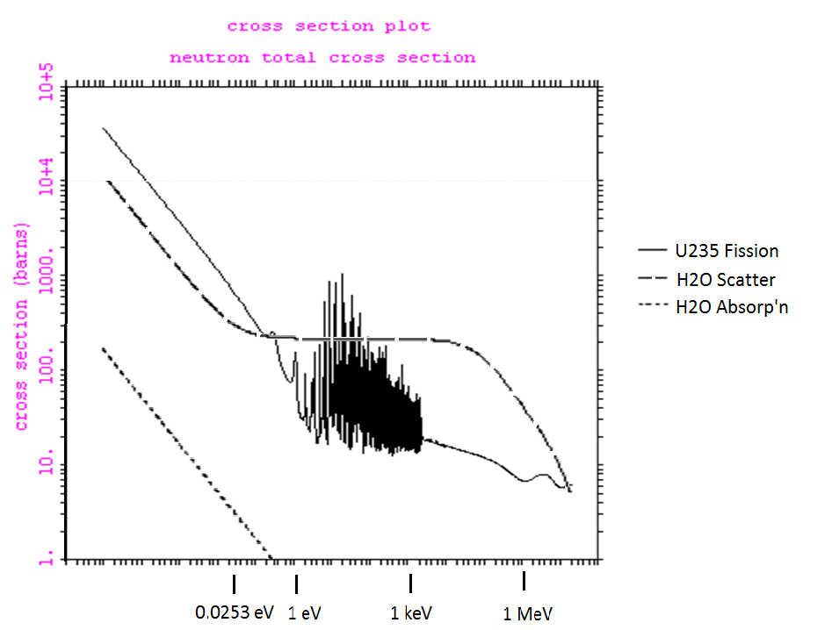
U-235 Cross sections

Slide 32
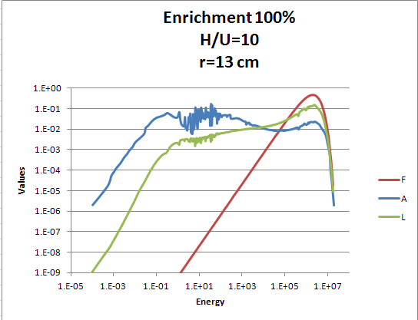
100% enriched, H/U=0

Slide 33
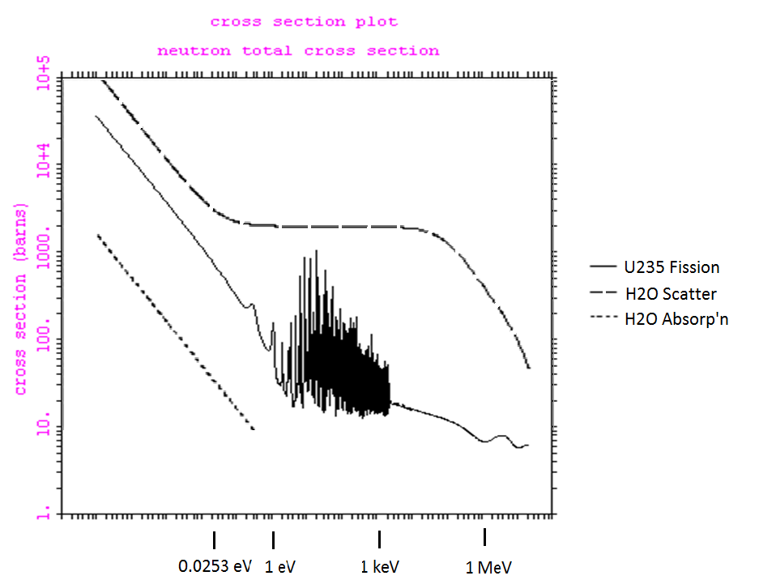
U-235 Cross sections

Slide 34
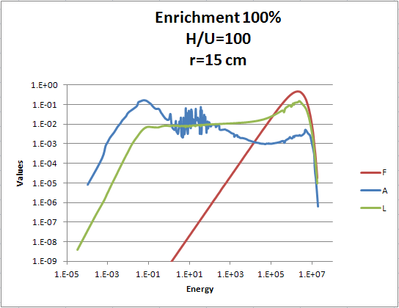
100% enriched, H/U=0

Slide 35
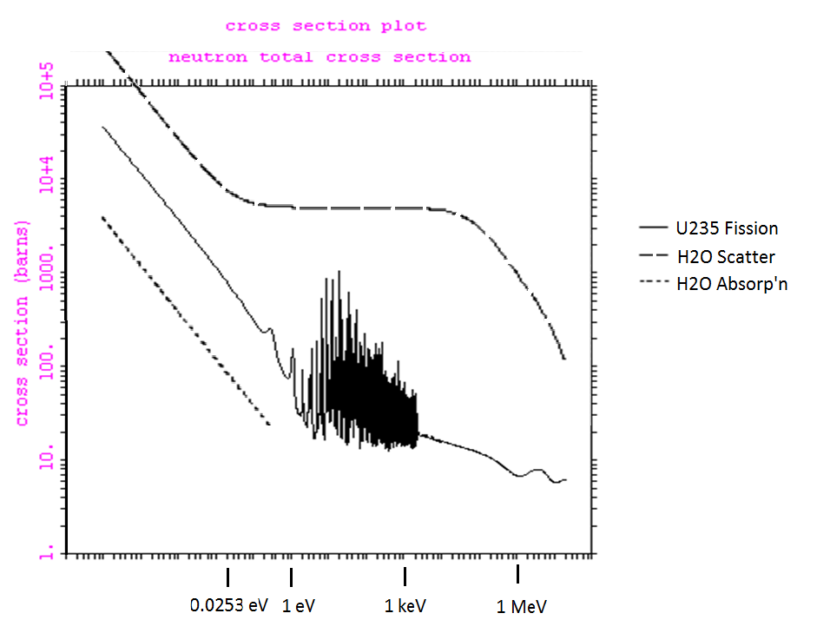
U-235 Cross sections

Slide 36
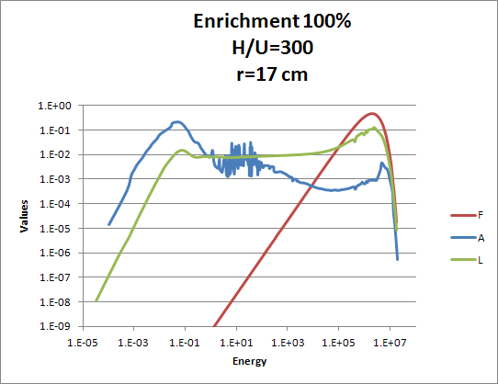
100% enriched, H/U=0

Slide 37
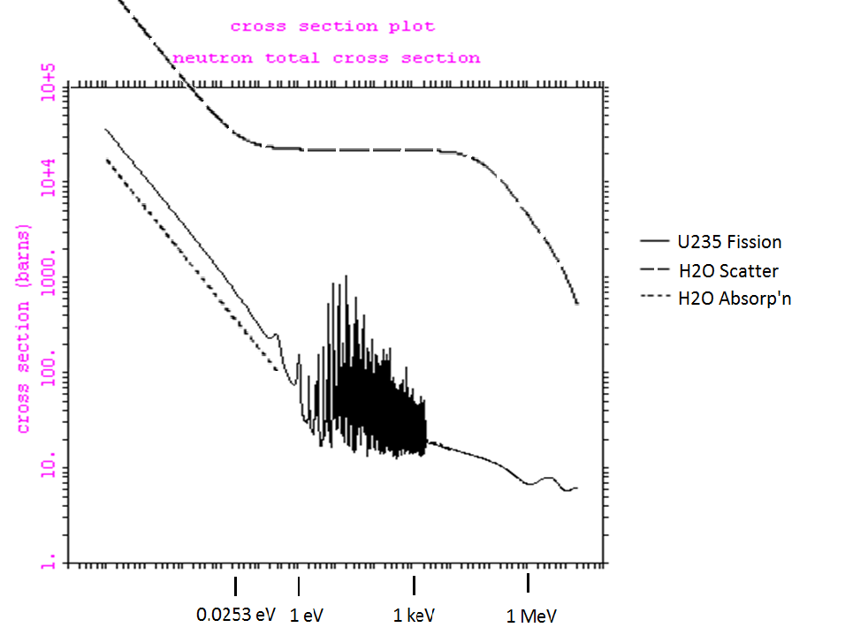
U-235 Cross sections

Slide 38
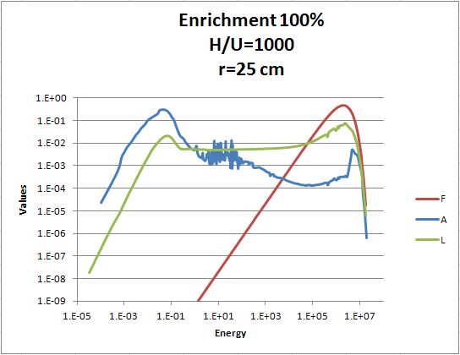
100% enriched, H/U=0

Slide 39
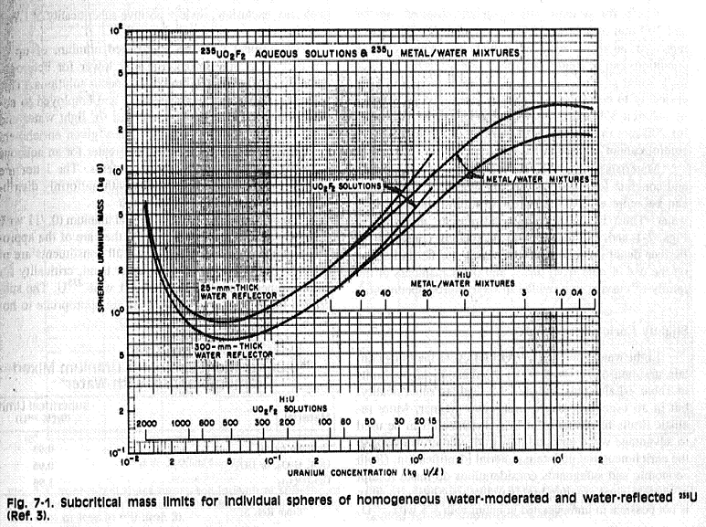
Critical mass curve

Slide 40
Parameter #7: Enrichment
Enrichment: % fissile in matrix
  U-235, Pu-239, U-233 (?)
  Higher is worse. (Counterexamples?)
  Source of problem in Tokai-mura accident
  Parametric studies?
40

Slide 41
Parameter #8: Reflection
Reflection: Non-fissile material surrounding the fissile unit
  Effect of interest: Bouncing neutrons back
  More is worse. (Counterexamples?)
  Usual cases:
    People: 100% water without gap
    Floors
    Walls: Assume in corner
  Worse than water: Poly, concrete, Be, steel, lead
  Do not underestimate nonhydrogenous reflect’n
  Parametric studies?
41

Slide 42
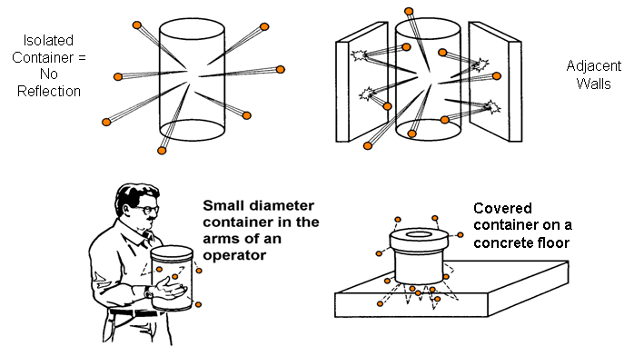
Figure 15: Nuclear Reflection

Slide 43
Parameter #9: Volume
Volume: Size of container holding fissile material
  Usually of concern for:
    Spacing of arrays (Less is worse.)
    Flooding situations. (More is worse.)
  Very sensitive to fissile mass
  Parametric studies?
43

Slide 44
Mental exercise
Which ones can provide COMPLETE protection alone?
F, A, or L?
M
A
G
I
C
M
E
R
V
44

