Slide 1
How to make valid comparisons between data and models

Slide 2
How to make valid comparisons between data and models

Slide 3
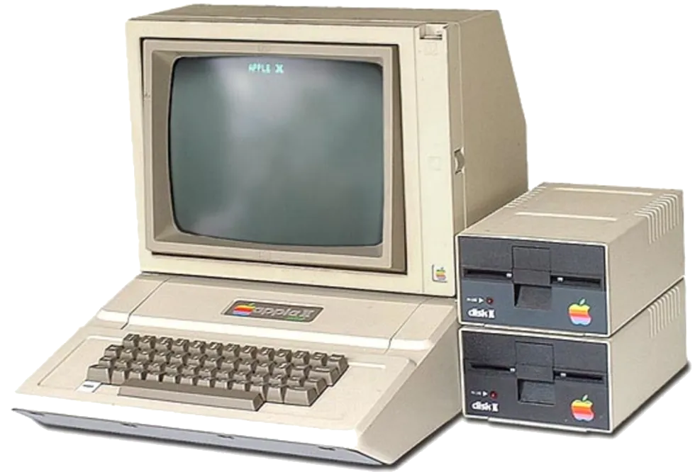
How to make valid comparisons between data and models

Slide 4
Acknowledgements
Antonio Da Silva
Patrick Steffanic
Tanner Mengel
Charles Hughes

Slide 5
1. Standard paradigm of background

Slide 6
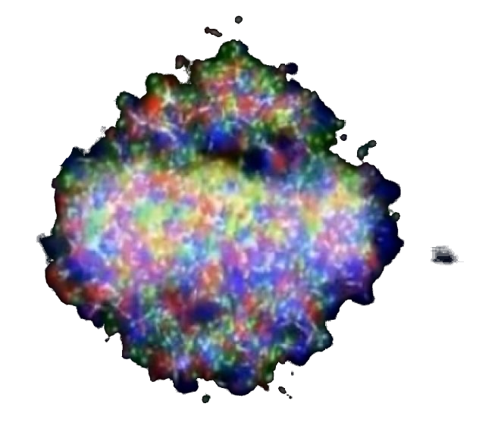
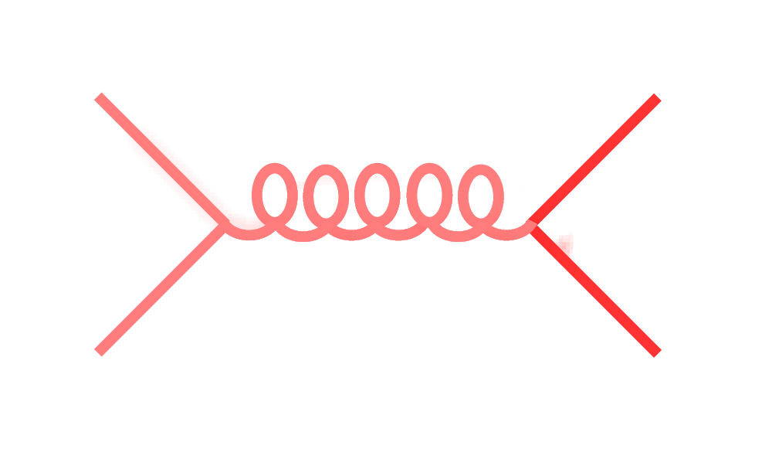
Signal vs Background: The standard paradigm
Background
Signal

Slide 7
Signal vs Background: The standard paradigm
Background
Combinatorial jets
Signal

Slide 8
Signal vs Background: The standard paradigm
Background
Combinatorial jets
Signal
= “fake” jets

Slide 9
Signal vs Background: The standard paradigm
Background
Combinatorial jets
Signal
*Some gray areas

Slide 10
A jet is what a jet finder finds.

Slide 11
2. Models

Slide 12
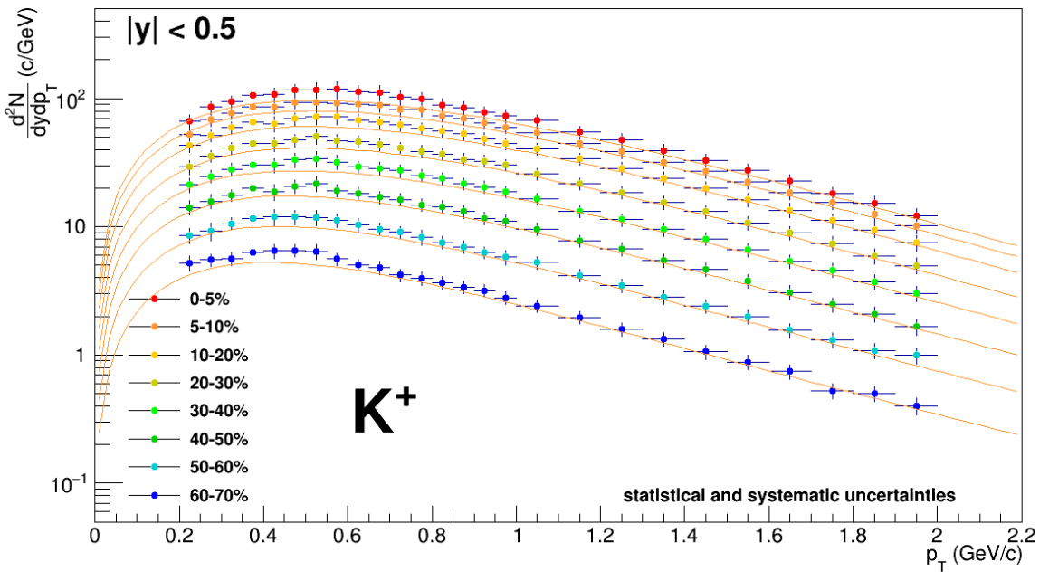
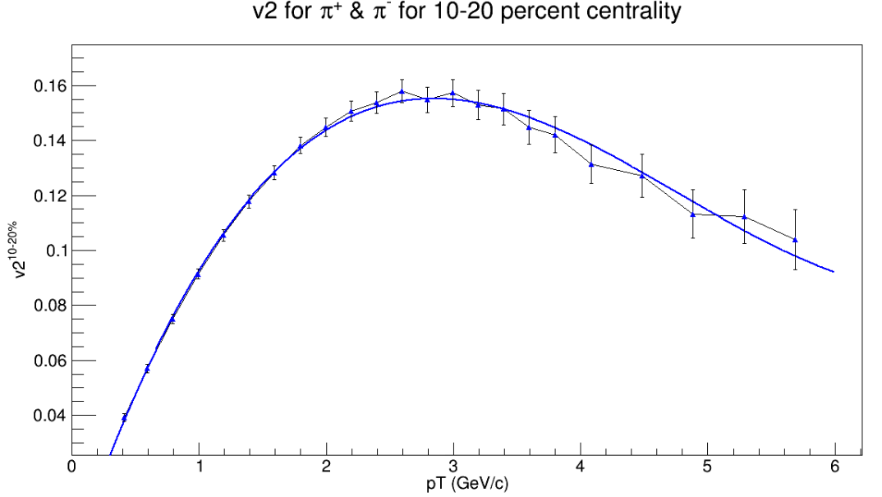
TennGen background generator
Track properties
Event properties
ε₁
ε₃
Momentum spectra
Blast Wave Fit
dN/dy
Random p_{T}
ε₂, ε₄, ε₆
ALICE PLB720 (2013) 52-62
p_{T}
ε₅
Even event planes fixed at Ψ=0
Odd planes at random φ
Multiplies from ALICE PRC88 (2013) 044910
Polynomial Fit
v_{n}
v_{n}
ALICE JHEP 1609 (2016) 164
Azimuthal asymmetries
Random φ
p_{T}
No jets! No resonances
Emulates hydro correlations

Slide 13
Mix TennGen with PYTHIA
Merge PYTHIA 𝑝𝑝 collisions into TennGen heavy ion background
Find charged anti-kT jets in merged event and geometrically match them back to PYTHIA jets
Use matched PYTHIA jet momentum as ground truth

Slide 14
3. Background and signal overlap

Slide 15
What happens to jet properties when you cut background?
Remaining background jets look like signal
Area cut
pThard=60 GeV/c
R=0.4
PRC108(2023)2,024909

Slide 16
What happens to jet properties when you cut background?
Remaining background jets look like signal
ML-optimized cut
pThard=60 GeV/c
R=0.4
PRC108(2023)2,024909

Slide 17
Silhouette Values
Average distance between a jet candidate and other jet candidates in its cluster (signal or background)
Average distance between jet candidate and jet candidates in the other cluster
Silhouette value
$a_{i}={\left\langle d_{i,j}\right\rangle }_{j≠i}$
$b_{i}=\left\langle d_{i,j}\right\rangle$
$s_{i}=\frac{b_{i}−a_{i}}{max\left[b_{i},a_{i}\right]}$
-1
1
0
Looks more like another cluster
Indistinguishable from other clusters
Looks more like its own cluster

Slide 18
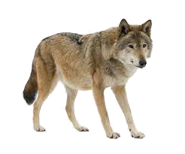
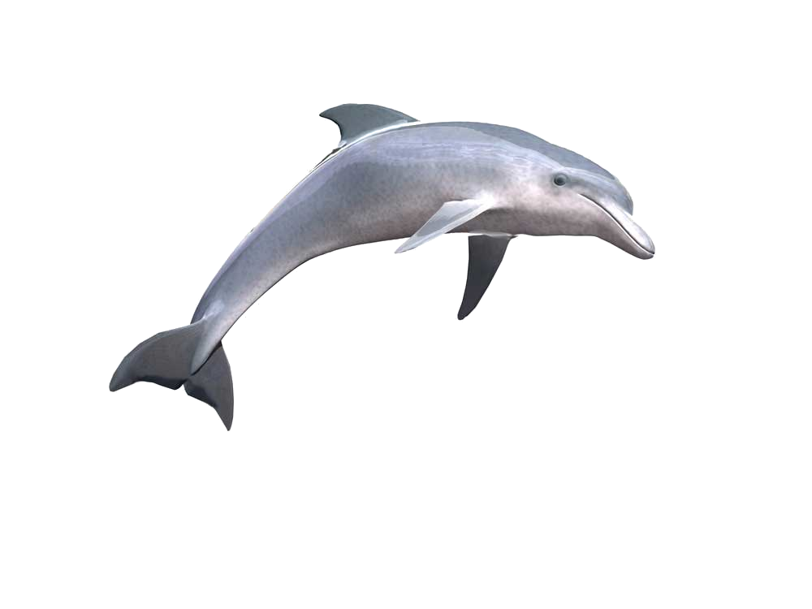
Silhouette values Example from Wikipedia
s
Silhouette scores from three types of animals rendered by Orange data mining suite.
s

Slide 19
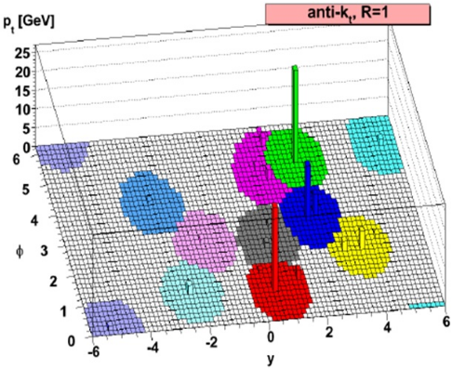
Silhouette Values
Define a distance between two jet candidates to determine how similar they are
$d_{i,j}=\sqrt{{\left(\frac{A_{i}−A_{j}}{A^{max}−A^{min}}\right)}^{2}+{\left(\frac{α_{i}−α_{j}}{α^{max}−α^{min}}\right)}^{2}+{\left(\frac{{\left\langle p_{T}\right\rangle }_{i}−{\left\langle p_{T}\right\rangle }_{j}}{{\left\langle p_{T}\right\rangle }^{max}−{\left\langle p_{T}\right\rangle }^{min}}\right)}^{2}+{\left(\frac{p_{T,i}^{L}−p_{T,j}^{L}}{p_{T}^{L,max}−p_{T}^{L,min}}\right)}^{2}}$
Area
Angularity
Average p_{T}
Leading p_{T}
$α=\frac{1}{p_{T}^{jet}}\sum{z_{k}}\left(\vec{R_{k}}\right)$

Slide 20
What happens to jet properties when you cut background?
Yes, you can cut background, but it comes at a cost. Background jets which look like signal remain.
PRC108(2023)2,024909
pThard=60 GeV/c
R=0.4

Slide 21
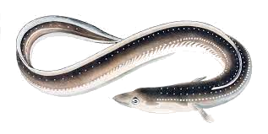

Slide 22
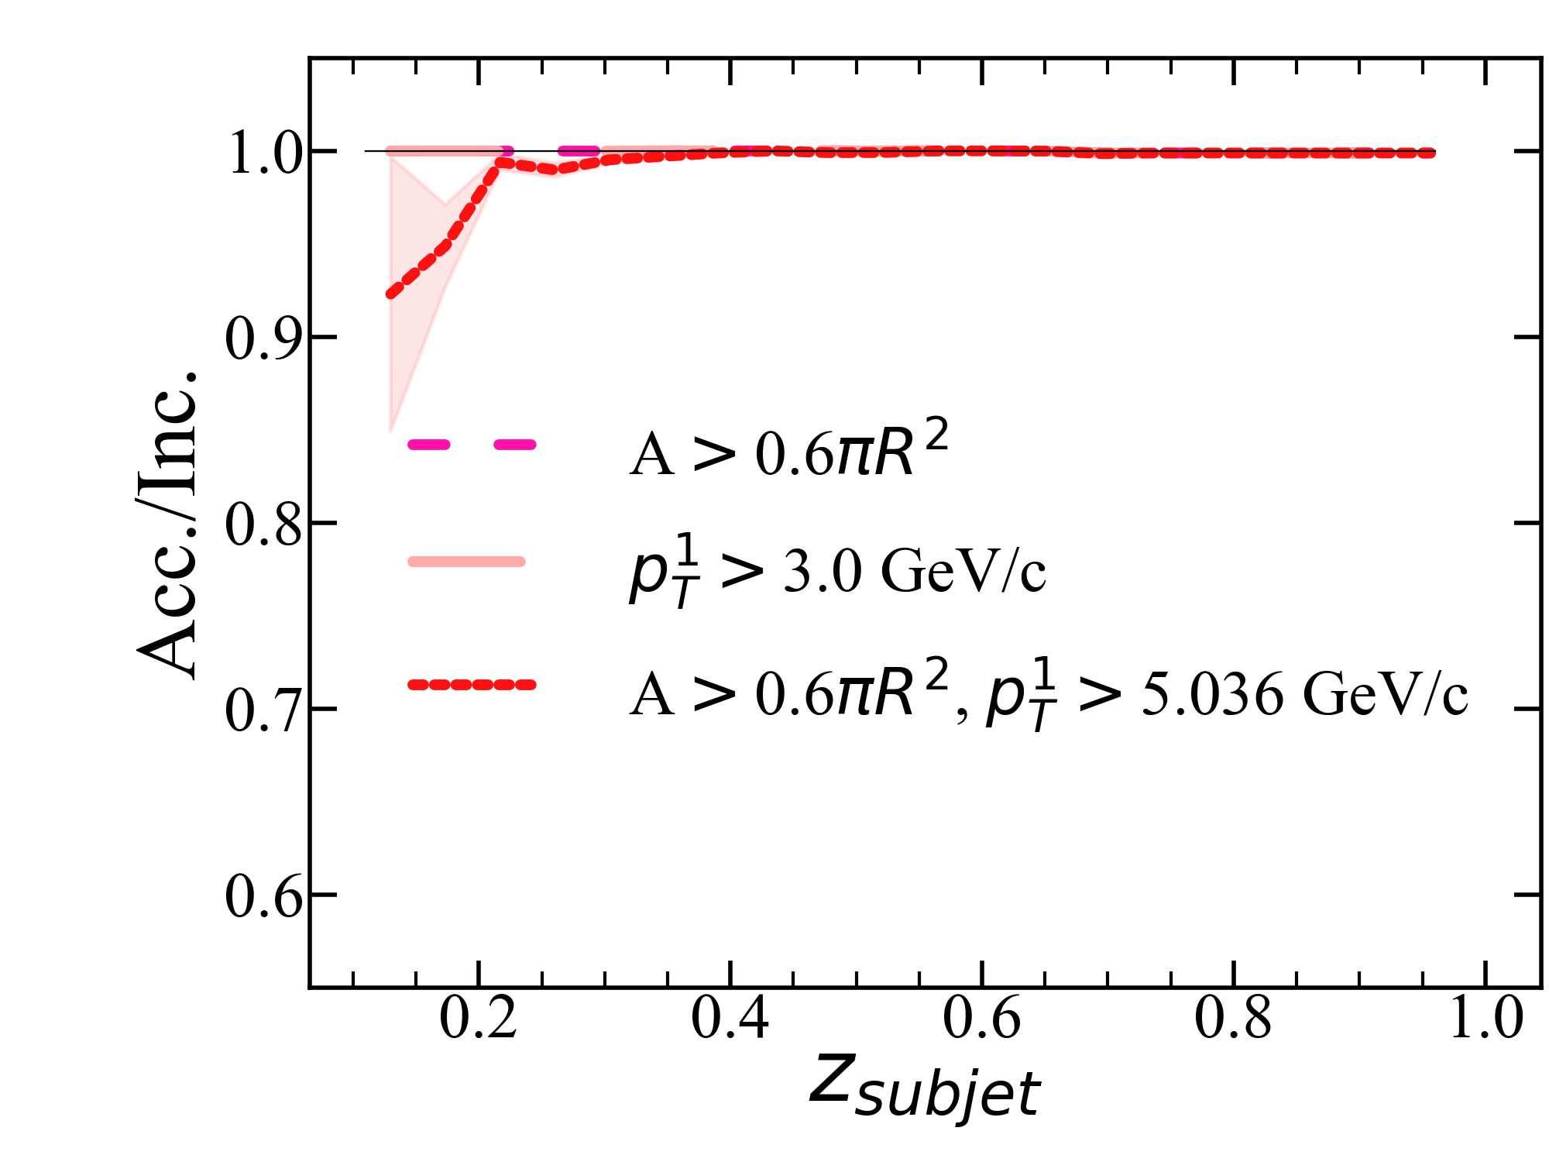
What’s left is biased towards quark-like jets
Subjet z Calculated using PYTHIA particles only
$p_{T}^{subjet}$
pThard=60 GeV/c
R=0.4
$z_{r}=\frac{p_{T}^{subjet}}{p_{T}^{jet}}$
$p_{T}^{jet}$
PRC108(2023)2,024909
Gluon-like
Quark-like

Slide 23
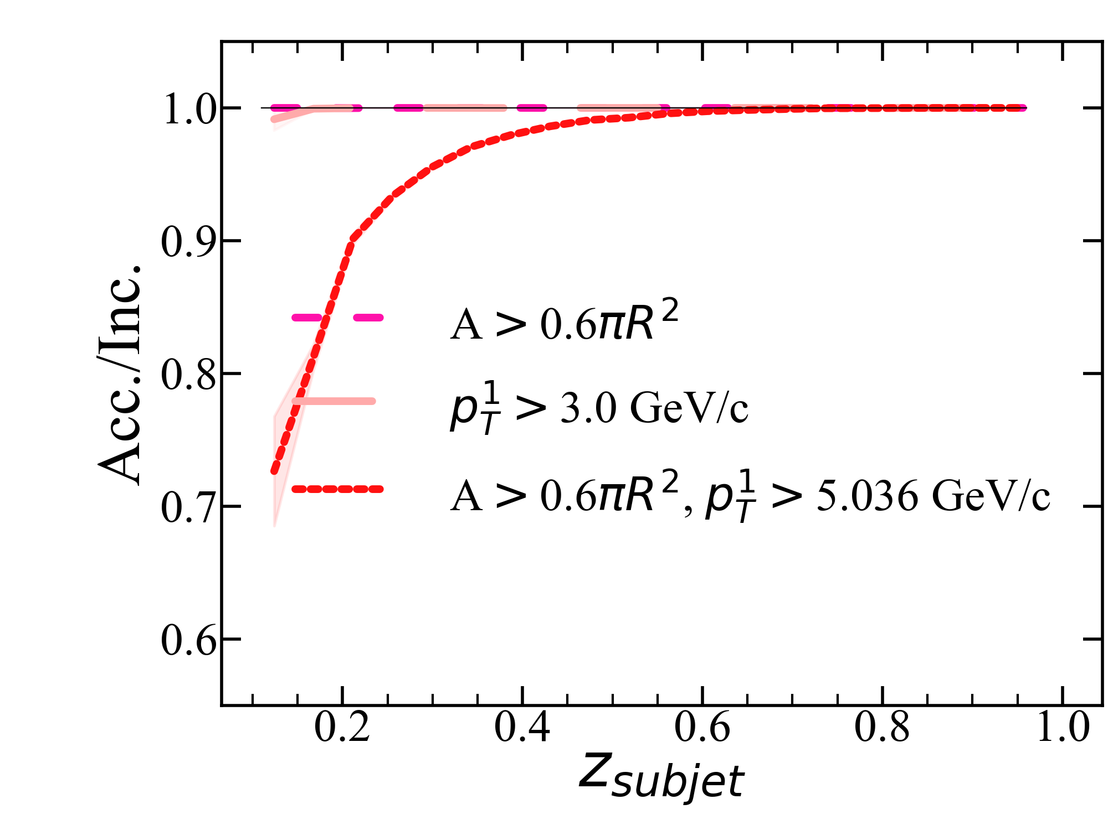
What’s left is biased towards quark-like jets
Subjet z Calculated using PYTHIA particles only
$p_{T}^{subjet}$
pThard=40 GeV/c
R=0.4
$z_{r}=\frac{p_{T}^{subjet}}{p_{T}^{jet}}$
$p_{T}^{jet}$
PRC108(2023)2,024909
Gluon-like
Quark-like

Slide 24
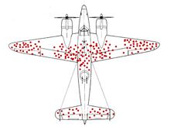
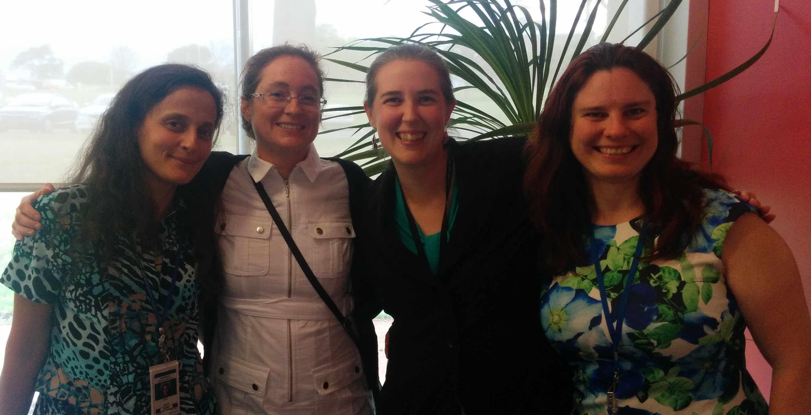
Survivor bias
First use of the term for jets in heavy ion collisions?
Rev. Mod. Phys. 90, 025005 (2018)
WWII Example: holes planes returning indicate where it’s safer to get hit
We’re looking at the jets which remain

Slide 25
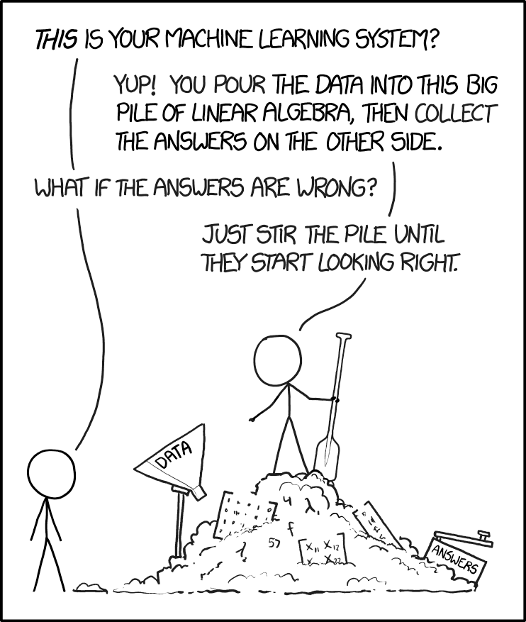
4. Machine learning only teaches you what you already know!

Slide 26
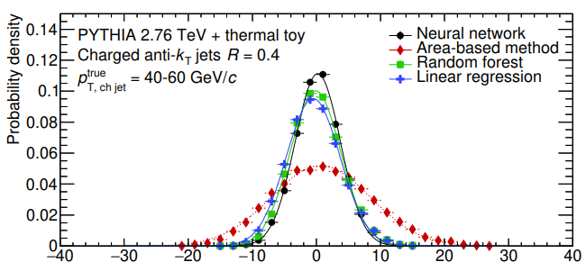
Observation – ML does better at background
Phys. Rev. C 99, 064904 (2019)
Width of determines momentum resolution of method.
$δp_{T}=\left(p_{T,jet}^{pred.}−p_{T,jet}^{truth}\right)$
$p_{T}^{Corr.}=p_{T}^{raw.}−ρA_{jet}$
Applied to data in ALICE Collaboration, PLB 849 (2024) 138412

Slide 27
Observation – ML does better at background
Phys. Rev. C 99, 064904 (2019)
Width of determines momentum resolution of method.
$δp_{T}=\left(p_{T,jet}^{pred.}−p_{T,jet}^{truth}\right)$
$p_{T}^{Corr.}=p_{T}^{raw.}−ρA_{jet}$
Applied to data in ALICE Collaboration, PLB 849 (2024) 138412

Slide 28
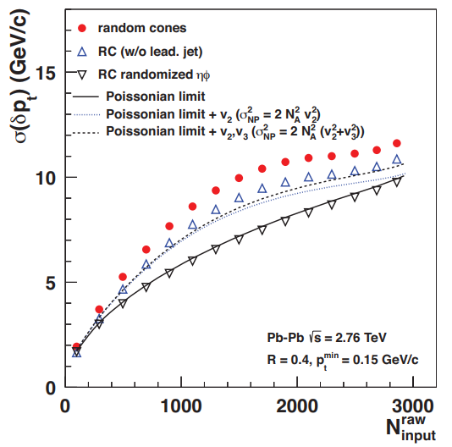
A better method?
Random cone:
Also confirmed inPRC 106, 044915 (2022)
$p_{T}^{corr}=p_{T}^{raw}−ρ_{A}A$
$σ_{total}=\sqrt{Nσ_{p_{T}}^{2}+\left(N+2N^{2}\sum{v_{n}^{2}}\right)μ_{p_{T}}^{2}}$
Tannenbaum, PLB(498),1–2,Pg.29-34(2001)
Multiplicity method:
JHEP 03 (2012) 053
$p_{T}^{corr}=p_{T}^{raw}−ρ_{N}\left(N_{tot}−N_{sig}\right)$
$σ_{total}=\sqrt{Nσ_{p_{T}}^{2}}$
PRC.108.L021901(2023)6

Slide 29
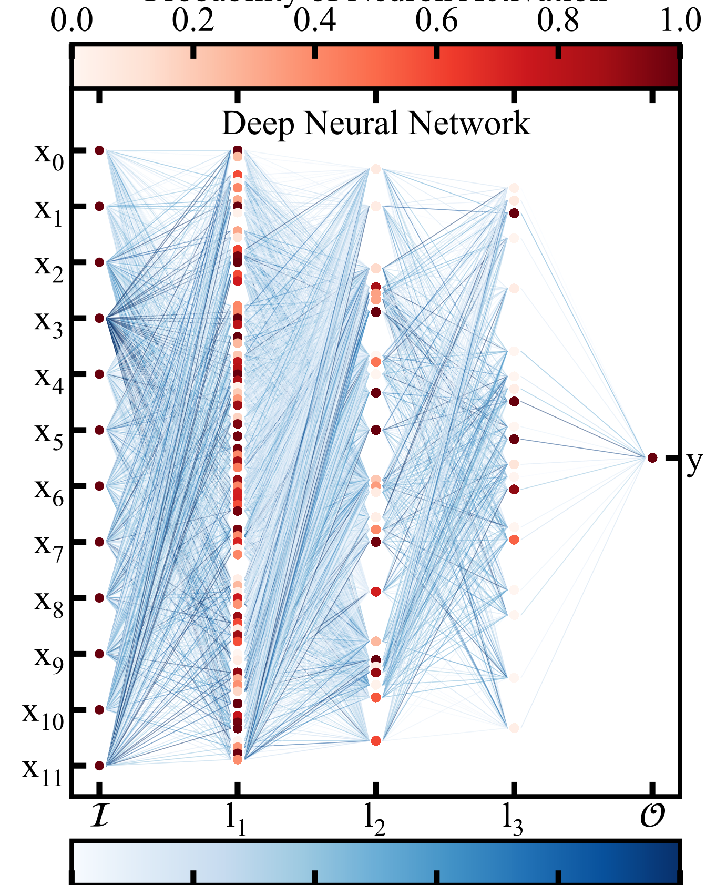
Trimming the network
Neuron activation probability
Information flows forward from layer to layer
Nodes are connected by weights
Follow up to PRC.108.L021901(2023)6 Arxiv pending

Slide 30
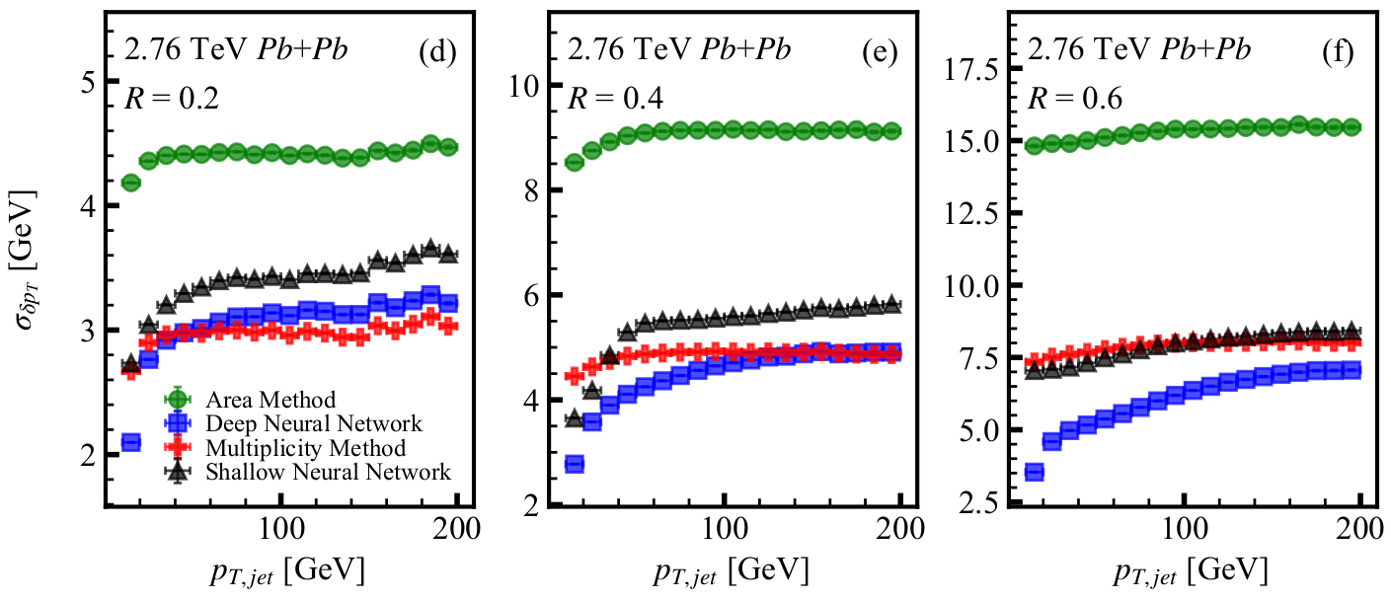
Algorithm Performance
Follow up to PRC.108.L021901(2023)6 Arxiv pending

Slide 31
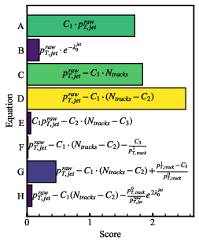
Symbolic regression
Follow up to PRC.108.L021901(2023)6 Arxiv pending
Analytical approximation
Trained on all input jet features with exponential, trigonometric, and arithmetic operations.
The best result was a linear combination.
Jet multiplicity
$p_{T}^{corr.}=p_{T}^{raw}−C_{1}∙\left(N−C_{2}\right)$
Learned optimization constants.

Slide 32
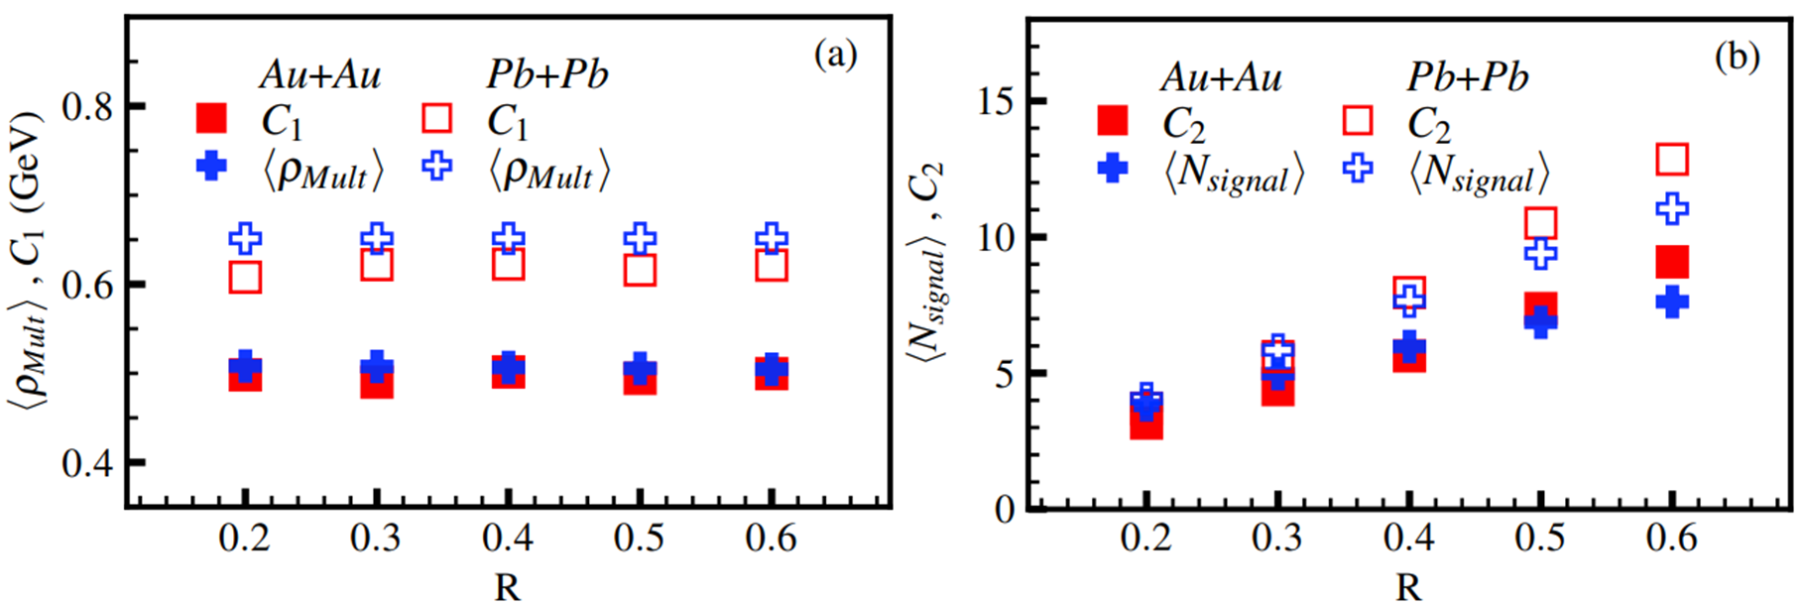
Neural network ≈ Multiplicity method
Constants learned by PySR are approximately the terms used in multiplicity background subtraction method.
PRC.108.L021901(2023)6

Slide 33
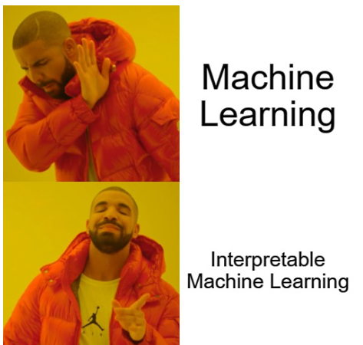
Interpretable ML
1. Method must be equivalently applicable to data and simulation.
2. Predictions must be understood outside the range of training set.
3. Systematic uncertainties can be assessed for predictions.
4. Learned relationships can be directly observed.

Slide 34
Interpretable ML
1. Method must be equivalently applicable to data and simulation.
2. Predictions must be understood outside the range of training set.
3. Systematic uncertainties can be assessed for predictions.
4. Learned relationships can be directly observed.

Slide 35
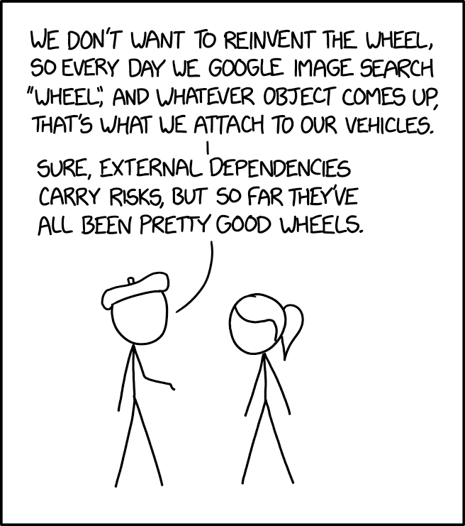
5. How should you compare to models?

Slide 36
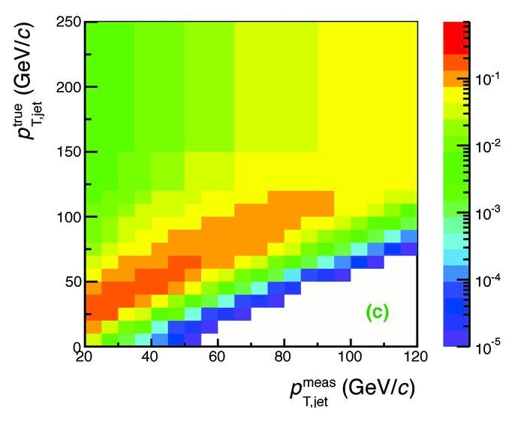
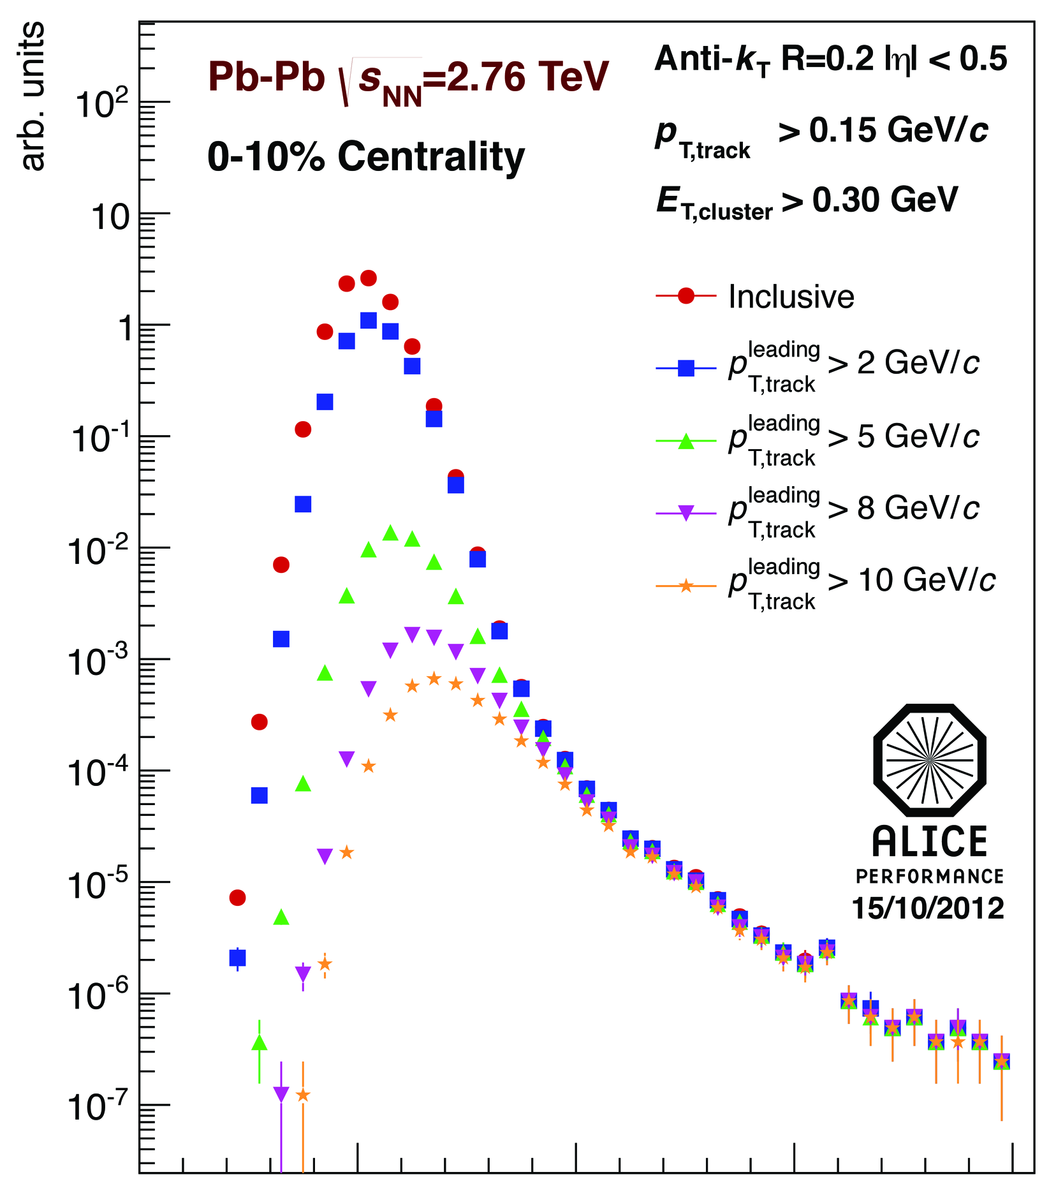
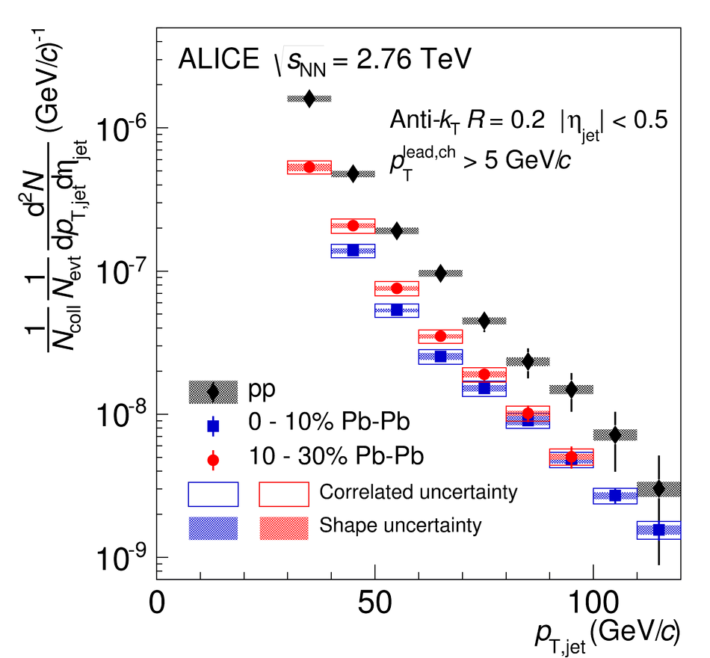
Analysis steps
Tracks
Jet finding algorithm
Jet candidates
Background subtraction
Clusters
Jet spectrum smeared by energy resolution, background fluctuations
Unfolding – corrects for single track reco ε, E resolution, background fluctuations
Corrected spectra

Slide 37
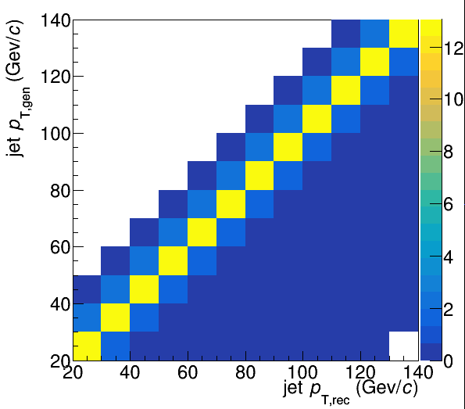
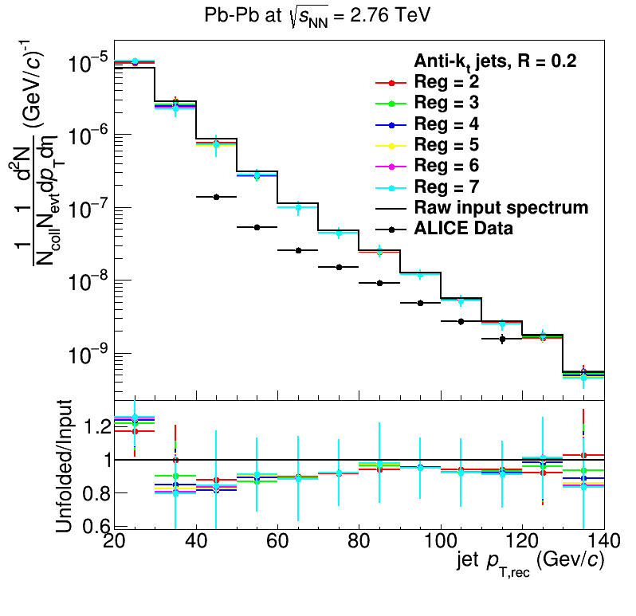
Analysis steps: Full Monte Carlo
Jet finding algorithm
Jet candidates
Background subtraction
Particles
Not a detector effect!
Unfolding – corrects for background fluctuations
Jet spectrum smeared by energy resolution
Corrected spectra

Slide 38
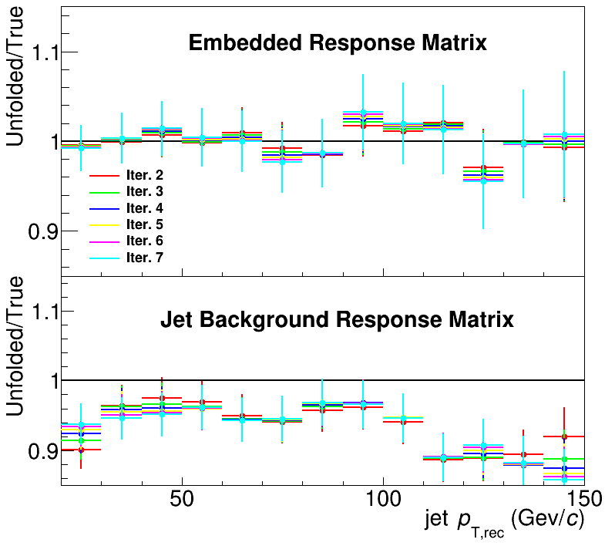
Closure
Methods
Use δp_{T} method to measure width of fluctuations with varying numbers of leading jets (LJ) discarded
Embed PYTHIA event into heavy ion event
Only embedding leads to full closure in Monte Carlo
Phys. Rev. C 106, 2022, 044915

Slide 39
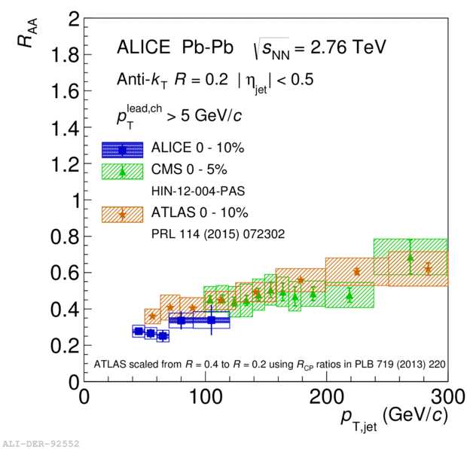
ATLAS
Background subtraction method:
Iterative procedure
Calorimeter jets: Reconstruct jets with R=0.2. v2 modulated <Bkgd> estimated by energy in calorimeters excluding jets with at least one tower with Etower > <Etower> Track jets: Use tracks with pT>4 GeV/c
Calorimeter jets from above with E>25 GeV and track jets with pT>10 GeV/c used to estimate background again.
Calorimeter tracks matching one track with pT>7 GeV/c or containing a high energy cluster E >7 GeV are used for analysis down to Ejet = 20 GeV
Constituent biases don't matter that much up here
Phys. Lett. B 719 (2013) 220-241
But they do matter down here!

Slide 40
Snowmass Accord: Apply the same algorithm to data and your model. Then the measurement and the calculation are the same.

Slide 41
Rivet: Apply the same algorithm to data and your model. Then the measurement and the calculation are the same.

Slide 42
This is also what people have learned in the soft sector in heavy ion collisions.

Slide 43
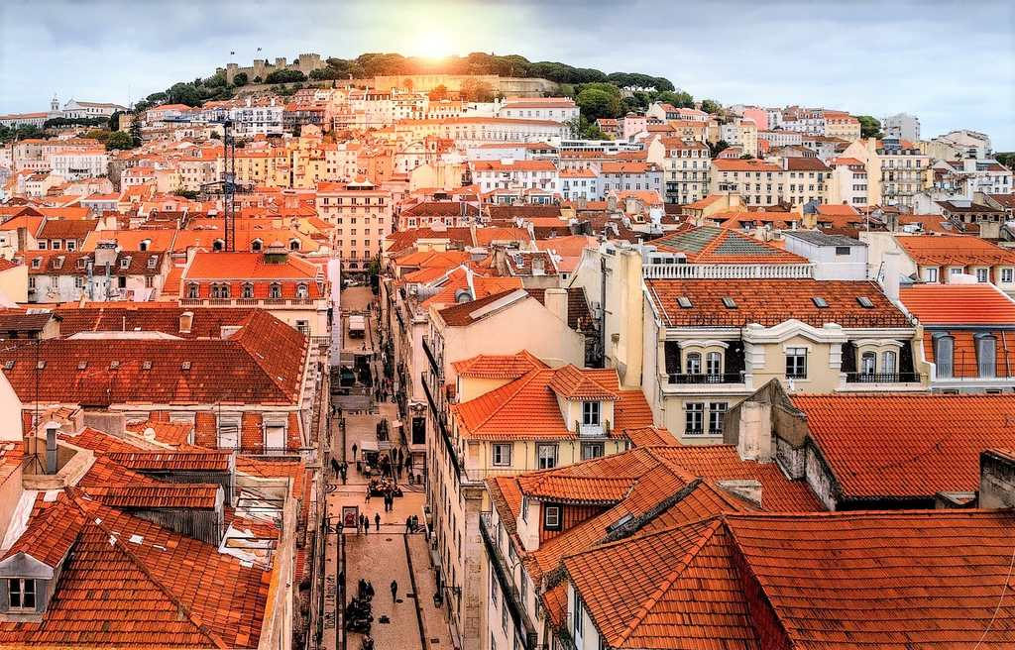
The Lisbon Accord
Lisbon Accord proposed that heavy ion analyses adopt RIVET in July 2014
https://www.aworldtotravel.com/things-lisbon-is-famous-for/

Slide 44
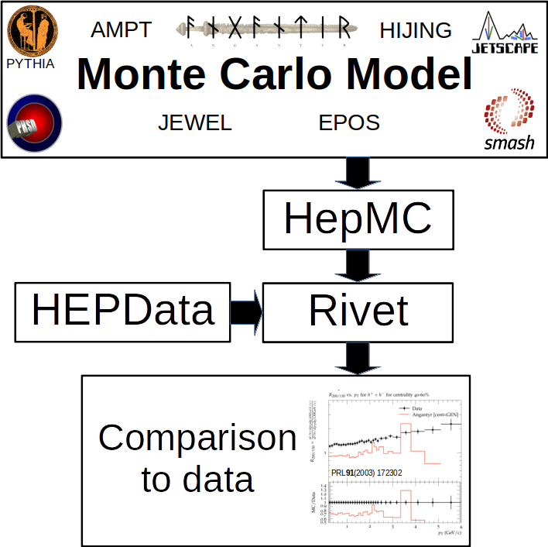

Slide 45
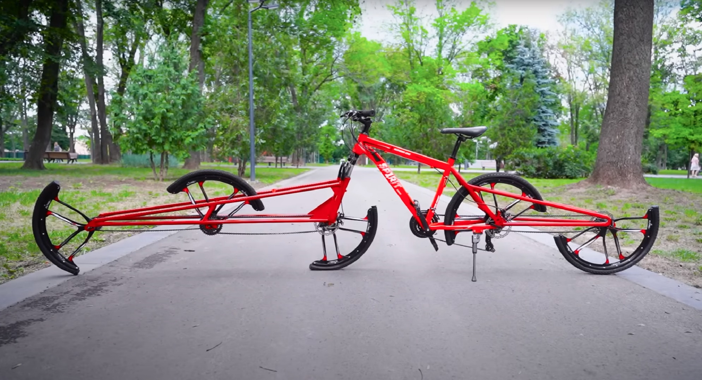
How should you compare to models? Let’s not reinvent the wheel!
This bike works!
https://www.autoevolution.com/news/this-split-wheel-vehicle-is-probably-the-most-overcomplicated-pedal-cycle-design-out-there-194413.html

Slide 46
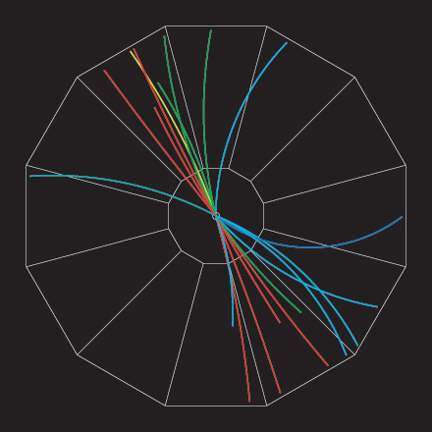
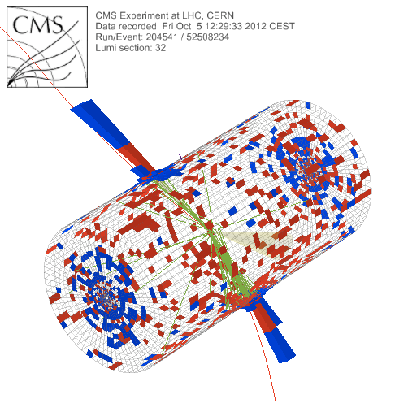
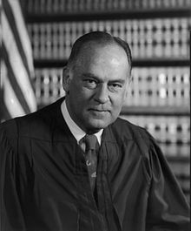
What is a jet?
p+p dijet
Beam pipe
“I know it when I see it”
US Supreme Court Justice Potter Stewart, Jacobellis v. Ohio

Slide 47
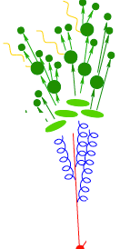
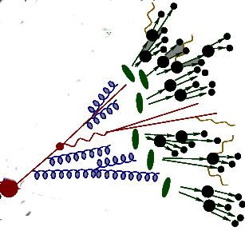
Definition of Jets in a Large Background July 25-27, 2018
Korinna Zapp
Provide enough details to make comparisons between data and models
Include anything correlated in definition of jet
Reconsider role of collinear safety
Discuss and put effort into the problem

Slide 48
Backup

Slide 49
Random cones
X
Excluded
$ϕ$
R=0.4
Real jets
Excluded
$η$

Slide 50
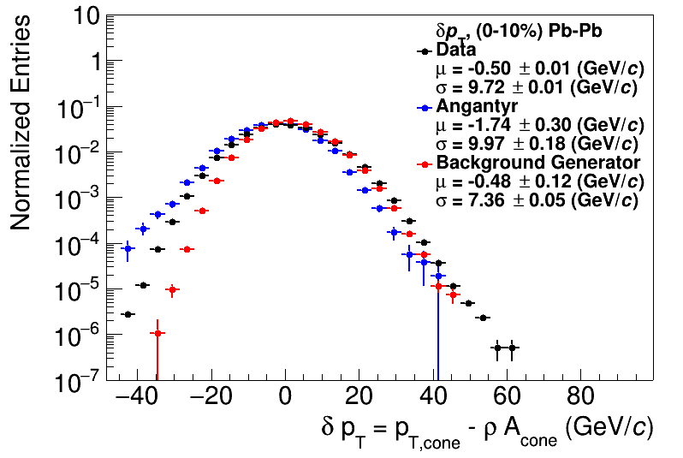
Random cones
ALICE Data: JHEP 03 (2012) 053
arXiv:2005.02320
ρ = Median(p_{T}/A)

Slide 51
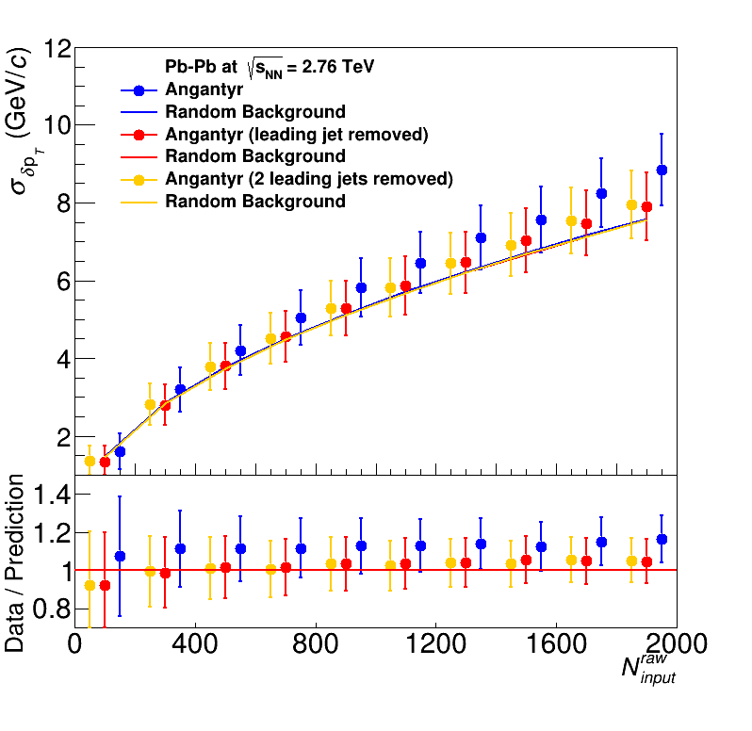
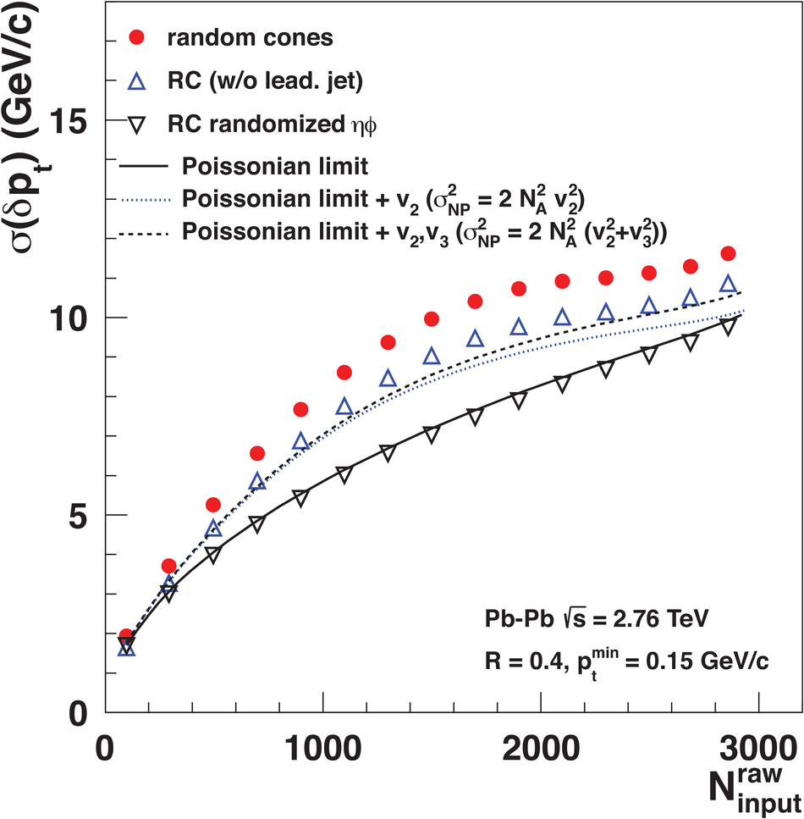
Width vs multiplicity
Angantyr
ALICE

Slide 52
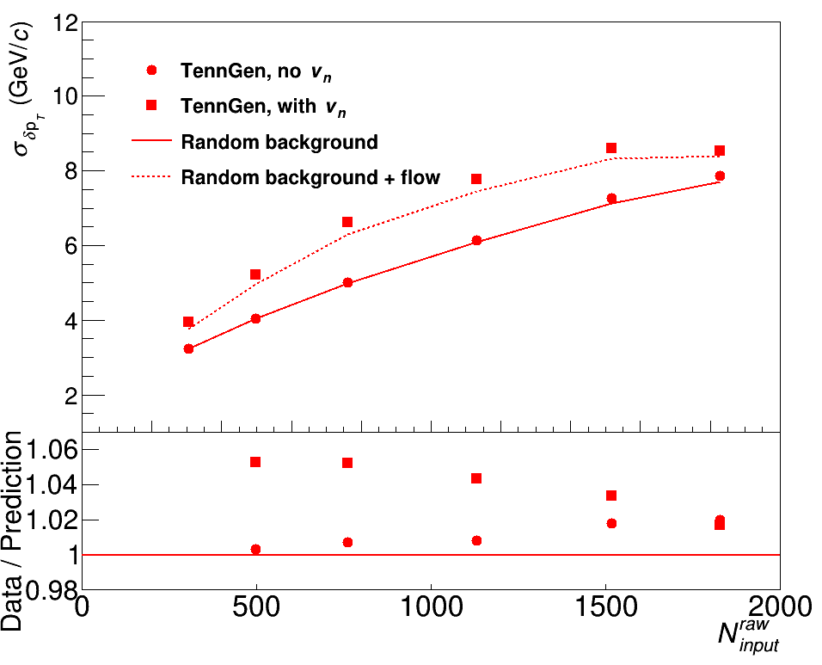
Width vs multiplicity
TennGen
ALICE
Impact of shape of spectrum
Correlations between event planes

Slide 53
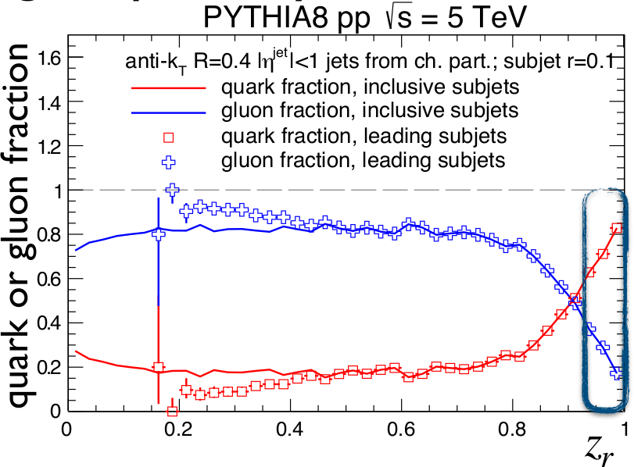
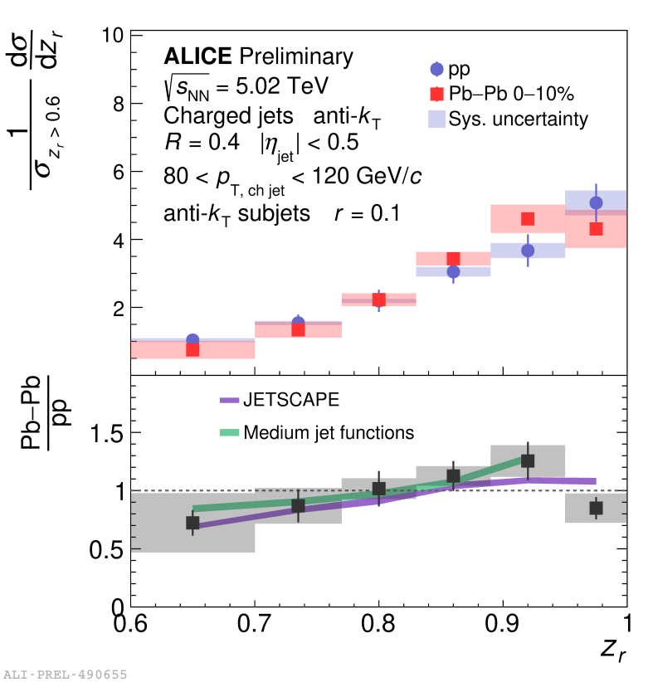
Subjet z
$p_{T}^{subjet}$
$z_{r}=\frac{p_{T}^{subjet}}{p_{T}^{jet}}$
$p_{T}^{jet}$
James Mulligan CERN seminar Dec. 2021
Cluster jets with anti-k_{T} with resolution parameter R
Recluster constituents with anti-k_{T} with resolution parameter r
Some discriminating power between quark-like and gluon-like jets
Strained at low momentum, small R

Slide 54
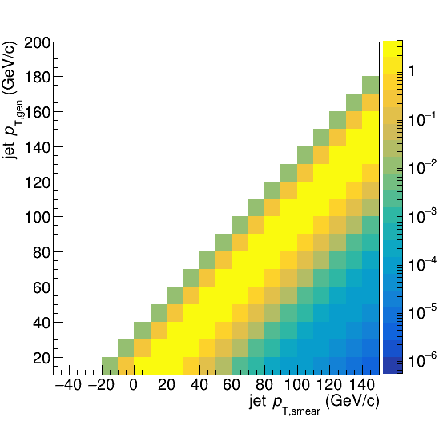
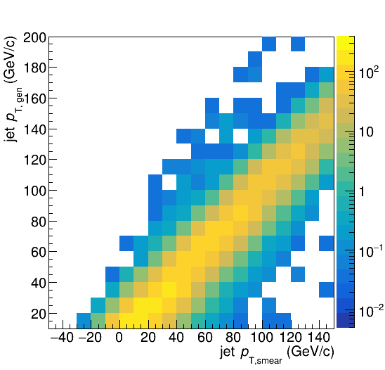
Construct a response matrix in Monte Carlo
Background fluctuations
Embedding

Slide 55
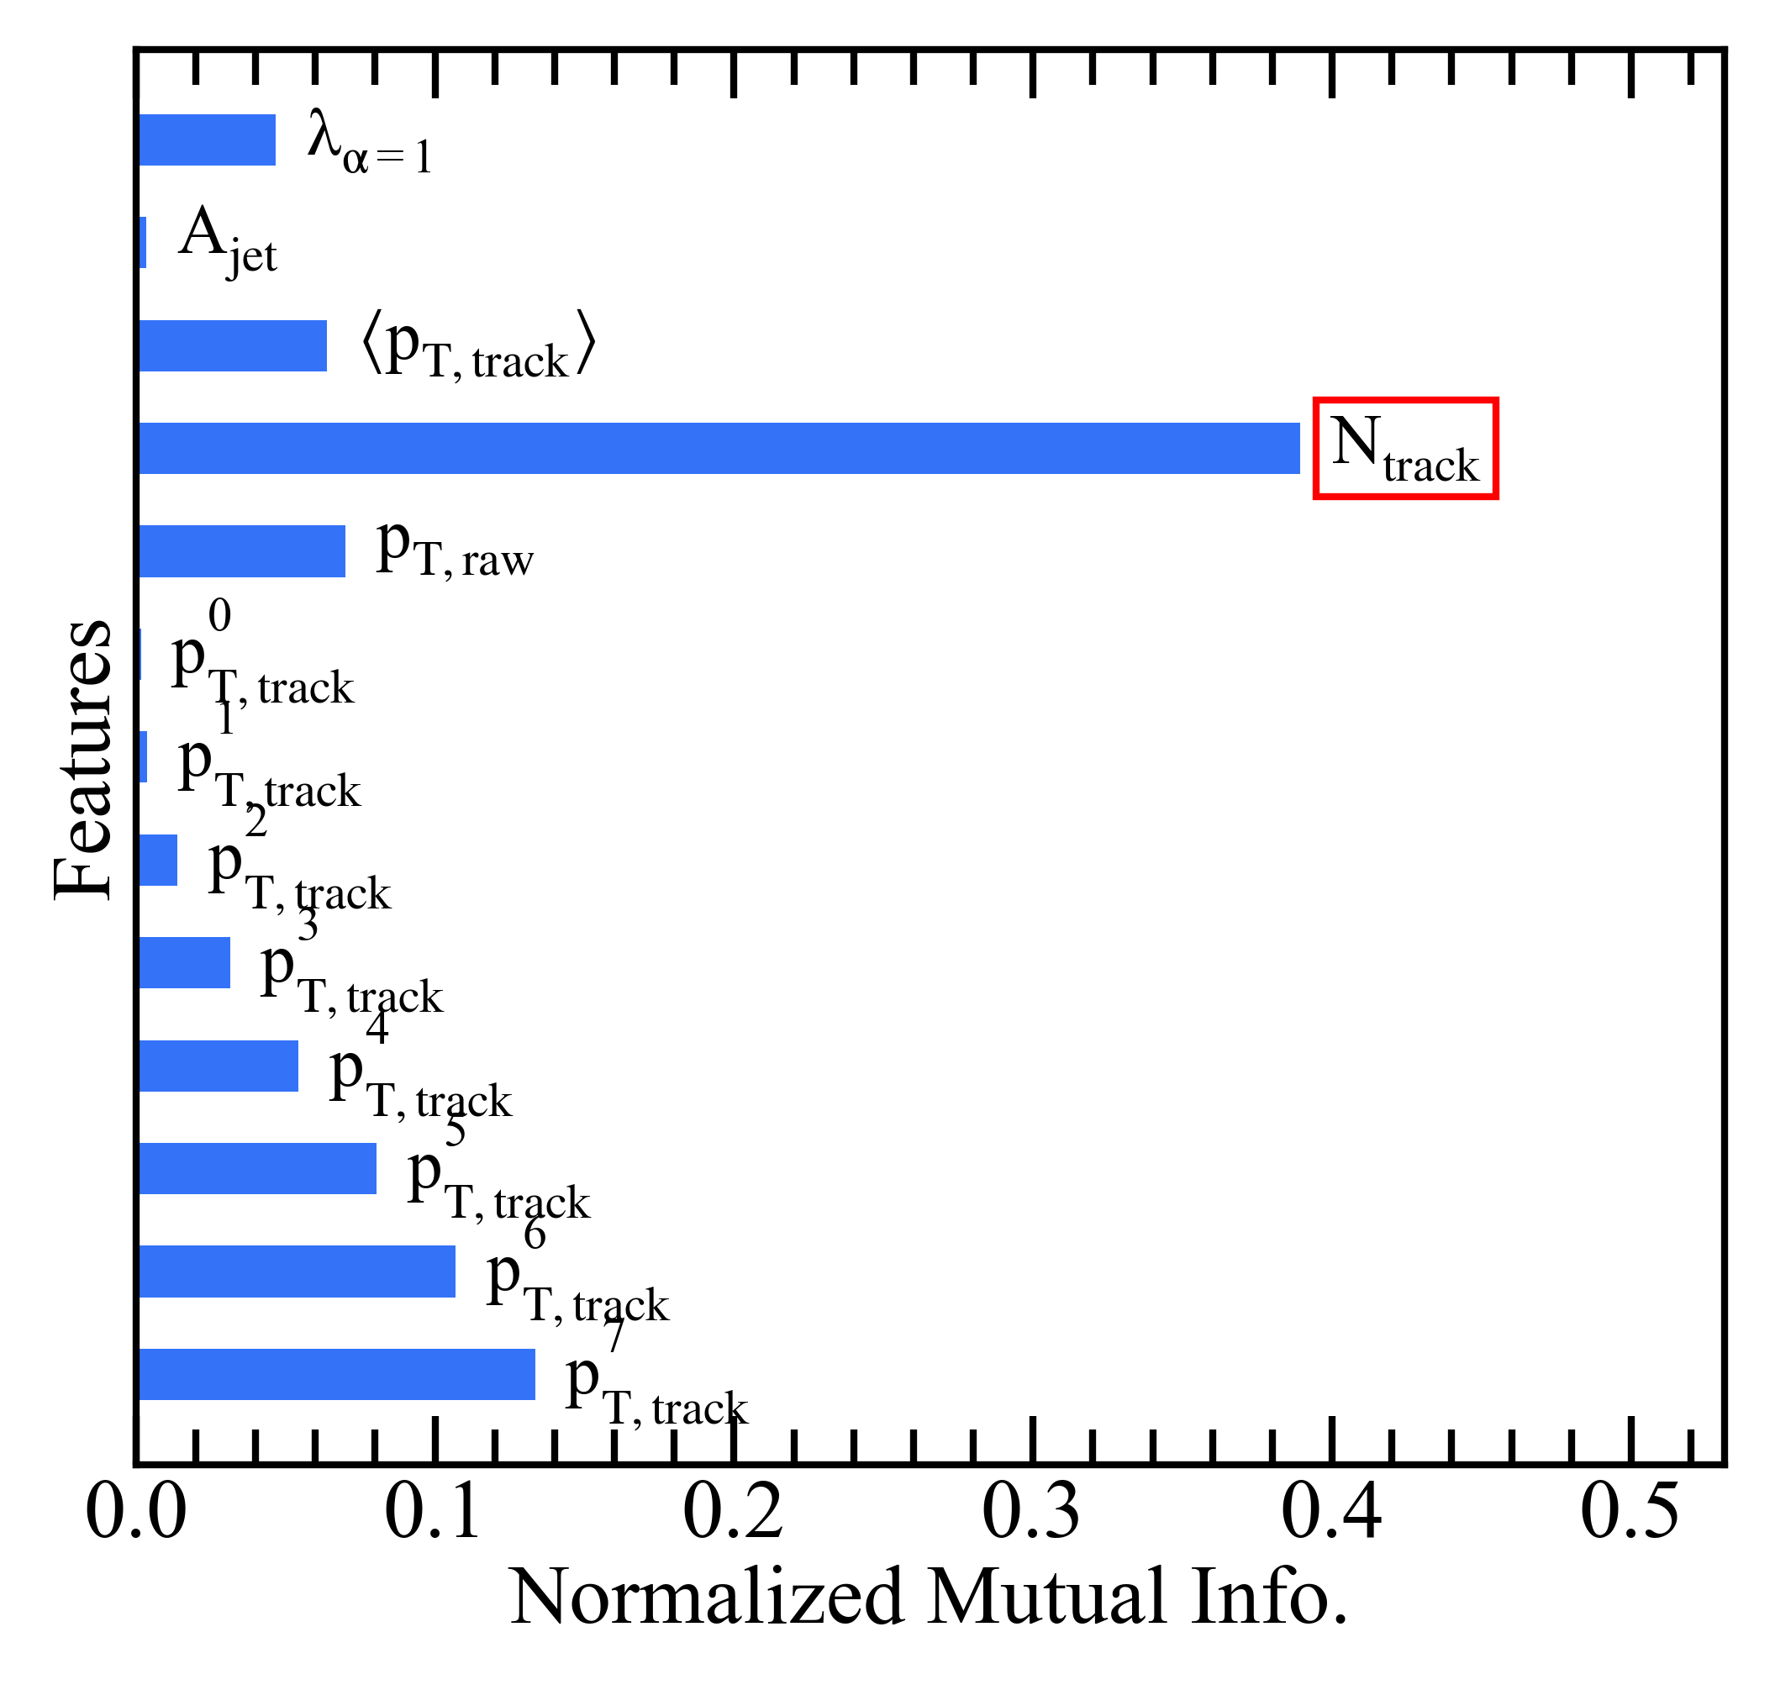
Designing a better method
Jet multiplicity largest mutual information w/jet momentum .
Background fluctuations are well described by multiplicity fluctuations. JHEP 03 (2012) 053, Phys. Rev. C 106, 044915 (2022), Physics Letters B 498, 29 (2001).

Slide 56
Definition of Jets in a Large Background July 25-27, 2019
Organizers: M. Connors, G. Milhano, C. Nattrass, R. Reed, S. Salur
Spectra conveners: R. Kunnawalkam Elayavalli, Y. Mehtar-Tani (R. Bertens)
Correlation conveners: J. Noronha-Hostler, J. Huang
Substructure conveners: Y. Lee, Y. Chien
Extensively discussed the interplay between experimental techniques and theoretical calculations with the aim of reaching an agreement* on the way forward for extracting jet measurements from large background events such as those in heavy ion collisions and high luminosity p-p or electron-ion collisions.
*Consensus on some points
62 Registered but due to various visa & travel complications: 45 + several BNL employees attended.

Slide 57
Jet properties
Area
Angularity
Average p_{T}
Leading p_{T}
$α=\frac{1}{p_{T}^{jet}}\sum{z_{k}}\left(\vec{R_{k}}\right)$

Slide 58
Shape of width of the distribution
Single particle spectra
$f_{Γ}\left(p_{T},p,b\right)=\frac{b}{Γ\left(p\right)}{\left(bp_{T}\right)}^{p−1}e^{−{bp}_{T}}$
Σp_{T} of N particles→N-fold convolution:
$\frac{{dpT}^{total}}{dy}∝f_{N}\left(p_{T},Np,b\right)$
$f_{N}\left(p_{T},p,b\right)=f_{Γ}\left(p_{T},Np,b\right)$
$\frac{dN}{dy}∝f_{Γ}\left(p_{T},2,b\right)=b^{2}p_{T}e^{−bp_{T}}$
$N=\frac{N_{total}}{A_{total}}πR^{2}$
$μ_{total}=\frac{Np}{b}=Nμ_{p_{T}},σ_{total}=\frac{\sqrt{Np}}{b}=\sqrt{N}σ_{p_{T}}$
$μ_{p_{T}}=\frac{p}{b},σ_{p_{T}}=\frac{\sqrt{p}}{b}$
Tannenbaum, PLB(498),1–2,Pg.29-34(2001)
Add Poissonian fluctuations in N:
$σ_{total}=\sqrt{Nσ_{p_{T}}^{2}+Nμ_{p_{T}}^{2}}$
Confirmed in JHEP 03 (2012) 053 ALICE PRC 106, 044915 (2022) Hughes et al
Add non-Poissonian fluctuations in N due to flow
$σ_{total}=\sqrt{Nσ_{p_{T}}^{2}+\left(N+2N^{2}\sum{v_{n}^{2}}\right)μ_{p_{T}}^{2}}$

