Slide 1
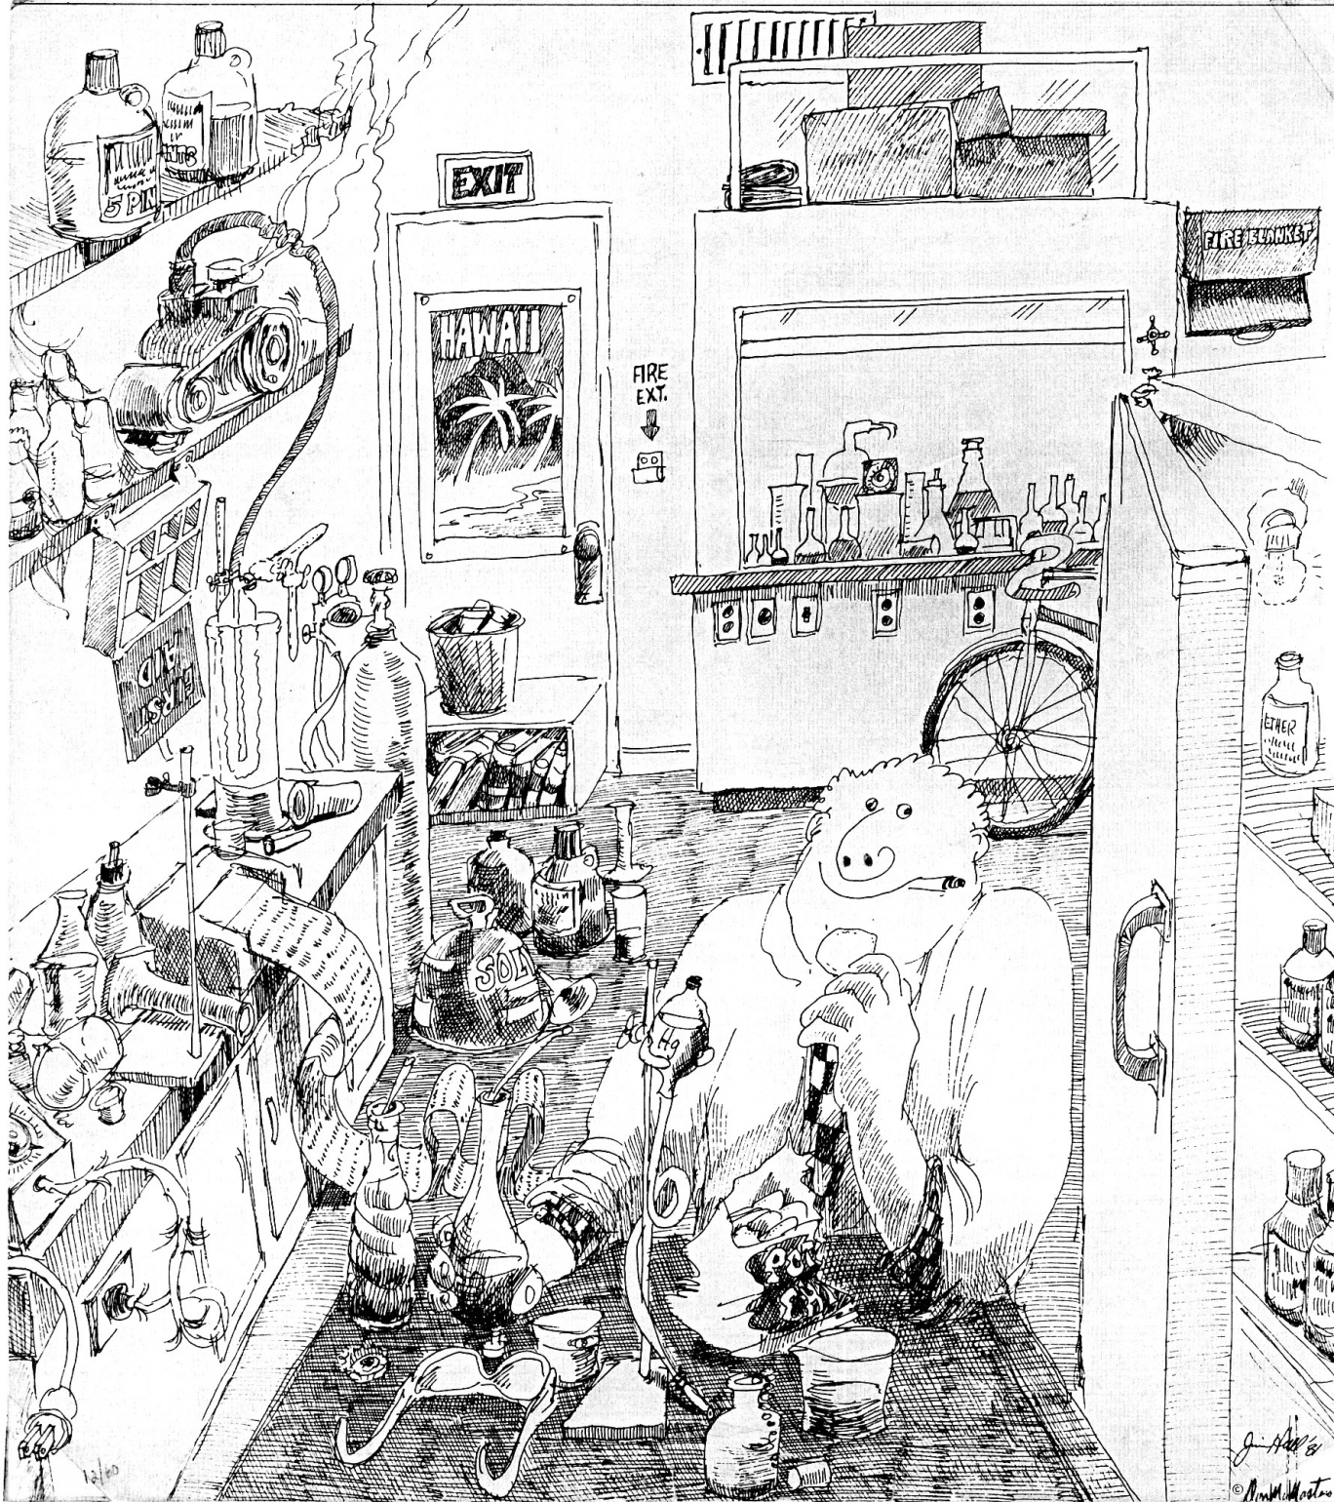
How
Many
Safety
Violations?

Slide 2
Safety in the UTK Chemistry Department
Prof. John Bartmess
Safety Officer and Chemical Hygiene Officer
These powerpoints: web.utk.edu/~bartmess/safety.ppt

Slide 3
Why Are You Here?
(grad school)
- Knowledge
- Skills
In the Real World:
- You will never do your thesis again.
- You will earn your salary by being able to
solve the next problem that walks in the door.
- You will deal with safety issues your entire career.

Slide 4
Why Are You Here?
(Safety lecture)
1. Legal Requirements
Certain things you must be told.
2. Information on specifics here
3. Professional Reasons
- public image of chemistry
("toxicchemical" as one word)
We are all safety officers in the eyes of the public

Slide 5
Safety as:
(1) Common sense
(2) always applied.
This is the hard part!
Being “Mindful“
(vs. ‘zoning out’ while driving)
"Lab discipline"

Slide 6
How do we impose these reactions on you?
"The Safety Culture"
(1) rationally (this lecture, emails, further training)
(2) telling stories.
Stories as source of safety information
(but don't tell stories to spouses)
Is chemistry a dangerous profession?

Slide 7
Safety Rules are written in Blood

Slide 8
Driver’s education: “Signal 30”
The silver nitrate explosion

Slide 9
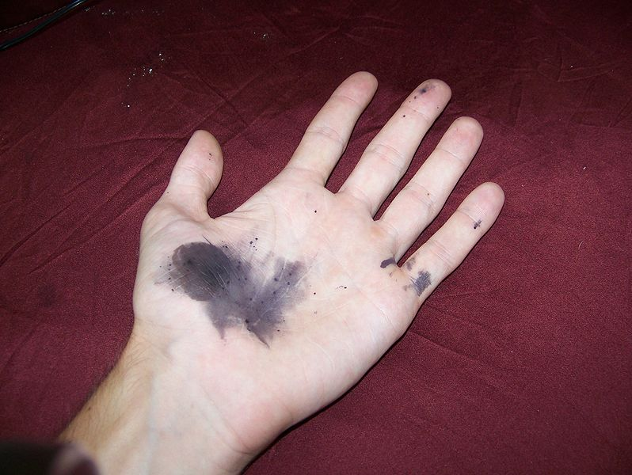

Slide 10
Cleaning a waste jar
“Oops, I forgot to…”

Slide 11
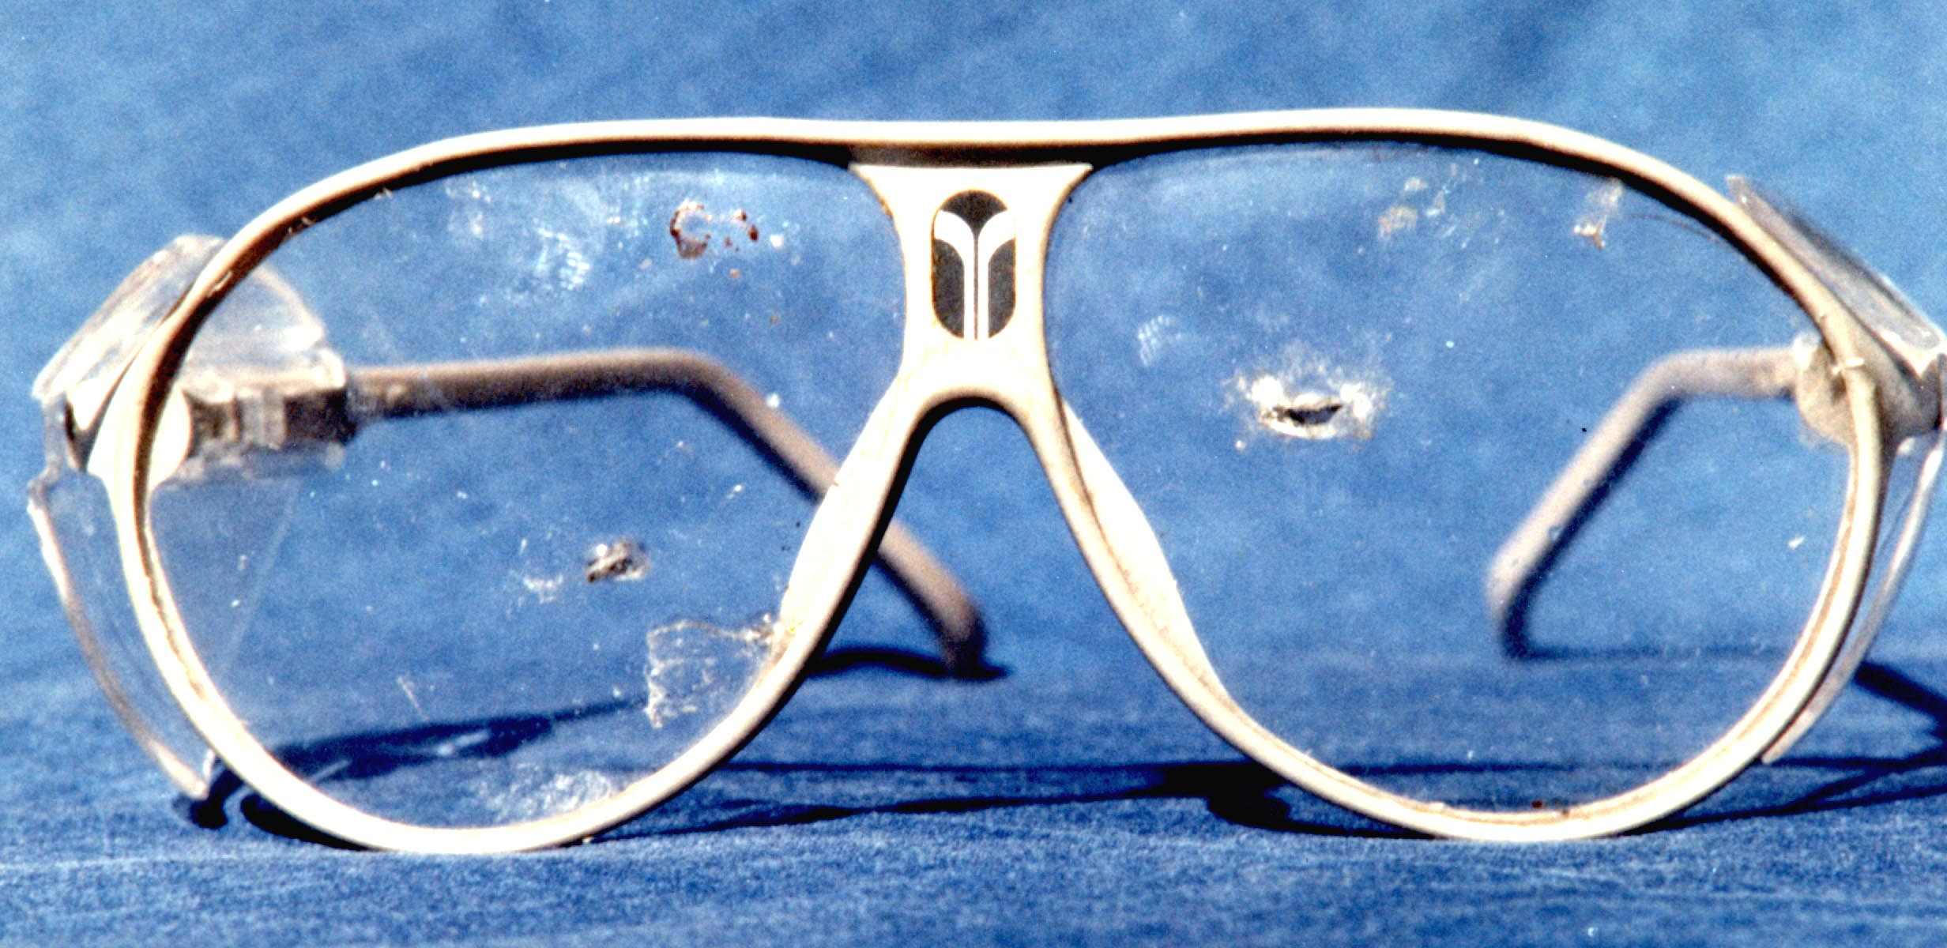

Slide 12
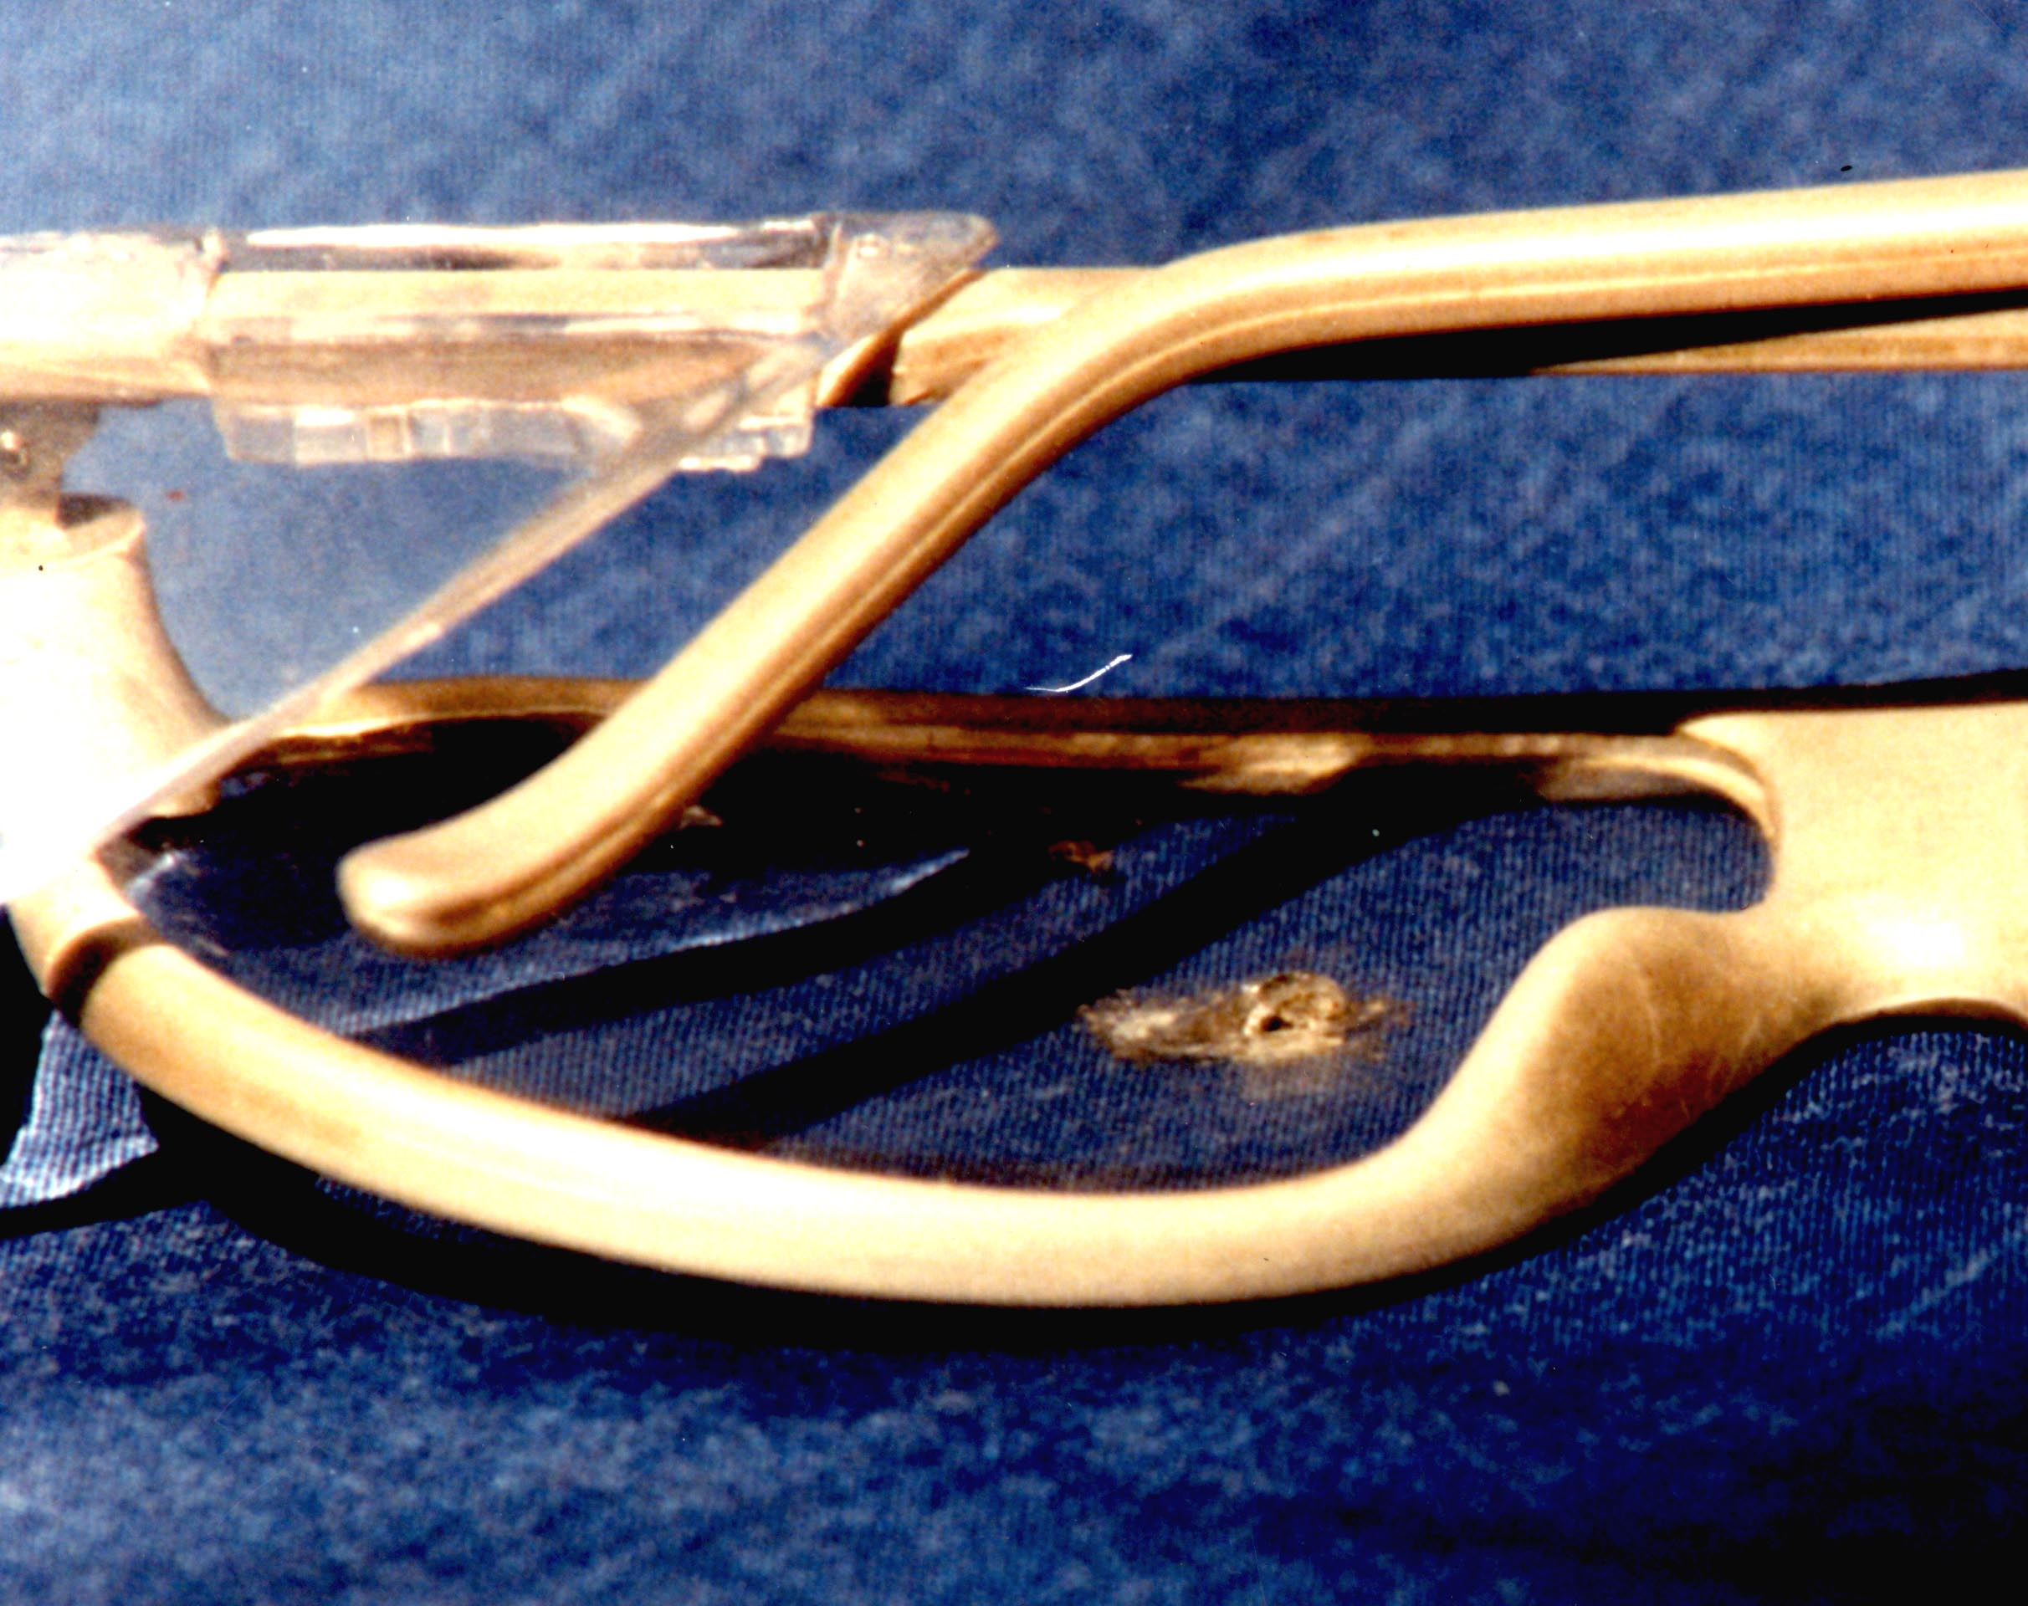

Slide 13
Practices vs. Facilities
What you do, versus what you do it with.
You are responsible for the former,
and should complain (constructively) about the latter.
Handout: “Safety Training For New Researchers”

Slide 14
Lab discipline:
- Always think things through before you start something
- Constant awareness of the status of things;
not just what’s there, but also what's missing or wrong
- Investigate problems!
- "Established practice" may be wrong.
Just because you have gotten away with something
100 times doesn't mean the 101st time is safe.
- Murphy’s Law: “What can go wrong, will go wrong.”

Slide 15
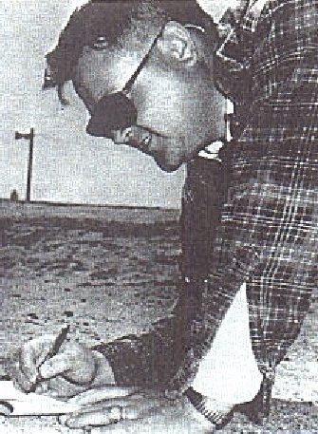
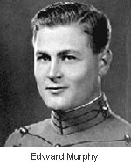
Maj. Edward A. Murphy, Jr. USAF (1918-1990)
West Point, 1940
Test pilot, 1953

Slide 16
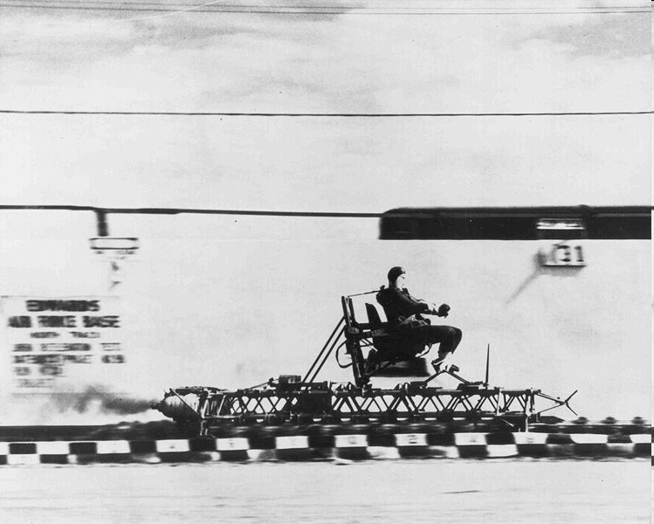

Slide 17
Competency:
Can do the assigned job, without constant supervision
Figures out how to self-train (with outside help, if needed)
Figures out who to contact, to get help, if needed
Communicates with adminstrators above, as to
problems/time frame

Slide 18
Chemical Hazards:
Reactivity:
corrosives
redox
flammable
N-N, N-O, O-O, N-halo, O-halo,
triple bonds, C3/C4 rings with heteroatoms
Toxicity:
acute poison
chronic poison
(“it’s all toxic save distilled water”)
carcinogens
tetratogens (HCONH₂)
mutagens
radioactivity

Slide 19
ΔE situations:
- heat
- cryogens
- compressed gases
pressure (1/3 Kg TNT)
cryogen
chemistry/toxicity
gravity
high energy compounds
(redox, others)
- mechanical
- gravity

Slide 20
Planning experiments, with safety in mind:
- Failure modes
- Interruptions
electrical power loss
evacuation
fume hood failure
cooling water loss
- Redundancy (“belt and suspenders”)
The Tale of the Aluminum Coffee Pot

Slide 21
Information Sources:
- Material Safety Data Sheets (MSDS)
BU 220 (dry ice room)
- in Reading Room BU653
Aldrich Safety Handbook
V. Sax, "Hazardous Properties of Industrial Materials"
- label
- Aldrich catalog
- Merck Index
- The MDs in the emergency room have no clue

Slide 22
Legal:
- Federal "Right to Know" Law
- Chemical Hygiene Plan
- web.utk.edu/~bartmess/safety.html
- Link from main Dept. web page

Slide 23
PPE: Personal Protective Equipment
- Eyewear
- Clothing
- Gloves (remove outside of lab!)
- Shoes
- Temperature
- Hair

Slide 24
Facilities and Department-specific practices:
Departmental Safety supplies and equipment:
LN2 room (BU 219)
- spill cleanup kit (vermiculite, bicarbonate)
- wet/dry vacuum
Individual labs:
- 1st aid
- fire extinguishers
- eye washes
- safety showers

Slide 25
Fume Hoods, Makeup Air, and Airflow
Make some problems disappear
Easily defeated by ignorance of how they work.
Air source (“makeup air”) unobstructed.
Doors closed!
Hood Linear velocity: 60-100 feet/min
(0.3-0.5 m/s, 0.7-1.1 mph)
Faster: turbulence and loss of vapors to room

Slide 26
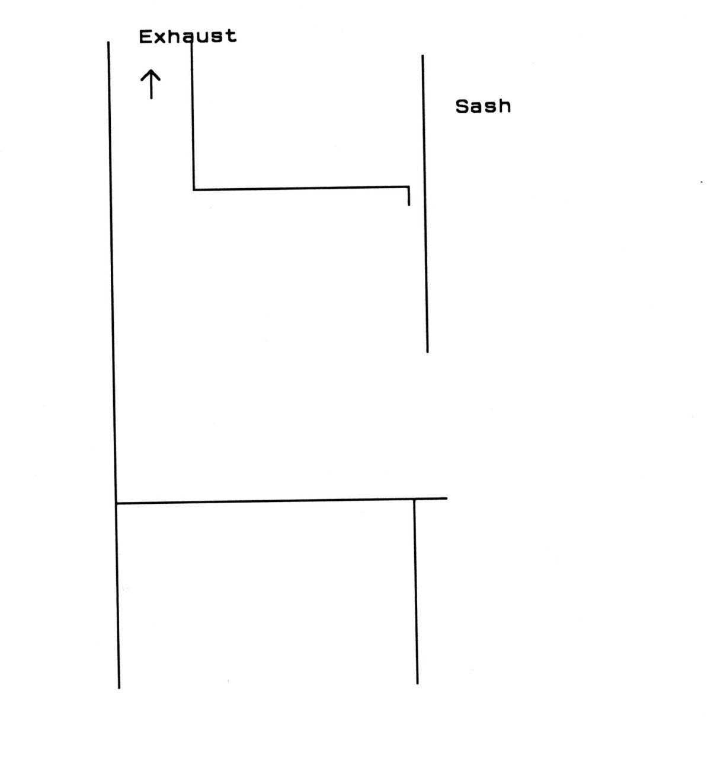

Slide 27
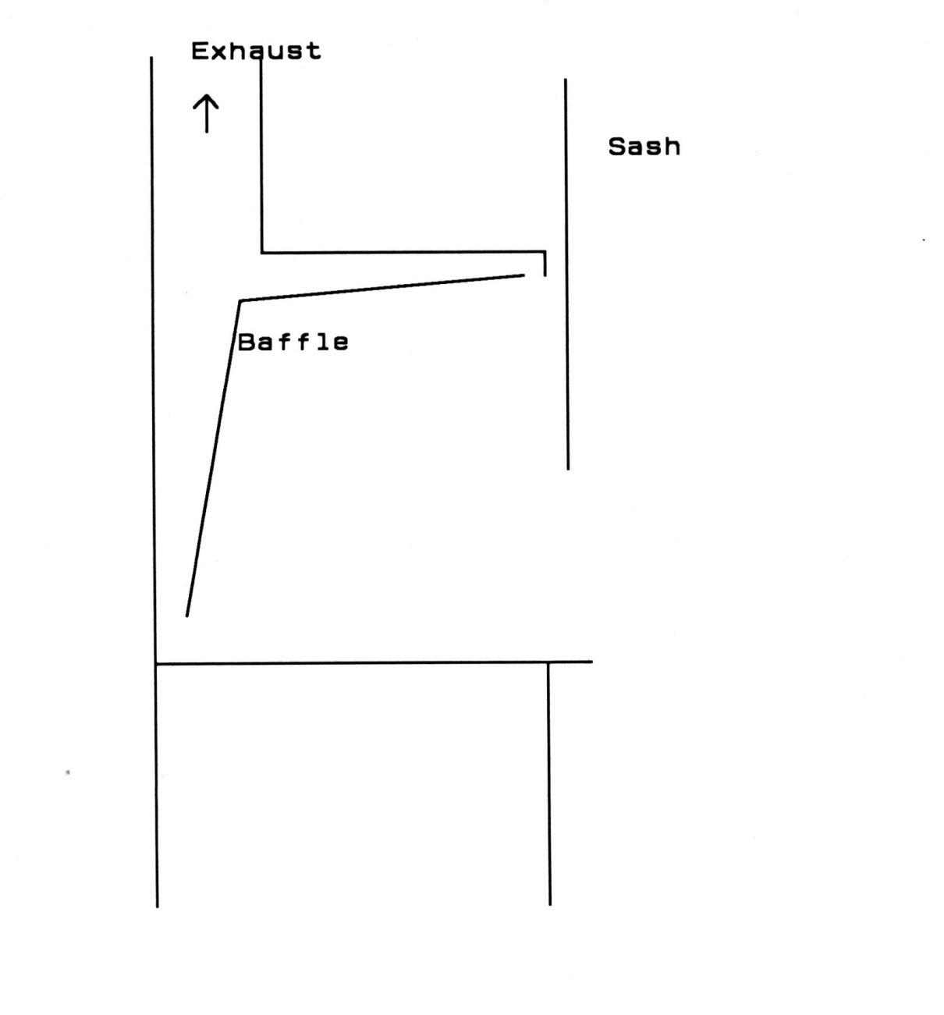

Slide 28
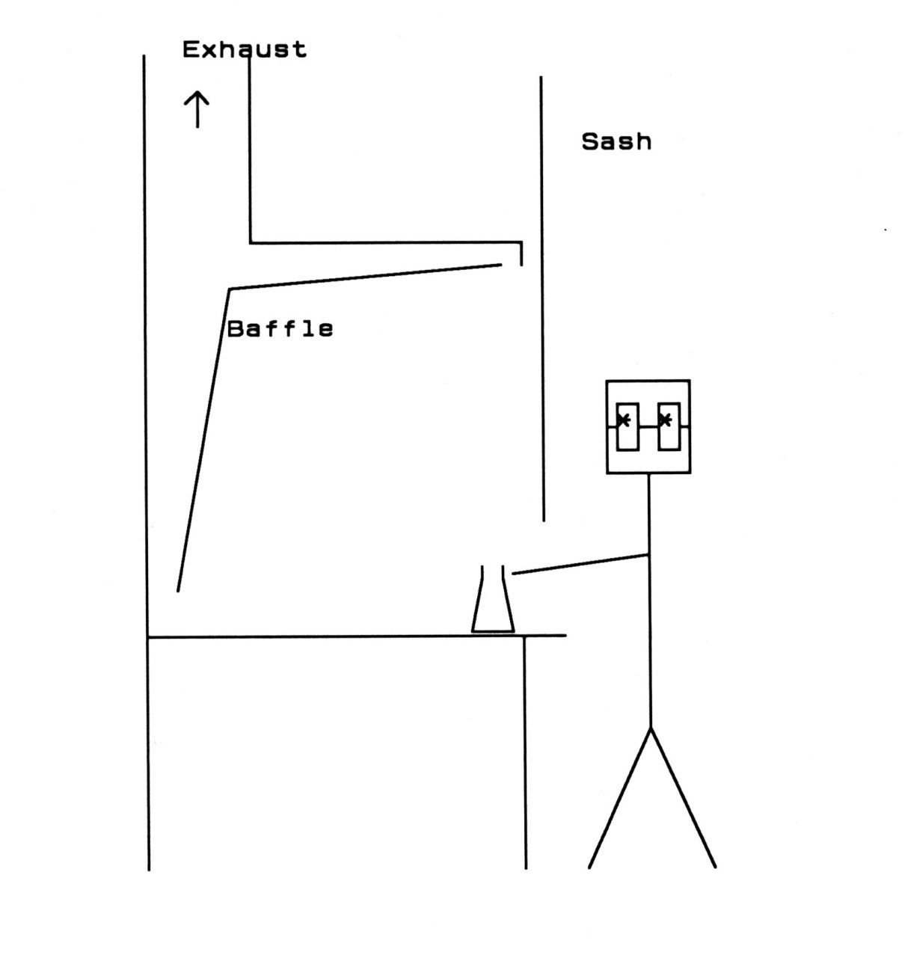

Slide 29
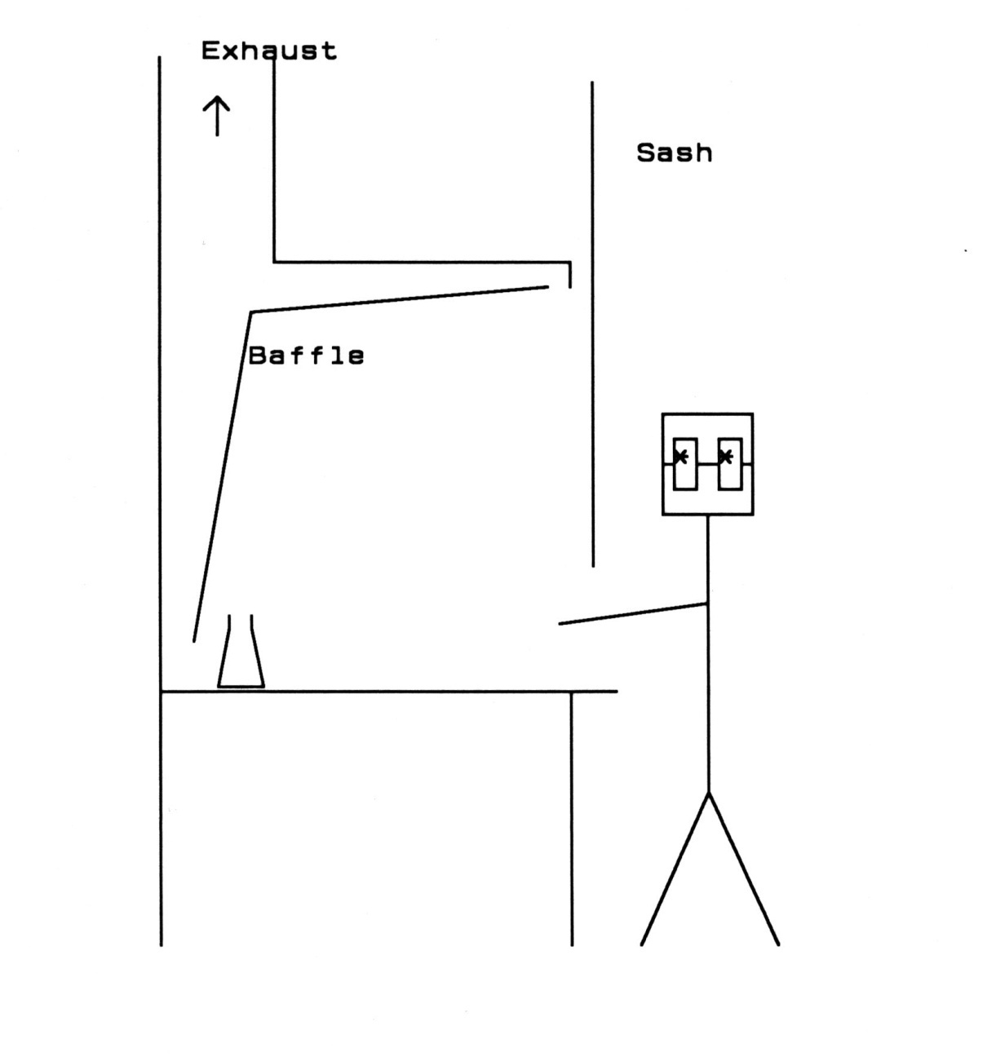

Slide 30
Flow sensors:
- Electronic with buzzer
Kimwipe or Kleenex strip taped to the
bottom of hood sash
Lower sash as far as reasonable, to minimize
face area, maximize linear velocity.
Keep rear clean; items on sides of hood.

Slide 31
Other Equipment
Bottle carriers: must have one to buy
more than 1 liquid pint at ChemStores
Reaction notice
Clamp your hoses!

Slide 32
Refrigerators:
NOT for storage of volatiles! Rather for chemicals
that can decompose at RT
Flammable storage: no ignition sources in these
Red “no flammables” label
Yellow “no Food” label
Vapors within a problem: seal all containers well.
Don’t breath those vapors
Log in; log out
- Flash Point: temperature at which there’s enough
vapor pressure to ignite from a spark/flame .
Ca. 60-70 Cº below atmospheric boiling point
- Autoignition temperature: where compound ignites
spontaneously

Slide 33
Mercury Spills
- Sulfur ineffective
- Hg vacuum from fish aquarium pump
and tubing - $9 {BU 633}

Slide 34
Entropy: Be Neat!
Clean up as you go.
Label everything now.
All lab equipment has a steward.
You are responsible for cleaning up your own messes.

Slide 35
Waste Handling
- Monthly or so pickups
- Segregate halogenated and non-halogenated organics
Keep all containers closed save for the moment
of adding waste
- Label it and keep excellent records
- Leave headspace at final seal
- Date at final seal, not before

Slide 36
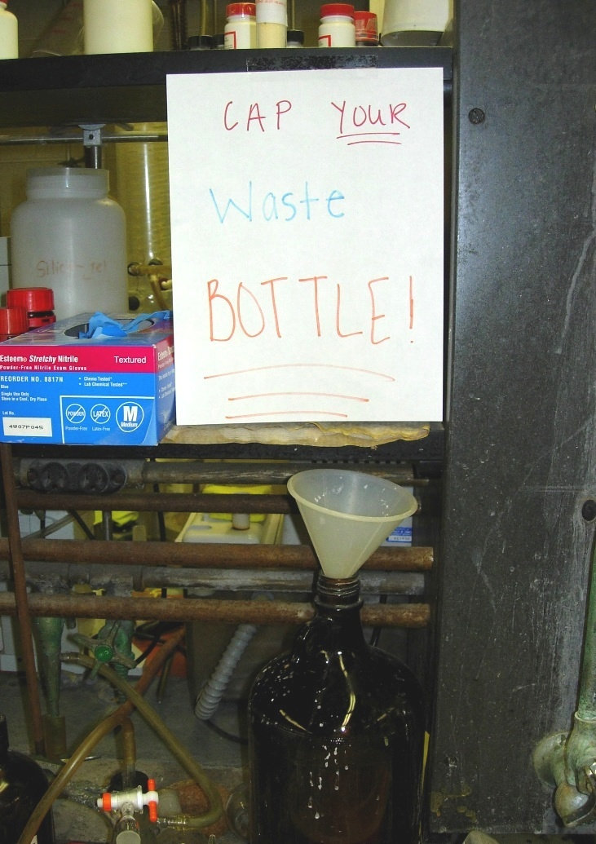

Slide 37
Security:
Keep lab doors locked when no one is there;
check as you leave
Be aware of suspicious people
Why?
Drug precursors
Simple $$$ theft (SERF 2016)
Irrational students, out for revenge for “ruining their life.”
- We are 30 miles from a nuclear weapons complex

Slide 38
Fire Fighting
- Prevent it!
- Judge the situation; fight or run?
- Call 911, or send someone for help
- Pull the alarms
- 1 extinguisher = 1 liter burning solvent

Slide 39
Always know the location of:
The nearest phone (day, night)
Cell Phone!
The nearest fire pull station
(calls both Campus Police and KFD)
The nearest “blue phone”
Safety Door Placard:
Responsible Person (PI)
Chemical Hygiene Officer
Occupants
Hazards

Slide 40
1. If it has a chemical in it, put a label on it.
2. If it’s broken, fix it or clean it up, and
reorder. (“It’s not my problem.”)
3. Your chemical spills are your problem
(keep the door closed)
4. It’s all toxic; it’s all flammable.
5. Plan safety into an experiment in the design
stage, not just before you open the bottle.

Slide 41
6. Clamp your hoses.
7. Hot glass looks just like cold glass.
8. Take notes now, so others can figure out
what went wrong after the accident.
9. Back up the hard drive, the memory stick,
the spectra, the notebook now.
10. Think Things Through before you do
anything.

Slide 42
Who to complain to:
- Person involved
interact politely with leading questions
("I don't understand...”
behavior modification)
- Research Director
- Safety Officer
(Prof. John Bartmess, BU 413)
- Dept. Head (Prof. Chuck Feigerle)

Slide 43
Building Emergencies:
Chuck Feigerle 4-3141, (C) 686-2811, (H) 692-8778
Shawn Campagna 4-3141, (C) (609) 213-2192
John Bartmess 4-6578, (C) 809-0702
Johnny Jones 4-3145, (C) (423) 215-5220
(H) (423) 569-8008
Campus phones: 4-xxxx = outside 974-xxxx
(“8” = outside line)
Environmental Health & Safety (Campus): 4-5084
UT Police: 4-3111 (blue phone 2 min)
Janitors (Bldg Services): 4-5107
(response time geologic time scale)

Slide 44
“Let’s be careful out there.”
- Sgt. Esterhaus, “Hill Street Blues”

